Slide 1
2023 Updates from ICRA
Leslie Woodard, CTR
ICRA Education Chair
Tumor Registry Manager, System Wide
Franciscan Health
Notes:
Welcome! This presentation is being recorded and will be shared with you, as well as posted to ICRAs members only section of the website. NCRA has approved the LIVE presentation for 1 category A CE. Those of you attending the live session will receive an email in the next week with the certificate of attendance, including the CE number.
Handouts located within the go to meeting taskbar, but also to be emailed out with the certificate of attendance.

Slide 2
Agenda
STORE 2023
SSDI and Grade Manual
AJCC
Solid Tumor Rules

Slide 3
STORE 2023
Review the summary of changes section
Notes:
You will hear me mention it multiple times in this presentation, but the most important take away from today is to make use of the summary of changes or change logs available for each and every manual we use. . There’s just not enough time for me to go into every single change today, and looking at that section in each manual is a quick and easy way to find out what fields had changes made to them, or even what fields were added

Slide 4
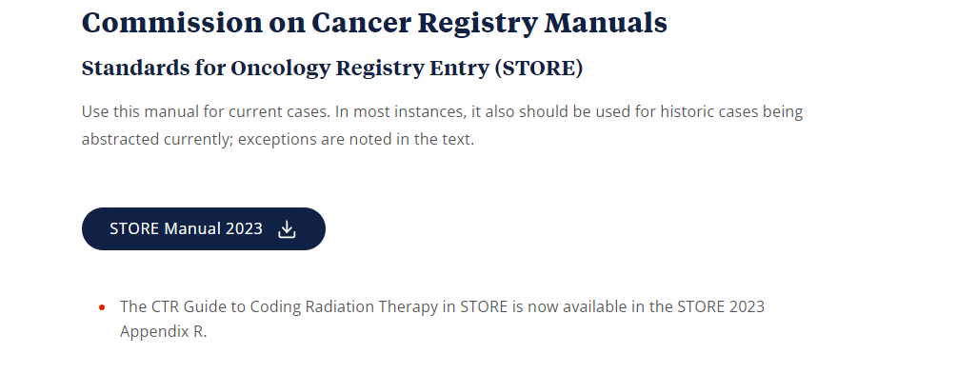
https://www.facs.org/quality-programs/cancer-programs/national-cancer-database/ncdb-call-for-data/registry-manuals/
Notes:
Here is the link of where to go to get the most recent STORE manual. During the webinar from the standard setters with Jim Hofferkamp, they did mention if you downloaded the 2023 manual too soon that you need to go back and download again, as some changes were made between the original posting and more recent. Unfortunately, I can't remember exactly when they said the updates were posted, so not a bad idea to just go out there and grab it now if you haven’t done so in the past couple of weeks.

Slide 5
New Fields
Tobacco Use Smoking Status
Was new for IN in 2022, now required by NCDB
Rx Hosp – Surg 2023
Replaces Surgical Procedure of Primary Site at this Facility for cases diagnosed 2023+
Rx Summ – Surg 2023
Replaces Surgical Procedure of Primary Site for cases diagnosed 2023+
Notes:
Tobacco use rules: Cigarette, cigar and pipe ONLY. Excludes marijuana, vaping, e-cig, chew.
If it can’t be verified what kind of smoker the patient was, code to 9.
Use code 1 (Current) if there is evidence the patient stopped smoking within 30 days of diagnosis

Slide 6
Tobacco Use Smoking Status Example
Case
Code: 1
12/5/22: CT Lung Screening. Patient reports he is a current smoker.
1/20/23 Bx: LUL Adenocarcinoma
1/25/23 Med Onc Consult: Patient reports he stopped smoking cigarettes 1/1/2023
Patient stopped smoking within 30 days prior to diagnosis. Per STORE, page 93, smoking within 30 days of diagnosis is reported as current smoker to separate those that may have stopped smoking due to symptoms leading to the cancer diagnosis

Slide 7
Tobacco Use Smoking Status Example
Case
Code: 1
1/05/23 Bx: LUL Adenocarcinoma
2/15/23 Med Onc Consult: Patient reports he stopped smoking cigarettes 2/10/23
Even though he is considered a former smoker as of 2/10/23, he was a smoker at the time of diagnosis, which is what is collected in this field

Slide 8
Removed Fields
Date flags
Surgical Procedure of Primary Site
Surgical Procedure of Primary Site at this Facility
Notes:
For cases diagnosed 2023+, pre 2023 these fields still apply

Slide 9
Reportability Changes
Juvenile pilocytic astrocytoma had a behavior change to /1
Anything diagnosed before 2023 still has a /3 behavior
Reportable for any year, as it is a CNS tumor
Notes:
Note: LAMN is listed, but it was reportable effective 2022, per STORE 2022

Slide 10
Reportability Changes
-Rads
Alone = not reportable
Confirmed by physician statement or biopsy = reportable, but back-date to the imaging date
Notes:
Prostate, liver and breast only!
SEER manual has more explicit guidelines than STORE, but since Indiana is not a SEER state we can’t follow their rules for this field. There are a number of questions on the forum about which –rads categories are to be used for diagnosis date vs which are not, but no answer has been given. Last update was the standard setters are discussing this and an announcement will be made when there’s a final decision.

Slide 11
-Rads Example
MRI Pelvis 1/17/2023
1/28/2023 Prostate Biopsy
Diagnosis Date
Impression: PI RADS 5 lesion right anterior midgland transition zone extending into the left anterior mid gland transition zone. This measures 2.6 cm
PI-RADS 5 – Very high (clinically significant cancer is highly likely to be present)
Prostate biopsy:
3/12 cores involved by prostatic adenocarcinoma, Gleason 3+4 = 7
1/17/2023
Per STORE, page 45:
“PI Rads, BI Rads, LI Rads alone are not reportable for CoC. PI Rads, BI Rads, LI Rads confirmed with biopsy or physician statement are reportable to CoC. Date of diagnosis is the date of the PI Rads, BI Rads, LI Rads imaging. The biopsy makes it reportable to CoC however the date of diagnosis is the date of the imaging.”

Slide 12
Reportability Changes
LCIS
First time to be documented as not reportable to CoC, but per CAnswer Forum, effective 2018
Still reportable to the state/NPCR
Notes:
Because it is reportable to the state and NOT COC, you should be reporting it as a class 34 or 36

Slide 13
LCIS Example
12/15/21 Excisional bx, left breast:
How to Report
Mammary hamartoma with extensive atypical lobular hyperplasia and lobular carcinoma in situ (LCIS)
Class of Case: 34
Staging: 88s
Notes:
Hasn’t been stageable since 2018 per AJCC

Slide 14
Surgery Codes
All alphanumeric, starting with A
Identical to the breast surgery codes from 2022
Melanoma surgery codes start with B because there was a major change
Notes:
Although they look different, they follow the same flow we are used to. There are NOS and more specific codes, always choose the most specific one
Margin status no longer has anything to do with melanoma shave, punch, or elliptical biopsies…they’re getting coded as a surgery no matter what.

Slide 15
Surgery Example
Case
Rx Hosp – Surg 2023
Rx Summ – Surg 2023
2/5/23 Colonoscopy: Large polyp located in the right colon, removed and tattooed.
2/5/23 Right colon polypectomy @ Hospital A: Adenocarcinoma arising in a polyp. Margins unable to be determined.
2/12/23 Right hemicolectomy @ Hospital B: No residual carcinoma
A280 Polypectomy – endoscopic
Date of First Surgical Procedure: 02/05/2023
A400 Subtotal colectomy/hemicolectomy (total right or left colon and a portion of transverse colon)
Date of Most Definitive Surgical Resection of Primary Site: 02/12/2023
*I am reporting on behalf of Hospital A
Notes:
Rx Hosp = surgery at YOUR hospital
Rx Summ = surgery at ANY hospital
If registry software allows only one procedure to be collected, document the most invasive surgical procedure for the primary site.
If registry software allows multiple procedures to be recorded, this item refers to the most invasive surgical procedure for the primary site.
When multiple first course procedures coded under the same item are performed for a primary, the most
extensive or definitive is the last performed, and the code represents the cumulative effect of the separate procedures
Date of First Surgical Procedure =
Record the date of the first surgical procedure of the types coded as Rx Summ – Surg 2023 [1291], Scope of Regional Lymph Node Surgery [1292] (excluding code 1) or Surgical Procedure/Other Site [1294] performed at this or any facility.
Even though that polypectomy is the diagnosis date, and only qualifies for clinical staging, it is getting coded as a surgery, as it was more than a simple biopsy. Remember, standard setters and specific fields have their own rules – just because it is coded as a surgery of the primary site doesn’t mean it has met the eligibility criteria to be pathologically staged.

Slide 16
Surgery Example
Case
Rx Hosp – Surg 2023
Rx Summ – Surg 2023
2/5/23 Colonoscopy: Large polyp located in the right colon, removed and tattooed.
2/5/23 Right colon polypectomy @ Hospital A: Adenocarcinoma arising in a polyp. Margins unable to be determined.
2/12/23 Right hemicolectomy @ Hospital B: No residual carcinoma
A400 Subtotal colectomy/hemicolectomy (total right or left colon and a portion of transverse colon)
Date of First Surgical Procedure: 02/05/2023
A400 Subtotal colectomy/hemicolectomy (total right or left colon and a portion of transverse colon)
Date of Most Definitive Surgical Resection of Primary Site: 02/12/2023
*I am reporting on behalf of Hospital B
Notes:
Rx Hosp = surgery at YOUR hospital
Rx Summ = surgery at ANY hospital
If registry software allows only one procedure to be collected, document the most invasive surgical procedure for the primary site.
If registry software allows multiple procedures to be recorded, this item refers to the most invasive surgical procedure for the primary site.
Date of first surgical procedure doesn’t change, regardless of who is reporting the case.
Same example, just showing how hospital B would report. They only did the hemicolectomy, so that’s the only one being reported on behalf of them. That doesn’t mean you don’t record the procedure at hospital A, if your software allows multiple procedures to be collected. Now I know what is seen on the slide isn’t always how we do things in our registry software systems. For example, if reporting this case in OncoLog I would have a surgery line for Hospital A for the polypectomy, and a surgery line for hospital B with hemicolectomy. The software then autofills these STORE fields for us, based off how we coded the surgery treatment lines. We don’t actually have direct access to code Rx HOSP Surg 2023 or Rx Summ Surg 2023, it is based off how we enter the treatment information for each facility. Be sure to work with your vendor if you question how it is done or notice some inconsistencies.

Slide 17
Melanoma Example
Case
Rx Hosp – Surg 2023
Rx Summ – Surg 2023
1/12/2023 Punch biopsy left upper arm @ Facility A: Malignant melanoma, superficially invasive, depth of invasion (Breslow’s depth) 0.3 mm, Margins negative
1/21/2023 WLE lesion Lt upper arm @ Facility B: No residual melanoma.
B230-Punch Biopsy, NOS
Date of First Surgical Procedure: 01/12/2023
B530-Punch Biopsy followed by wide excision
Date of Most Definitive Surgical Resection of Primary Site: 01/21/2023
*I am reporting on behalf of Facility A
Notes:
For melanoma skin surgical codes ONLY: o The priority order for sources used to assign surgery codes:
• Operative report, statement from a physician, description of the surgical procedure on a pathology report, results of the pathology report.
Code based on the description of the procedure.
• Do not code base on margin status documented in the pathology report.
Surgical Diagnostic and Staging Procedure: 00, since the punch biopsy is recorded as a surgical code
Date of Most Definitive Surgical Resection of Primary Site: path results don’t have anything to do with this, i.e. no residual carcinoma doesn’t equate to the WLE not being the most definitive

Slide 18
Melanoma Example
Case
Rx Hosp – Surg 2023
Rx Summ – Surg 2023
1/12/2023 Punch biopsy left upper arm @ Facility A: Malignant melanoma, superficially invasive, depth of invasion (Breslow’s depth) 0.3 mm, Margins negative
1/21/2023 WLE lesion Lt upper arm @ Facility B: No residual melanoma.
B530-Punch Biopsy followed by wide excision
Date of First Surgical Procedure: 01/12/2023
B530-Punch Biopsy followed by wide excision
Date of Most Definitive Surgical Resection of Primary Site: 01/21/2023
*I am reporting on behalf of Facility B
Notes:
Again, same example, just showing the fields for facility B.
For melanoma skin surgical codes ONLY: o The priority order for sources used to assign surgery codes: • Operative report, statement from a physician, description of the surgical procedure on a pathology report, results of the pathology report. Code based on the description of the procedure.
• Do not code base on margin status documented in the pathology report.
Surgical Diagnostic and Staging Procedure: 00
Date of Most Definitive Surgical Resection of Primary Site: path results don’t have anything to do with this, i.e. no residual carcinoma doesn’t equate to the WLE not being the most definitive

Slide 19
Some Other Updates
Mets at Diagnosis
0 is to be used for any reportable tumor with a behavior of benign (/0), borderline (/1), or in situ (/2)
Clarified radiation codes
Updated/removed some examples
Notes:
8 used to be assigned for benign/borderline brain and CNS tumors
Radiation examples: Node combinations and which node code to use; parametrium included in code 71 (uterus or cervix)

Slide 20
New to STORE!
Appendix M
Case Studies for Coding Melanoma in STORE v23
Appending R
CTR Guide to Coding Radiation Therapy Treatment in the STORE
Notes:
**Show this and summary of changes section**

Slide 21
SSDI Manual
Review the summary of changes section

Slide 22
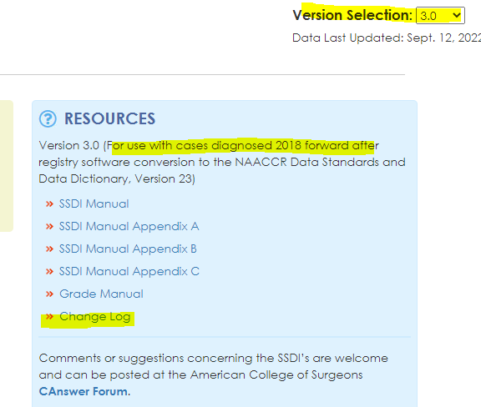
https://apps.naaccr.org/ssdi/list/3.0

Slide 23
SSDI Updates
General rules – priority order officially documented
Notes updated/added for different SSDIs to help with clarification
Notes:
Priority Order for SSDIs • Addendums or amendments (corrections that are not incorporated into the initial synoptic report, including CAP Cancer Protocol) • Synoptic report (including CAP Cancer Protocol) • Pathology report: final diagnosis • Physician statement

Slide 24
SSDIs Removed
Estrogen Receptor Total Allred Score
Progesterone Receptor Total Allred Score
Notes:
Effective with diagnosis 1/1/2023+ these fields no longer need completed. They will stay in software, as required 2018-2022. If your facility doesn’t use them for any reports, stop collecting.

Slide 25
SSDIs Added
p16 Anus
Must be p16, not HPV test
Histologic Subtype – Appendix
Complete for all cases, but interested in 8480
Clinical Margin Width – Melanoma
Wide excisions
Source is operative note
Notes:
Effective diagnosis date 1/1/23+, anything prior these are to be left blank
If you are concurrent you will need to make note of the these three SSDIs and revisit all anal, appendix and melanoma cases once you get your v23 upgrade to complete the SSDI.
p16 test only
HPV by DNA, antibody testing not used
Weak intensity or limited distribution = 0
Clinical margin width – easy way to audit your CoC standard 5.5 cases that not only require a synoptic op note, but also specific margin statuses
MOHS does not count as a wide excision

Slide 26
P16 Anus
Example 1
Example 2
2/4/2023 Anus bx: Squamous cell carcinoma, HPV positive
SSDI:
9 Not tested for p16; unknown
1/5/2023 Anus bx: Squamous cell carcinoma, p16 weak staining
SSDI:
0 p16 Negative; nonreactive
Notes:
*Can’t use HPV testing or statement of HPV negative/positive. Must by p16 test

Slide 27
Histologic Subtype – Appendix
Example 1
Example 2
Example 3
2/5/2023 Appendectomy: Well differentiated neuroendocrine/carcinoid tumor
SSDI:
0 Histology is NOT 8480
2/5/2023 Appendectomy: Low grade appendiceal mucinous neoplasm (LAMN)
SSDI:
1 Low-grade appendiceal mucinous neoplasm LAMN
2/5/2023 Appendectomy: Mucinous adenocarcinoma of the appendix
SSDI:
3 Mucinous adenocarcinoma/carcinoma
Notes:
Colloid = mucinous

Slide 28
Clinical Margin Width - Melanoma
Example 1
Example 2
Example 3
1/3/23 Shave bx: Breslow depth 1.5 mm malignant melanoma
1/17/23 Op Note: Wide local excision with 2.5 cm elliptical margins
1/17/23 WLE: Minimal focus of malignant melanoma, margins negative, closest 10 mm.
SSDI: 2.5
1/3/23 Shave bx: Breslow depth 0.9 mm malignant melanoma
1/17/23 Op Note: Mohs
1/17/23 Mohs: Negative margins
SSDI: XX.9
1/3/23 Shave bx: Breslow depth 0.8 mm malignant melanoma
1/17/23 Op Note: Wide local excision with 2 cm margins
1/17/23 WLE: Residual melanoma in situ, extending to the lateral margin
1/25/2023 Op Note: Repeat WLE with 0.5 cm margins
1/25/2023 WLE: No residual melanoma
SSDI: 2.0
Notes:
You’re ignoring the margins on the path report for this SSDI, strictly using the op note. If not documented in the op note, code as unknown
If multiple wide excisions are performed, code the clinical margin width from the procedure with the largest margin

Slide 29
Major Changes
SSDI: FIGO Stage
The instructions changed and you can no longer assume a stage given is FIGO, it must be documented as FIGO
Schema Discriminator 1: EsophagusGEJunction/Stomach
Completely rewritten, much more detailed instructions
Notes:
Now, if you have discussed this with your physicians and they say the only assign FIGO, you can use it – but make sure to have a policy documenting this.

Slide 30
FIGO Stage
Example 1
Example 2
11/7/2022 TAH-BSO: Endometrium 2 cm Endometrioid carcinoma, FIGO Grade 2, 1.1 cm myometrium invaded, thickness 2 cm. No other tissue/organ involvement, No LVI. All margins neg for invasive carcinoma. 0/10 pelvic nodes. pT1b N0
11/21/22 Post Op Note: FIGO G2 endometrial cancer, stage 1
SSDI: 99
11/7/2022 TAH-BSO: Endometrium 2 cm Endometrioid carcinoma, FIGO Grade 2, 1.1 cm myometrium invaded, thickness 2 cm. No other tissue/organ involvement, No LVI. All margins neg for invasive carcinoma. 0/10 pelvic nodes. pT1b N0
11/21/22 Post Op Note: FIGO G2 endometrial cancer, FIGO 1B
SSDI: 1B
Notes:
Note 1: There must be a statement about FIGO stage from the managing physician in order to code this data item. x Do not code FIGO stage based on the pathology report x Do not code FIGO stage based only on T, N, M x If "FIGO" is not included with a stated stage, then do not assume it is a FIGO stage
Note 2: FIGO stage is not the same thing as FIGO grade

Slide 31
Schema Discriminator 1: EsophagusGEJunction/Stomach
Example 1
Example 2
EGD: One 3 cm ulcerated polypoid lesion was found at the gastroesophageal junction extending about 1 cm into the cardia.
Schema discriminator: 2
INVOLVEMENT of esophagus or esophagogastric junction (EGJ) AND epicenter LESS THAN OR EQUAL TO 2 cm into the proximal stomach
EGD: Ulcerated lesion was seen in the gastroesophageal junction extending from the gastric fundus
Schema discriminator: 3
INVOLVEMENT of esophagus or esophagogastric junction (EGJ) AND epicenter GREATER THAN 2 cm into the proximal stomach
Notes:
Under primary site code C160, there are two different structures that are staged differently. x Esophagogastric junction (Esophagus Schemas) x Cardia of the Stomach (Stomach schema)
Chapter 16: Esophagus and Esophagogastric Junction (see code 2) Note 1: Use code 2 when x EGJ is documented as involved and the midpoint (epicenter) is within the proximal (above) 2 cm of the cardia x EGJ is documented as involved and there is no mention of extension into the stomach or stomach involvement x Example 1: MRI: Findings most consistent with metastatic GE junction cancer. Upper EUS: Medium-sized, fungating, polypoid and ulcerated mass with no active bleeding was found in the gastric cardia extending from GEJ to 42 cm from incisors. One malignant-appearing lymph node was visualized in the peripancreatic region. o Answer: Code 2 for involvement of the GE Junction/Cardia and no mention of involvement of the stomach x EGJ is documented as involved and there is no information on stomach involvement and o Esophagus CAP Protocol is used OR o Esophagus Staging System is used o If the CAP Protocol and AJCC Staging System are different, default to the AJCC Staging System
Chapter 17: Stomach (see codes 0, 3, and 9) Note 1: Use code 0 when only the cardia is documented as involved (no mention of EGJ) Note 2: Use code 3 when x EGJ is documented as involved and the midpoint (epicenter) is more than 2 cm distal (below) from the EGJ x EGJ is documented as involved and there is no information on stomach involvement AND o Stomach CAP Protocol is used OR o Stomach AJCC Staging System is used o If the CAP Protocol and AJCC Staging System are different, default to the AJCC Staging System

Slide 32
Grade Manual
Review the summary of changes section
Notes:
Change log is shared with the SSDI manual; changed can be applied to any case diagnosed 2018+ once you have the v23 software upgrade

Slide 33
Grade Updates
General instructions – priority order
A few notes added for clarification
Notes:
. Priority order for grade a. Synoptic report (including CAP protocol) b. Pathology report: Final diagnosis c. Physician statement
Many clarification notes on default values for behavior /2 cases

Slide 34
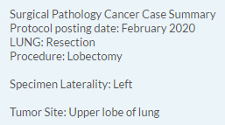
Priority Order Example
Grade pathological: 1
Notes:
Rules are to code the highest grade, but that is in reference to when there are multiple procedures done (example a biopsy showing grade 2 but resection showing grade 1). How do we handle when a single report lists the grade differently? I posted this question last year because it wasn’t addressed in the grade manual like the solid tumor rules did, and they came up with the specified priority order, now documented in the grade manual:
. Priority order for grade a. Synoptic report (including CAP protocol) b. Pathology report: Final diagnosis c. Physician statement

Slide 35
Sarcoma Grade Tables 9-10
Only site with a code added
H for ‘high grade’ only
Previously generic grade code D
Also includes instruction change
Code 1 to be used for low grade
Previously generic grade code B
Notes:
H won’t be an option until you have the v23 upgrade, but you can start applying code 1 for low grade immediately. Jennifer Ruhl stated in her presentation of this change that you can just code high grade as D and not worry about changing to D when you get v23 upgrade.

Slide 36
AJCC

Slide 37
Version 9 Protocols Effective 1/1/2023
Appendix
Anus
Brain & Spinal Cord
Notes:
Like the cervix protocol, released via kindle version. I was successful in working with our hospital librarian to get a copy available resulting in no personal out of pocket costs.
I am going to be honest here and let you know I haven’t dived into the changes too much just yet, so this part if going to be short and sweet. I briefly looked at the summary of changes located at the beginning of each protocol, and scrolled through each page to see what all the new protocols entail and visually it looks great. I don’t recall any major changes to any of the rules or specific definitions of the TNM values, but there was some rework with some of the staging tables. Personally, when I looked at the updates I was a bit excited to see what all was now available for us to reference. It appears the protocols are a step in the right direction for the AJCC manual becoming an even better resource for us as registrars. For example, they break out what information is used to assign which staging categories and when, and even went as far as providing common staging scenarios.

Slide 38
Appendix
Histology types
Illustrations
Survival data
Notes:
Still excludes neuroendocrine/carcinoid tumors, as they have their own chapter
Grade effects stage group for stage IVs

Slide 39
Anus
Stage groups changed
Removed Tis and Stage Group 0
Regional node update
Importance of p16
Illustrations
Notes:
Obturator nodal regions were added to the list of regional nodes and included in illustrations

Slide 40
Brain & Spinal Cord
WHO Classification
Inclusion of pediatric tumors
Notes:
**If time allows, so how the new protocols look**

Slide 41
Solid Tumor Rules
Review the summary of changes section

Slide 42
https://seer.cancer.gov/tools/solidtumor/

Slide 43
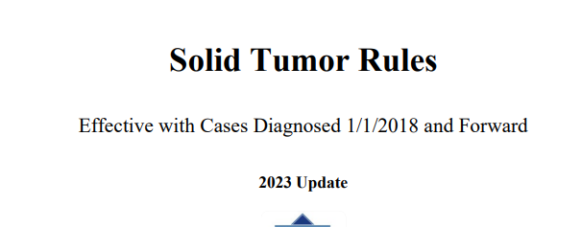
Applying the Rules
General instructions section apply to every site
Cutaneous Melanoma section: 1/1/2021+ diagnosis
Other sites: 1/1/2023+ diagnosis
All other: 1/1/2018+ diagnosis
Notes:
If there is a rule that doesn’t apply until a specific year, it will be spelled out in the instructions. No need to find historical manuals on cases unless they’re outside of these ranges above (i.e. if it’s a tumor that falls into other sites, diagnosed in 2021, you’re going to have to go to the 2007 MPH rules, but if it is a breast cancer diagnosed in 2021, you can use the link to the 2023 update).

Slide 44
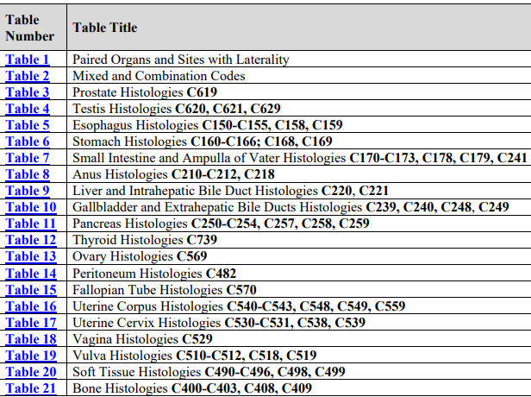
Major Change
Other Sites section released!
Code most specific histology, not most representative specimen
21 different tables to be referred to
Notes:
Histology rule notes: Use Tables 3-21 to code histology. New codes, terms, and synonyms are included in Tables 3-21 and coding errors may occur if the table is not used.

Slide 45
Liver Example
2/5/2023 CT Abd & Pelvis: Single mass in left lobe liver, suspicious for cholangiocarcinoma
2/7/2023 Liver bx: Adenocarcinoma
2/10/2023 Med Onc: Consulted for diagnosis of cholangiocarcinoma
Histology code: 8140/3
Notes:
Per histology coding rules, pathology and cytology have priority over clinical/physician diagnosis, leaving us with a single histologic type. To ensure we are coding the correct histology code, we are referred to tables 3-21. The liver table has a special note about cholangio, discussing how it is many times a clinical diagnosis and we are to stick to the solid tumor rules in that pathology has priority over the clinical diagnosis, therefore coding to adenoca. Clinicians often indicate a clinical diagnosis of cholangiocarcinoma without pathologic confirmation. If there is no path/cytology and they’re calling it cholangio, that is when you would code to cholangiocarcinoma.

Slide 46
Ovary Example
1/27/2023 TAH-BSO: Left ovarian primary, high grade serous carcinoma
Histology code: 8461/3
Notes:
We again have a single histologic type and are referred to the ovary table to find the histology code – high grade serous is a specific subtype of serous carcinoma NOS, so code the subtype per the histologic rule listed at the beginning of the coding histology rules: Code the most specific histology or subtype/variant

Slide 47
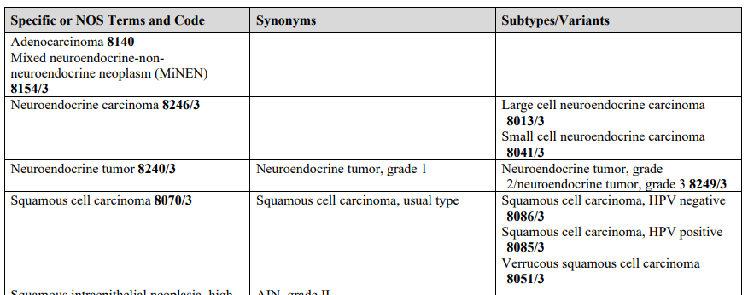
Anus Example
2/1/2023 Anal canal biopsy: p16 positive squamous cell carcinoma
Histology code: 8085/3
Notes:
We once again have a single histologic type and are referred to the site specific table to check the histology. There is a note in the anal section, similar to H&N, saying p16 results can be used to code HPV positive vs negative SCC. Remembering back to the general rules we are to code the most specific histology, which would be a subtype when given. Looking at the table we have HPV positive SCC, so 8085/3 rather than 8070/3 SCC, NOS.

Slide 48
Endometrium Example
1/13/2023 TAH-BSO: Endometrioid adenocarcinoma with clear cell carcinoma component
Histology code: 8323/3
Notes:
Here we have 2 subtypes of carcinoma: endometrioid carcinoma and clear cell carcinoma
This takes us to rule H19, which refers us to table 2
Per table 2 we are to look at ICD-O-3.2 to confirm there isn’t a specific code.
I do this by using ctrl+f and searched endometrioid. There were no matches that included clear cell, so I returned to Table 2, instructing us to code 8323

Slide 49
Minor Changes
Breast
Cutaneous Melanoma
Head & Neck
Malignant & Non-malignant CNS
Notes:
Just something to be aware of and not default when you’re determining number of primaries or the histology code to use. You can view the changes on the change log, but I would be very surprised if you had memorized what the rules previously were – so in the end it is easiest to go to the specific chapter in the manual. Again, you can use the 2023 update for all cases diagnosed 2018+ (excluding melanoma which would be diagnosed 2021+ and other sites being 2023+)

Slide 50
Notes:
If I have any unanswered questions, I will put them in a document and provide answers to send out with the certificate of attendance, along with the recording link and handouts.

Slide 51
Thank you
Leslie Woodard
Leslie.Woodard@franciscanalliance.org
www.icra-Indiana.net
Notes:
Reminder: Those that attended the live session will receive an email in the next week with the certificate of attendance, including the CE number. This presentation was approved by NCRA for 1 category A CE for live participants only.

