Slide 1
Abstracting Cutaneous Melanoma
Leslie woodard, ctr
Icra education chair

Slide 2
Agenda
Introduction
Solid Tumor Rules
Staging
SSDIs
Treatment
Case Examples

Slide 3
Introduction

Slide 4
Intro
Melanoma can arise anywhere on the skin
Can also arise in non-cutaneous sites, which account for 5% of melanoma cases
Ocular
Mucosal (H&N most common)
Oral
Anal/rectal
Vulvar
Vaginal
Initial presentation of lymph node metastases (only), no primary found
Presume they’re regional (per AJCC) and report as C44.9
Source: Q&A: Non-skin melanomas | MD Anderson Cancer Center

Slide 5
Intro
Most common metastatic sites
Skin or soft tissue
Distant nodes
Lung
Liver
Brain
Bone
GI tract
Source: Q&A: Non-skin melanomas | MD Anderson Cancer Center

Slide 6
Intro
Laterality
Required for C44.1-C44.7
0 for C44.0, C44.8-C44.9 per ISCR Manual
Text
Pre-biopsy tumor size, location
Nodal PE
Clinical margin width on WLE
Source: Q&A: Non-skin melanomas | MD Anderson Cancer Center

Slide 7
Solid Tumor Rules

Slide 8
Solid Tumor Rules
Do NOT use for…
In-transit metastases
Mets that occur along the lymph pathways between the primary tumor >2 cm from the scar and the regional lymph nodes
Satellite tumors
Grossly visible cutaneous and/or subcutaneous metastases occurring within 2 cm of the primary melanoma (microsatellites found via pathological exam)
Subcutaneous tissue
Distant metastases in skin
Any other distant metastasis
Source: Cutaneous Melanoma Solid Tumor Rules 2023 Update (cancer.gov)

Slide 9
Solid Tumor Rules
Code the most specific histology
Early/evolving melanoma became reportable 1/1/2021+
Superficial spreading type = low-cumulative sun damage
Component is only coded when it is described as a melanoma

Slide 10
Solid Tumor Rules
Multiple tumor highlights
Different 4th character = multiple primaries
Different laterality = multiple primaries
Timing rule = 60 days

Slide 11
Solid Tumor Rules
Histology rule highlights
Most specific histology, regardless if it is majority, minority or component
BUT it MUST be described as a melanoma:
Melanoma with a nodular component
Melanoma with a nodular melanoma component

Slide 12
Staging

Slide 13
AJCC Staging
Clinical
Pathological
Physical exam
Shave/punch/excisional biopsy
Imaging
+/- node biopsy
Requires a wide local excision
Must meet minimum margin guidelines
Unknown primary melanoma can’t be pathologically staged
Special rule for pT1
cN0 can be used
SLN or node dissection
Notes:
Path: Everything from time of diagnosis through surgery
Also meet eligibility with just microscopic proof of distant metastatic disease

Slide 14
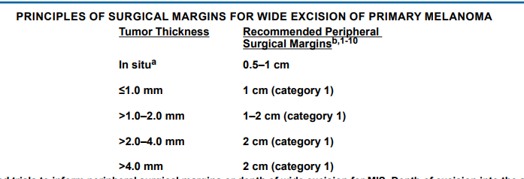
AJCC Staging
Surgical margins for wide excision
cutaneous_melanoma.pdf (nccn.org)
NCCN Guidelines, page ME-E 1 of 2

Slide 15
AJCC Staging
cT
Breslow depth
Ulceration
cN
Satellites/in-transit mets
Occult vs. non-occult
Node biopsy / SLN
If done prior to WLE
cM
Distant mets, clinically or pathologically proven
pT
Breslow depth
Deepest; don’t add together
Ulceration
Non-traumatic
pN
Use of cN0
Node procedures
Occult vs. non-occult
Satellites/In-transit mets
Still requires nodal eval
pM
Same as cM

Slide 16
AJCC Staging
Clinical and pathological stage groups are different!
Example:
cT1b cN0 cM0 = 1B
pT1b cN0 cM0 = 1A
Isolated tumor cells = N+

Slide 17
AJCC Staging
Multiple primary melanomas, same nodal basins
When node positive, they’re assigned to the melanoma with highest T category
When distant mets found, assigned to the melanoma with the highest N category (or highest T if N0)
Source: AJCC Cancer Staging Manual. 8th ed

Slide 18
AJCC Staging
Melanoma with no epidermal component
Commonly represent regressed melanoma
Difficult for pathologist to determine primary vs. metastatic lesion
Things to look for: atypical epidermal melanocytes, epidermal thinning, fibrosis and vascular proliferation of the dermis (and more)
In absence of prior melanoma history and no other metastatic disease, report as a primary melanoma
Source: AJCC Cancer Staging Manual. 8th ed

Slide 19
AJCC Staging
CAnswer Forum Resources
Melanoma Pathological Stage Moh's Procedure - CAnswer Forum (facs.org)
MOHS for pathological staging - CAnswer Forum (facs.org)
pathological staging - MOHS for in-situ with no residual - CAnswer Forum (facs.org)
Shave bx removed all cancer and clinical stage - CAnswer Forum (facs.org)
Assistance with staging case with excisional biopsy only - CAnswer Forum (facs.org)
OLD guidance to now ignore
Slow Mohs/staged excision - CAnswer Forum (facs.org)
Mohs procedure - CAnswer Forum (facs.org)

Slide 20
Summary Stage

Slide 21
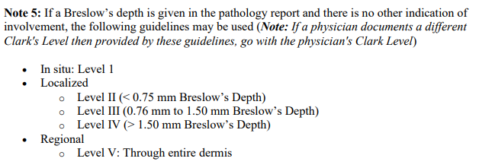
Summary Stage
Code the greatest extent of invasion from any procedure
Clark level
Microsatellites, satellite lesions, in-transit mets all fall under regional node code
H&N primaries with bilateral or contralateral node involvement = regional
All other sites = distant
Source: Skin: Summary Stage Manual 2018 v3.0 (cancer.gov)

Slide 22
SSDIs

Slide 23
SSDIs
Breslow Tumor Thickness
Coded as mm
Greatest thickness, regardless of procedure
Do not add together
If pathologist does, you can use it
Specific A codes when reported as ‘at least’
‘Greater than’ reported as XX.9
In-situ is NOT 0.0
Ulceration
Path report only
Must be addressed to code anything but 9, including in-situ
One specimen negative, other unknown, code 0
Mitotic Rate Melanoma
Make sure it is reported as mitoses per square mm
X4 if different denominator
Code the highest, regardless of procedure it came from
X9 if not mentioned, including in-situ cases
Source: SSDI Manual.02.15.2023_SA.pdf (naaccr.org)

Slide 24
SSDIs
LDH
Typically, only ordered for stage IV disease
Upper Limits of Normal
Pretreatment Lab Value
Pretreatment Level
Differs by lab, patient age and units of measurement
Record the highest value
Can be after primary site/regional node surgical procedures; must be prior to systemic therapy, radiation, or surgery to metastatic site
Low/normal
High
Source: SSDI Manual.02.15.2023_SA.pdf (naaccr.org)

Slide 25
SSDIs
Clinical Margin Width
For cases diagnosed 2023+ only, blank prior to that
Comes from the wide excision OP NOTE
Peripheral margin
Do NOT use the path report
If multiple wide excisions, code the largest margin
Recorded in cm
MOHS = XX.9

Slide 26
Clinical Margin Width Clarifications
‘Minimum of 1 cm margins’
Recorded as 1.0
Clinical Margin Width - 'a minimum of' - CAnswer Forum (facs.org)
‘Minimum of 7-10 mm margins’
Recorded as 0.7
Clinical Margin Width - Range Provided - CAnswer Forum (facs.org)

Slide 27
Treatment

Slide 28
Treatment
Biopsy
Shave/punch/excisional
Sentinel lymph node procedure
Counts as work up only (class 30 if all you did)
Wide excision or MOHS
Therapeutic node dissection
Systemic therapy
Radiation therapy
Typically for unresectable disease, high-risk patients or stage IV
Immunotherapy most common
WLE commonly done at same time as SLN if cN0
If cN+ or SLN+

Slide 29
Treatment - Surgery
Margins / residual pigmentation no longer matters
All excisional biopsies are recorded as surgery

Slide 30
Treatment - Surgery
2023 skin surgery codes begin with ‘B’
Priority order:
Operative report
Physician statement
Path report
As always, code the most extensive procedure
Most (? all) registry software allows for coding multiple procedures
Definitive resection date and surgery discharge date applies to the final surgery

Slide 31
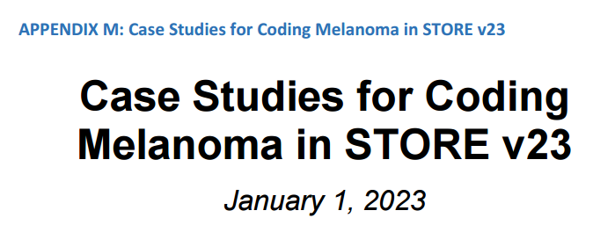

Slide 32
Case #1

Slide 33
Facility ABC
5/1/23 Dermatology Appointment
Physical exam: 8 mm red nodule located on the right upper back
DDx: Neoplasm of unspecified behavior vs. BCC vs. melanotic vs. atypical nevus
Plan: Right upper back shave biopsy

Slide 34
Facility ABC
5/1/23 Skin, right upper back shave biopsy
Malignant melanoma, superficial dermal deposit. Deep margin positive for tumor.
Note: Given the lack of overlying melanoma in situ and the overall morphology of the tumor. Metastasis is favored. Should this represent a primary melanoma, the lesion is not ulcerated and shows a Breslow depth of at least 2.1 mm with tumor transected at the base. There are scattered mitotic figures, approximately 3 per square mm.
Sections show an atrophic epidermis. The dermis is consumed by a nodule of atypical streaming and spindled melanocytes with intervening inflammation and dermal fibrosis. The melanocytes are somewhat uniform and have prominent nucleoli.

Slide 35
Facility 123 (me)
5/12/23 Surgeon consult:
65 y.o. male who presented for routine derm follow-up. He had multiple basal cells noted but also had biopsy of right upper back, just adjacent to midline. This was found to be malignant melanoma "based on the lack of epidermal component, a metastatic lesion is favored". He does have a history of melanoma in situ of the face.
Physical Exam: No palpable lymphadenopathy. Total body skin exam deferred to derm with multiple healing biopsy sites but R upper back biopsy site healing well. No surrounding hyperpigmentation or satellitosis noted.
We did obtain a PET/CT, which was negative for metastatic disease and as such we decided to treat this like a primary melanoma with a wide local excision and sentinel node.

Slide 36
Facility 123
5/23/23 Right upper back wide local excision 3 x 9 cm) with complex closure (9.5 cm) and right axillary sentinel lymph node biopsy with injection for sentinel node.
He was reprepped and draped with attention to the right upper back melanoma. This was just adjacent to the midline and a minimum of 1 cm margins was demarcated around this biopsy site. This yielded a diameter of 3 x 9 cm and this was excised full thickness after the instillation of local anesthetic with a 10 blade. This was taken down to the fascia overlying the musculature of the upper back without disrupting the fascia and muscle. This was then marked with a stitch at the 12 o'clock superior portion and sent for permanent pathology.

Slide 37
C. Sentinel lymph node, right axillary #3, excision:
Isolated tumor cells of metastatic melanoma involving one lymph node
(1/1) confirmed by Melan-A and SOX-10 immunohistochemical stains
with controls.
Extranodal tumor extension: Absent
Size of largest metastatic focus: Isolated tumor cells.
Location of tumor: Subcapsular.
Capsular nevus.
Note: The tumor cells are not present on HMB-45 immunohistochemical
stains which were performed and compared to controls.
D. Skin, right upper back, wide local excision:
Scar and changes of prior procedure.
Negative for melanoma.
Incidental lentigo, multiple.
Incidental irritated seborrheic keratosis
5/23/23
A. Sentinel lymph node, right axillary #1, excision:
One lymph node negative for metastatic melanoma confirmed on
HMB45, SOX-10, and Melan-A immunohistochemical stains with controls
(0/1).
B. Sentinel lymph node, right axillary #2, excision:
One lymph node negative for metastatic melanoma confirmed on
HMB45, SOX-10, and Melan-A immunohistochemical stains with controls
(0/1).

Slide 38
Outside Physician Office
6/14/23 Medical Oncologist:
pT3aN1aM0 cutaneous melanoma of the right upper back. I recommend adjuvant treatment with immunotherapy. He has low-risk disease, technically speaking, so he should receive single-agent immunotherapy. I am recommending nivolumab administered once every four weeks for a total of one year.
7/5/23: Start Nivolumab

Slide 39
Solid Tumor Rules
History of melanoma in situ of face (C44.3)
Now with invasive melanoma, right back (C44.5)

Slide 40
Facility ABC
5/1/23 Skin, right upper back shave biopsy
Malignant melanoma, superficial dermal deposit. Deep margin positive for tumor.
Note: Given the lack of overlying melanoma in situ and the overall morphology of the tumor. Metastasis is favored. Should this represent a primary melanoma, the lesion is not ulcerated and shows a Breslow depth of at least 2.1 mm with tumor transected at the base. There are scattered mitotic figures, approximately 3 per square mm.
Sections show an atrophic epidermis. The dermis is consumed by a nodule of atypical streaming and spindled melanocytes with intervening inflammation and dermal fibrosis. The melanocytes are somewhat uniform and have prominent nucleoli.

Slide 41
AJCC Note
Melanoma with no epidermal component
Commonly represent regressed melanoma
Difficult for pathologist to determine primary vs. metastatic lesion
Things to look for: atypical epidermal melanocytes, epidermal thinning, fibrosis and vascular proliferation of the dermis (and more)
In absence of prior melanoma history and no other metastatic disease, report as a primary melanoma
Source: AJCC Cancer Staging Manual. 8th ed

Slide 42
Multiple Primary Rules
M1: Abstract a single primary when it is not possible to determine if there is a single melanoma or multiple melanomas
M2: Abstract a single primary when there is a single melanoma
M3: Abstract multiple primaries when there are separate, non-contiguous melanomas in sites with ICD-O side codes that differ at the second (CXXX), third (CXXX) or fourth (CXXX) character

Slide 43
Abstract

Slide 44
5/1/23 Right upper back shave biopsy @ ABC: Malignant melanoma. Based on lack of epidermal involvement, metastatic lesion should be considered. Should this represent a primary melanoma, the lesion is not ulcerated and shows a Breslow depth of at least 2.1 mm with tumor transected at the base. There are scattered mitotic figures, approximately 3 per square mm.
5/23/23 Right upper back WLE and SLN bx @ 123: No residual melanoma. 1/3 lymph nodes with ITCs. ENE absent.
5/1/23 65 year old white male presents with a nodule on right upper back, measuring 8 mm. Reports a history of MIS of face many years ago. No other history. Shave bx completed.
5/12/23 surgeon PE: No palpable lymphadenopathy. Total body skin exam deferred to derm with multiple healing biopsy sites but R upper back biopsy site healing well. No surrounding hyperpigmentation or satellitosis noted.
Notes:
ITCs = positive node per AJCC and STORE

Slide 45
5/1/23 Right upper back shave biopsy @ ABC: Malignant melanoma. Based on lack of epidermal involvement, metastatic lesion should be considered. Should this represent a primary melanoma, the lesion is not ulcerated and shows a Breslow depth of at least 2.1 mm with tumor transected at the base. There are scattered mitotic figures, approximately 3 per square mm.
5/12/23 Surgeon consult @ 123 (me)
5/23/23 Right upper back WLE and SLN bx @ 123 (me): No residual melanoma. 1/3 lymph nodes with ITCs. ENE absent.
7/5/23 Nivolumab @ Outside physician office
Class of Case
Date First Contact
21
Diagnosed @ ABC
Shave biopsy
Surgery @ 123 (me)
Immunotherapy @ physician office
5/23/23
Date my facility became analytic

Slide 46
Staging

Slide 47
5/1/23 Right upper back shave biopsy @ ABC: Malignant melanoma. Based on lack of epidermal involvement, metastatic lesion should be considered. Should this represent a primary melanoma, the lesion is not ulcerated and shows a Breslow depth of at least 2.1 mm with tumor transected at the base. There are scattered mitotic figures, approximately 3 per square mm.
5/23/23 Right upper back WLE and SLN bx @ 123: No residual melanoma. 1/3 lymph nodes with ITCs. ENE absent.
Clinical
Pathological
cT3a
Greater than 2 mm but less than 4 mm Breslow depth, no ulceration
cN0
PE and PET negative
cM0
PET Negative
Stage Group IIA
pT3a
Everything from time of dx, up through surgery
pN1a
1 SLN with ITCs
(sn)
cM0
No change
Stage Group IIIB

Slide 48
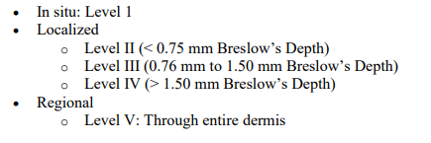
Summary Stage
2.1 mm BD
Localized
1 node with ITCs
Summary stage: 3

Slide 49
SSDIs

Slide 50
5/1/23 Right upper back shave biopsy @ ABC: Malignant melanoma. Based on lack of epidermal involvement, metastatic lesion should be considered. Should this represent a primary melanoma, the lesion is not ulcerated and shows a Breslow depth of at least 2.1 mm with tumor transected at the base. There are scattered mitotic figures, approximately 3 per square mm.
5/23/23 Right upper back WLE and SLN bx @ 123: No residual melanoma. 1/3 lymph nodes with ITCs. ENE absent.
Breslow Tumor Thickness
Ulceration
2.1
0
Mitotic Rate Melanoma
LDH Upper Limits of Normal
03
XX9
LDH Pretreatment Lab Value
LDH Pretreatment Level
XXXXX.9
9
Clinical Margin Width
1.0

Slide 51
Treatment

Slide 52
5/1/23 Right upper back shave biopsy @ ABC
5/23/23 Right upper back WLE and SLN bx @ 123
7/5/23 Nivolumab @ outside physician office, Dr. Example
Reason for No Surgery of Primary Site
Date of Most Definitive Surgical Resection of the Primary Site
0 Surgery of the primary site was performed
05/23/2023
Date 1st Surgical Procedure
Date of Surgical Discharge
05/01/2023
05/23/2023
Rx Hosp – Surg 2023
Surgical Margins of the Primary Site
B220 for facility ABC
B520 for facility 123
0 No residual tumor
Rx Summ – Surg 2023
Scope of Regional LN Surgery
B520 for both facilities
2 Sentinel Lymph Node Biopsy

Slide 53
5/1/23 Right upper back shave biopsy @ ABC
5/23/23 Right upper back WLE and SLN bx @ 123
7/5/23 Nivolumab @ outside physician office, Dr. Example
Date of First Course of Treatment
Systemic/Surgery Sequence
05/01/2023
3 Systemic therapy after surgery
Date Systemic Therapy Started
Chemotherapy
07/05/2023
00 None, chemotherapy was not part of the planned first course therapy.
Immunotherapy
Hormone Therapy
01 Immunotherapy administered as first course therapy
00 None, hormone therapy was not part of the planned first course therapy.
Rx Summ – Treatment Status
1 Treatment Given

Slide 54
Case #2

Slide 55
Facility ABC
3/2/23 Dermatology Appointment
Physical exam: 4 mm suspicious mole on the left forehead and a 6 mm mole on the left chin
Plan: Shave biopsy x2

Slide 56
Facility ABC
3/2/23 Skin, left chin shave biopsy
Malignant melanoma, superficial spreading melanoma. Breslow depth 0.8 mm, no ulceration, 2 mitoses per square mm. No LVI. Transected at base.
3/2/23 Skin, left forehead shave biopsy
Malignant melanoma, with a nodular component. Breslow depth 0.7 mm, no ulceration. No mitoses. No LVI. Negative margins.

Slide 57
Facility 123 (me)
3/9/23 Surgeon consult:
82 y.o. white female who presented for routine derm follow-up. Found to have two spots on left side of face, both proven to be melanoma.
Physical Exam: No palpable lymphadenopathy. Total body skin exam deferred to derm with multiple healing biopsy sites. Noted sun/skin damaged on face, neck.
Discussed left forehead and left chin excision procedure via MOHS at Indiana Skin Cancer Center and sentinel node biopsy with dual tracer and lymphoscintigraphy here.

Slide 58
Facility 123 (me)
3/21/23 Left cervical neck sentinel lymph node biopsy with injection for sentinel node:
The patient is a very pleasant 82-year-old female who presented with a 0.8 mm melanoma of her left chin and 0.7 mm melanoma of her left forehead. She is proceeding with Mohs excision given the location with additional wide excisional margins by the Mohs physician, but presents for sentinel lymph node biopsy. She underwent lymphoscintigraphy, which demonstrated prompt drainage into one location in her left upper neck and the submandibular obtained. I also instilled 1 mL of Lymphazurin blue dye in the area around the melanoma prior to prepping and draping, but after the instillation of local anesthetic.
3/21/23 Left cervical lymph nodes: Two lymph nodes negative for metastatic melanoma confirmed on HMB45, SOX-10, and Melan-A immunohistochemical stains with controls (0/2).

Slide 59
Indiana Skin Cancer Center
3/22/23
This morning under local anesthesia, the left forehead and left chin tumors were surgically removed using Mohs micrographic surgery technique utilizing MART-1 immunostains for margin clearance. The results are summarized below.
Left chin:
MM BD 0.8 mm
Mohs stages: 2
Left forehead:
MM BD 0.7 mm
Mohs stages: 1

Slide 60
Facility 123 (me)
3/30/23 Surgeon post-op:
Stage IA left chin melanoma
Stage IA left forehead melanoma
Return to clinic as needed, follow up with dermatology q3-6 months for 2-3 years

Slide 61
Solid Tumor Rules
Left forehead shave biopsy: Malignant melanoma with a nodular component (C44.3; 8720/3)
Left chin shave biopsy: Superficial spreading type melanoma (C44.3; 8743/3)

Slide 62
Multiple Primary Rules
M1: Abstract a single primary when it is not possible to determine if there is a single melanoma or multiple melanomas.
M2: Abstract a single primary when there is a single melanoma.
M3: Abstract multiple primaries when there are separate, non-contiguous melanomas in sites with ICD-O side codes that differ at the second (CXXX), third (CXXX) or fourth (CXXX) character.
M4: Abstract multiple primaries when there are separate, non-contiguous melanomas with different lateralities.
M5: Abstract multiple primaries when separate/non-contiguous tumors are two or more different subtypes/variants in Column 3, Table 2 in the Equivalent Terms and Definitions. Timing is irrelevant.
M6: Abstract a single primary when synchronous, separate/non-contiguous tumors are on the same row in Table 2 in the Equivalent Terms and Definitions. Tumors must have the same site code.

Slide 63
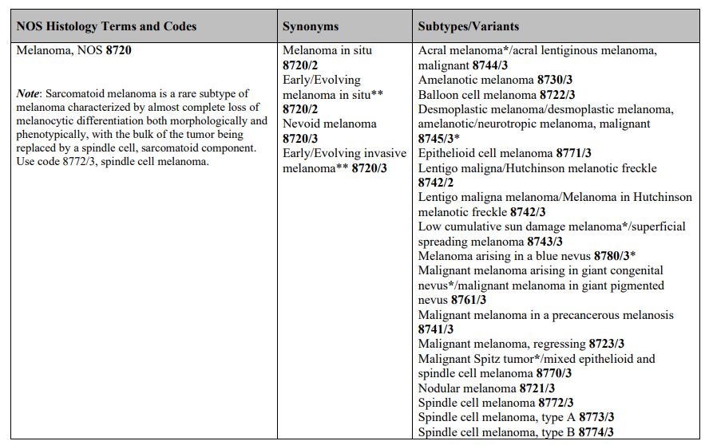
Multiple Primary Rules
Column 3, Table 2

Slide 64
Multiple Primary Rules
M1: Abstract a single primary when it is not possible to determine if there is a single melanoma or multiple melanomas.
M2: Abstract a single primary when there is a single melanoma.
M3: Abstract multiple primaries when there are separate, non-contiguous melanomas in sites with ICD-O side codes that differ at the second (CXXX), third (CXXX) or fourth (CXXX) character.
M4: Abstract multiple primaries when there are separate, non-contiguous melanomas with different lateralities.
M5: Abstract multiple primaries when separate/non-contiguous tumors are two or more different subtypes/variants in Column 3, Table 2 in the Equivalent Terms and Definitions. Timing is irrelevant.
M6: Abstract a single primary when synchronous, separate/non-contiguous tumors are on the same row in Table 2 in the Equivalent Terms and Definitions. Tumors must have the same site code.
Notes:
Note: The same row means the tumors are: • The same histology (same four-digit ICD-O code) OR • One is the preferred term (column 1) and the other is a synonym for the preferred term (column 2) OR • A NOS (column 1/column 2) and the other is a subtype/variant of that NOS (column 3)

Slide 65
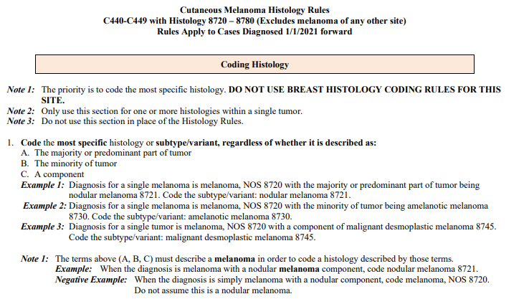
Histology Rules
3/2/23 Skin, left chin shave biopsy
Malignant melanoma, superficial spreading melanoma. Breslow depth 0.8 mm, no ulceration, 2 mitoses per square mm. No LVI. Transected at base.
3/2/23 Skin, left forehead shave biopsy
Malignant melanoma, with a nodular component. Breslow depth 0.7 mm, no ulceration. No mitoses. No LVI. Negative margins.

Slide 66
Histology Rules
Left forehead shave biopsy: Malignant melanoma with a nodular component (C44.3; 8720/3)
Left chin shave biopsy: Superficial spreading type melanoma (C44.3; 8743/3)
H1: Code the histology when only one histologic type is identified.
H2: Code the invasive histology when there are invasive and in situ components
H3: Code the histologic type when the diagnosis is regressing melanoma and a histologic type.
H4: Code 8723/3 (malignant melanoma, regressing) when the diagnosis is regressing melanoma.
H5: Code the histologic type when the diagnosis is lentigo maligna melanoma and a histologic type.
H6: Code 8742/3 (lentigo maligna melanoma) when the diagnosis is lentigo maligna melanoma with no other histologic types.

Slide 67
Histology Rules
Left forehead shave biopsy: Malignant melanoma with a nodular component (C44.3; 8720/3)
Left chin shave biopsy: Superficial spreading type melanoma (C44.3; 8743/3)
H7: Code the subtype/variant when there is a NOS and a single subtype/variant of that NOS.

Slide 68
Abstract

Slide 69
3/2/23 Derm PE showing 6 mm left chin and 4 mm left forehead suspicious moles. Shave biopsy x2 @ ABC showing BD 0.8 mm on left chin, no ulceration, 2 mitoses/square mm and no LVI. Transected at base. 0.7 mm left forehead, no ulceration or mitoses. No LVI. Negative margins. 3/9/23 Surgeon consult @ 123 (me): Negative skin exam and no lymphadenopathy 3/21/23 SLN Bx @ 123 (me) = 0/2 lymph nodes 3/22/23 Mohs NOS @ Indiana Skin Cancer Center
Date of Initial Diagnosis
Laterality
03/02/2023
2
Primary Site
Tumor Size Summary
C443
006
Histology
Lymphovascular Invasion
8743/3
0
Sequence Number
Diagnostic Confirmation
00
1

Slide 70
3/2/23 Derm PE showing 6 mm left chin and 4 mm left forehead suspicious moles. Shave biopsy x2 @ ABC showing BD 0.8 mm on left chin, no ulceration, 2 mitoses/square mm and no LVI. Transected at base. 0.7 mm left forehead, no ulceration or mitoses. No LVI. Negative margins. 3/9/23 Surgeon consult @ 123 (me): Negative skin exam and no lymphadenopathy 3/21/23 SLN Bx @ 123 (me) = 0/2 lymph nodes 3/22/23 Mohs NOS @ Indiana Skin Cancer Center
Regional Lymph Nodes Positive
Sentinel Lymph Nodes Positive
00
00
Regional Lymph Nodes Examined
Sentinel Lymph Nodes Examined
02
02
Date Regional Lymph Node Dissection
Date of Sentinel Lymph Node Biopsy
blank
03/21/2023

Slide 71
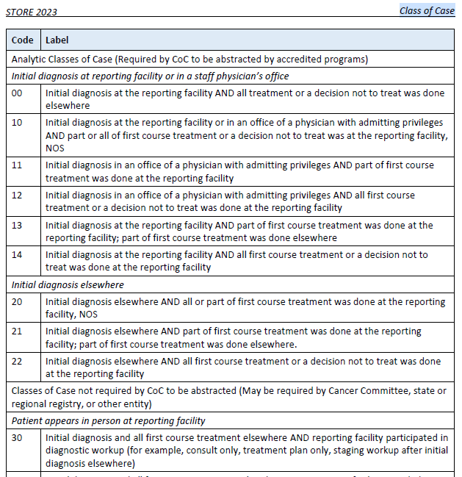
3/2/23 Derm PE showing 6 mm left chin and 4 mm left forehead suspicious moles. Shave biopsy x2 @ ABC showing BD 0.8 mm on left chin, no ulceration, 2 mitoses/square mm and no LVI. Transected at base. 0.7 mm left forehead, no ulceration or mitoses. No LVI. Negative margins. 3/9/23 Surgeon consult @ 123 (me): Negative skin exam and no lymphadenopathy 3/21/23 SLN Bx @ 123 (me) = 0/2 lymph nodes 3/22/23 Mohs NOS @ Indiana Skin Cancer Center
Class of Case
30
Sentinel lymph node is part of work-up, developed to accurately stage patients
Source: Sentinel lymph node biopsy considered treatment - CAnswer Forum (facs.org) and NCCN Guidelines Version 2.2023 Melanoma: Cutaneous page ME-F 1 of 3

Slide 72
3/2/23 Derm PE showing 6 mm left chin and 4 mm left forehead suspicious moles. Shave biopsy x2 @ ABC showing BD 0.8 mm on left chin, no ulceration, 2 mitoses/square mm and no LVI. Transected at base. 0.7 mm left forehead, no ulceration or mitoses. No LVI. Negative margins. 3/9/23 Surgeon consult @ 123 (me): Negative skin exam and no lymphadenopathy 3/21/23 SLN Bx @ 123 (me) = 0/2 lymph nodes 3/22/23 Mohs NOS @ Indiana Skin Cancer Center
Date First Contact
03/09/2023
Non-analytic case = date the patient’s nonanalytic status begins with respect to the cancer (STORE)

Slide 73
Staging

Slide 74
3/2/23 Derm PE showing 6 mm left chin and 4 mm left forehead suspicious moles. Shave biopsy x2 @ ABC showing BD 0.8 mm on left chin, no ulceration, 2 mitoses/square mm and no LVI. Transected at base. 0.7 mm left forehead, no ulceration or mitoses. No LVI. Negative margins. 3/9/23 Surgeon consult @ 123 (me): Negative skin exam and no lymphadenopathy 3/21/23 SLN Bx @ 123 (me) = 0/2 lymph nodes 3/22/23 Mohs NOS @ Indiana Skin Cancer Center
Clinical
Pathological
cT1b
8 mm Breslow depth, no ulceration
Anything with BD 0.8-1.0 is T1b, regardless of ulceration
cN0 (sn)
PE and SLN negative
When SLN is done prior to WLE, it is used clinically
cM0
H&P with no concern for mets (AJCC Chapter 1)
Stage Group IB
pT blank
Mohs, by definition, doesn’t meet WLE criteria
There are times you can path stage with Mohs, if you have documentation, they met the minimum margins as recommended by NCCN / CoC
pN blank
Because there was no WLE, or microscopic proven distant mets, you cannot path stage
pM blank
As above
Stage Group 99 (not staged)

Slide 75
Summary Stage
Breslow’s depth 0.8 mm = Level III
Summary Stage 1

Slide 76
SSDIs

Slide 77
3/2/23 Derm PE showing 6 mm left chin and 4 mm left forehead suspicious moles. Shave biopsy x2 @ ABC showing BD 0.8 mm on left chin, no ulceration, 2 mitoses/square mm and no LVI. Transected at base. 0.7 mm left forehead, no ulceration or mitoses. No LVI. Negative margins. 3/9/23 Surgeon consult @ 123 (me): Negative skin exam and no lymphadenopathy 3/21/23 SLN Bx @ 123 (me) = 0/2 lymph nodes 3/22/23 Mohs NOS @ Indiana Skin Cancer Center
Breslow Tumor Thickness
Ulceration
0.8
0
Mitotic Rate Melanoma
LDH Upper Limits of Normal
02
XX9
LDH Pretreatment Lab Value
LDH Pretreatment Level
XXXXX.9
9
Clinical Margin Width
XX.9

Slide 78
Treatment

Slide 79
3/2/23 Derm PE showing 6 mm left chin and 4 mm left forehead suspicious moles. Shave biopsy x2 @ ABC showing BD 0.8 mm on left chin, no ulceration, 2 mitoses/square mm and no LVI. Transected at base. 0.7 mm left forehead, no ulceration or mitoses. No LVI. Negative margins. 3/9/23 Surgeon consult @ 123 (me): Negative skin exam and no lymphadenopathy 3/21/23 SLN Bx @ 123 (me) = 0/2 lymph nodes 3/22/23 Mohs NOS @ Indiana Skin Cancer Center
Reason for No Surgery of Primary Site
Date of Most Definitive Surgical Resection of the Primary Site
0 Surgery of the primary site was performed
03/22/2023
Date 1st Surgical Procedure
Date of Surgical Discharge
03/02/2023
03/22/2023
Rx Hosp – Surg 2023
Surgical Margins of the Primary Site
B220 for facility ABC
B000 for facility 123
B310 for Indiana Skin Cancer Center
9 Unknown, not stated
Rx Summ – Surg 2023
Scope of Regional LN Surgery
B310 for all facilities
2 Sentinel Lymph Node Biopsy
Notes:
Surgical margins: As documented on path report. We don’t have path report.

Slide 80
3/2/23 Derm PE showing 6 mm left chin and 4 mm left forehead suspicious moles. Shave biopsy x2 @ ABC showing BD 0.8 mm on left chin, no ulceration, 2 mitoses/square mm and no LVI. Transected at base. 0.7 mm left forehead, no ulceration or mitoses. No LVI. Negative margins. 3/9/23 Surgeon consult @ 123 (me): Negative skin exam and no lymphadenopathy 3/21/23 SLN Bx @ 123 (me) = 0/2 lymph nodes 3/22/23 Mohs NOS @ Indiana Skin Cancer Center
Date of First Course of Treatment
Systemic/Surgery Sequence
03/02/2023
0 No systemic therapy/surgery
Date Systemic Therapy Started
Chemotherapy
blank
00 None, chemotherapy was not part of the planned first course therapy.
Immunotherapy
Hormone Therapy
00 None, immunotherapy was not part of the planned first course therapy
00 None, hormone therapy was not part of the planned first course therapy.
Rx Summ – Treatment Status
1 Treatment Given

Slide 81
Questions?

Slide 82
Continuing Education
NCRA Approved for 1 CE hour, which meets the Category A requirement
Certificate of attendance to be emailed out, including the NCRA approval number
Only valid for those that attended the live session

Slide 83
Thank You
Leslie Woodard
Leslie.Woodard@franciscanalliance.org
www.icra-Indiana.net
Notes:
Reminder: Those that attended the live session will receive an email in the next week with the certificate of attendance, including the CE number. This presentation was approved by NCRA for 1 category A CE for live participants only.

Slide 84
Resources
The University of Texas MD Anderson Cancer Center (2009). Q&A: Non-skin melanomas.
Q&A: Non-skin melanomas | MD Anderson Cancer Center
Dickie L., Johnson, CH., Adams, S., Negoita, S. (May 2023). Solid Tumor Rules. National Cancer Institute, Rockville, MD 20850.
Cutaneous Melanoma Solid Tumor Rules 2023 Update (cancer.gov)
Ruhl J, Hofferkamp J, et al. (October 2022). Site-Specific Data Item (SSDI) Manual. NAACCR, Springfield, IL 62704-4194
SSDI Manual.02.15.2023_SA.pdf (naaccr.org)
Amin MB, Edge SB, Greene FL, et al, eds. AJCC Cancer Staging Manual. 8th ed. New York: Springer; 2017.
STORE 2023. https://www.facs.org/media/j5bp1dn4/store-2023-final-version-06282023.pdf

