Slide 1
CoC Chapter 5 and 6 Standards and the CTR
Leslie Woodard, CTR
ICRA Education Chair
Franciscan Health Tumor Registry Manger, System Wide
June 14, 2023

Slide 2
Objectives
Define CoC Standards 5.1, 5.3-5.8, 6.1 and 6.4.
Provide ideas and examples on how a CTR can play a role in facility compliance to each standard.
Discuss roadblocks you may run into when the registry owns these standards, with possible solutions based on my experience.

Slide 3
5.1 College of American Pathologists Synoptic Reporting
Updated February 24, 2023!
Pathology reports no longer reviewed for CAP compliance during the site review, specific to 5.1
New requirement: Internal annual audit to confirm compliance to synoptic reporting
Must be reported to Cancer Committee annually
Action plan required if 90% of the audited reports are not meeting compliance

Slide 4
5.1 CAnswer Forum Clarifications
An audit of 10-20% of your denominator meets the requirement
The program can choose who performs the audit. A pathologist cannot audit their own cases.
Even if you have hard stops that require compliance, an internal audit is required
Internal audit - CAnswer Forum (facs.org)
CAP Compliant; MTuitive software for reporting-makes us 100% compliant already - CAnswer Forum (facs.org)
Notes:
Highly recommend doing all lung and rectal cases, as that helps with 5.7 and .58

Slide 5
5.1 Audit
Compare the current CAP protocol to the surgical resection pathology report on your case
Must be in synoptic format and have all elements to be compliant
Present annually to cancer committee
If under 90% compliance, create action plan and continue auditing
Notes:
If an element is missing, it’s not compliant!

Slide 6
5.1 Ways to Comply
First, check with your lead pathologist to see if they perform an audit already
2nd option: Have your registry do it
Use software and audit while abstracting
Monthly/quarterly audit of all cases
Notes:
Based off what we do at my facilities

Slide 7
5.1 Registry Audit: Things to Consider
Using software and audit while abstracting
Monthly/quarterly audit of all cases
Best for
Concurrent cases
Smaller registries or those that assign certain sites to certain people
Easy to run reports
Adds more time needed per abstract
May need to add supplemental fields
Best for
Facilities that aren’t as concurrent as they would hope to be
Larger registries that separate duties/don’t want everyone trained on CAP
Depending on caseload, can pull a CTR away from other duties for 1-2 days straight
Requires a report from IS

Slide 8
5.1 Registry Audit
Pull the requirements from CAP website
Cancer Protocol Templates | College of American Pathologists (cap.org)
Read the introduction listed above the required elements
If you have questions about a specific element, reference the note letter assigned to that element and see notes at the end of the required elements

Slide 9
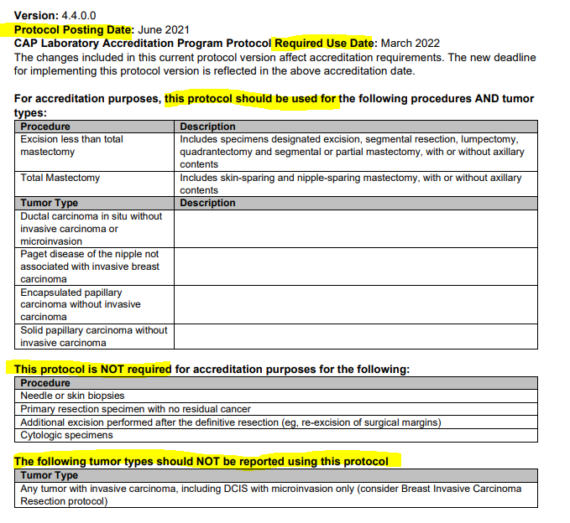

Slide 10
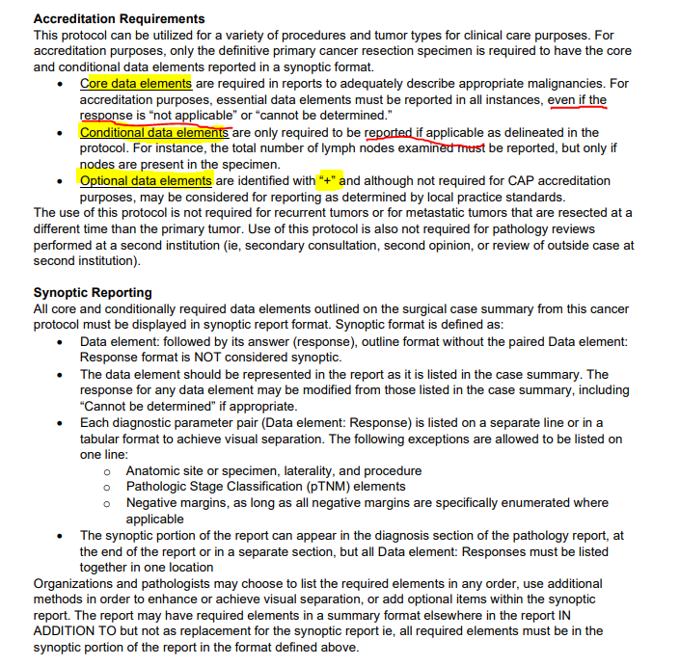

Slide 11
5.1 Quarterly Audit Process
Receive report from IS that includes all oncologic resections for past quarter
Audit all lung, breast and rectal cases required to follow CAP protocols
Mark in excel Y/N for each data element, along with MRN, patient name, lab accession number, pathologist name and date of report
Summarize findings per pathologist and share results with the pathology medical director
Pathologist addends their reports to add missing data elements
Updates are verified by CTR and report made for cancer committee

Slide 12
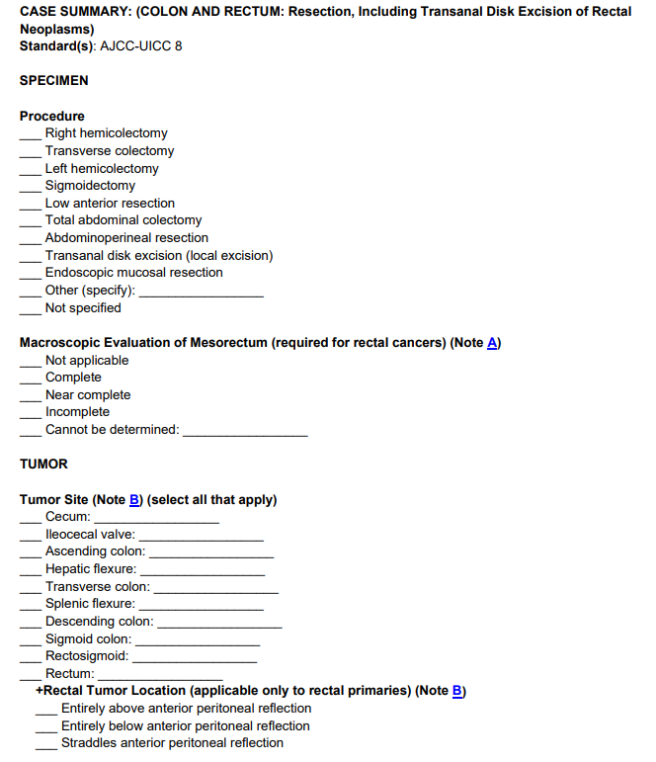
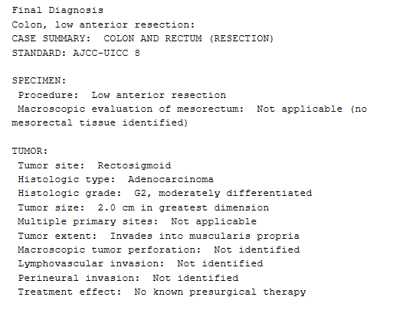

Slide 13
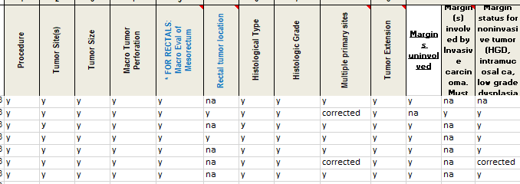

Slide 14
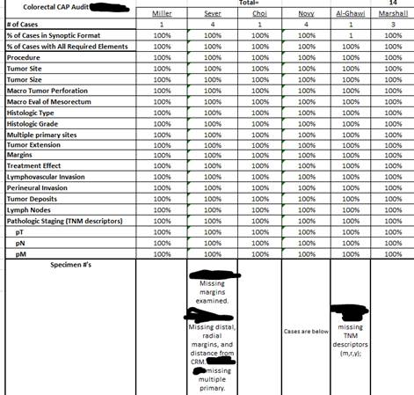
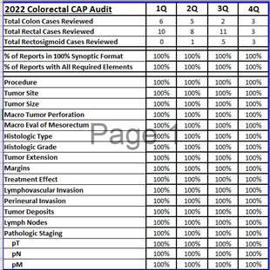

Slide 15
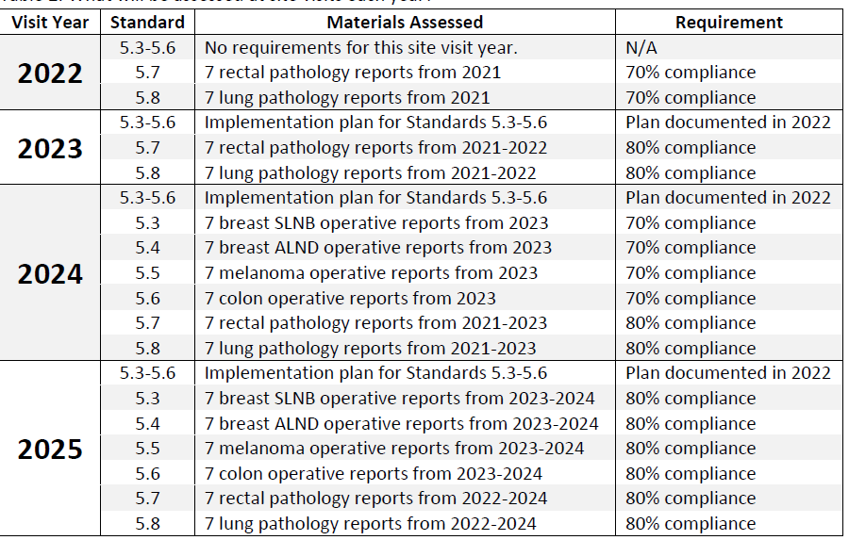
5.3-5.8 Synoptic Operative Reports
C
Operative Standards Toolkit | ACS (facs.org)

Slide 16
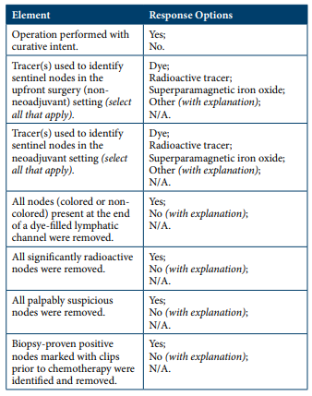
5.3 Breast Sentinel Node Biopsy
All sentinel nodes for breast cancer are identified using tracers or palpation, removed, and subjected to pathologic analysis.
Operative reports for sentinel node biopsies for breast cancer document the required elements in synoptic format.

Slide 17
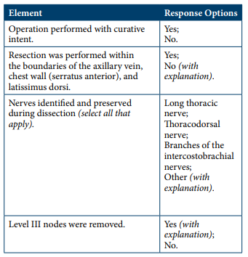
5.4 Breast Axillary Dissection
Axillary lymph node dissections for breast cancer include removal of level I and II lymph nodes within an anatomic triangle comprised of the axillary vein, chest wall (serratus anterior), and latissimus dorsi, with preservation of the main nerves in the axilla.
Operative reports for axillary lymph node dissections for breast cancer document the required elements in synoptic format.

Slide 18
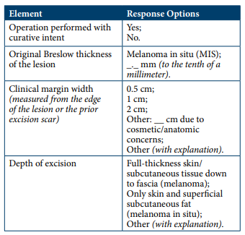
5.5 Primary Cutaneous Melanoma
Wide local excisions for melanoma include the skin and all underlying subcutaneous tissue down to the fascia (for invasive melanoma) or the skin and the superficial subcutaneous fat (for in situ disease). Clinical margin width is selected based on original Breslow thickness:
a. Clinical margin width for wide local excision is 1 cm for invasive melanomas less than 1 mm thick.
b. Clinical margin width for wide local excision is 1 to 2 cm for invasive melanomas 1 to 2 mm thick.
c. Clinical margin width for wide local excision is 2 cm for invasive melanomas greater than 2 mm thick.
d. Clinical margin width for wide local excision is at least 5 mm for melanoma in situ.
Operative reports for wide local excisions of primary cutaneous melanomas document the required elements in synoptic format.

Slide 19
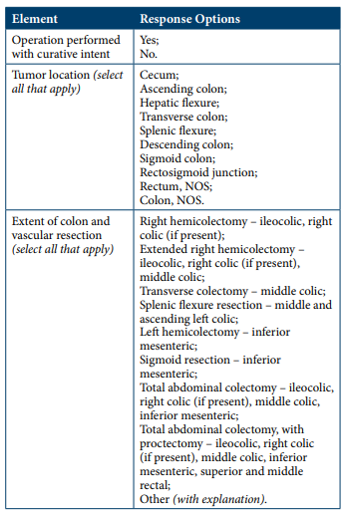
5.6 Colon Resection
Resection of the tumor-bearing bowel segment and complete lymphadenectomy is performed en bloc with proximal vascular ligation at the origin of the primary feeding vessel(s).
Operative reports for resections for colon cancer document the required elements in synoptic format.

Slide 20
5.3-5.6 Audits
Not required, but recommended
coc-operative-standards-self-audit-recommendations_final_20220602142406.pdf (facs.org)
Two components:
Synoptic operative report
Technical requirement
Just like 5.1, can audit while abstracting or do in bulk

Slide 21
5.3-5.6 Audits: My Process
IS created a report that pulls patients based off the standard criteria
Could also use surgery schedules or surgeon office schedules (post-op visits)
I run the report weekly and audit all cases
Excel
Software
Notify surgeons of non-compliant cases
Synoptic op note is added
Technical requirements are used as reminders for future cases
Present YTD totals at each cancer committee meeting

Slide 22
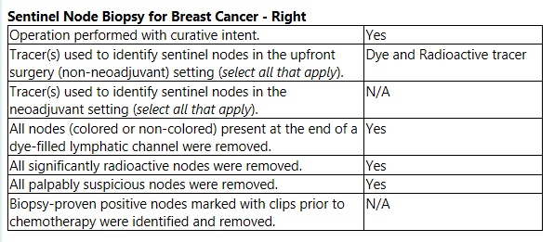
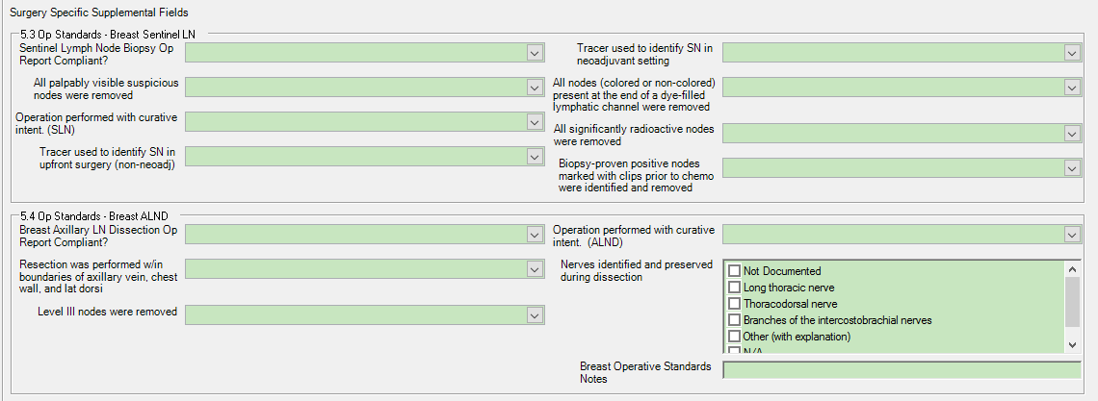

Slide 23
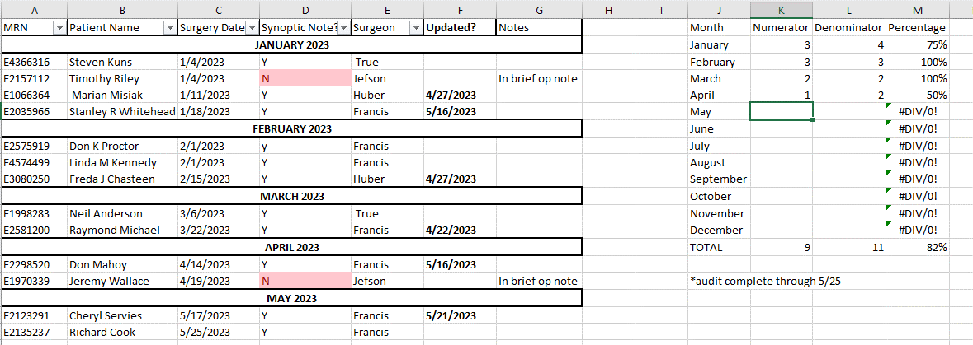

Slide 24
5.7 Total Mesorectal Excision
Total mesorectal excision is performed for patients undergoing radical surgical resections of mid and low rectal cancers, resulting in complete or near-complete total mesorectal excision.
Pathology reports for resections of rectal adenocarcinoma document the quality of TME resection (complete, near complete, or incomplete) in synoptic format.
Notes:
Rectal adenocarcinoma only. Excludes in situ cases and those with no residual cancer.

Slide 25
Cases That Fall Into 5.7
Invasive mid and low rectal adenocarcinoma only
Curative intent cases only
Surgery code 30 or higher
2023 surgery code A300+
No residual cancer found by pathology at time of surgery does not qualify

Slide 26
5.7 Audit
Is it mid or low rectal tumor?
Source: Op note, rectal MRI, EUS, colonoscopy
Per CoC FAQ: In the CAP pathology report, a response of “Entirely above anterior peritoneal reflection” to the “Rectal Tumor Location” data element indicates a high rectal tumor
Was a TME performed?
Source: Op note
Surgery codes 30+/A300+
Is the pathology report in synoptic format?
Does the synoptic format include the quality of TME?
Was the quality of the TME complete or near complete?

Slide 27
5.7 Audit
Op Note
MRI
Path Report

Slide 28
5.7 Tracking
Use your software or excel to track
Run report on both aspects
Path report in synoptic format and includes the quality of the mesorectal excision
Mesorectal excision was complete or near complete
Report results to Cancer Committee quarterly
Total reviewed: (41) | Accreditation period (Total) | 2022 |  | 2023 YTD
5.7 (TME) 80% compliance required for 2025 site visits | 93% | Total (29) | 97% | Total (12) | 83%

Slide 29
5.8 Pulmonary Resection
Pulmonary resections for primary lung malignancy include lymph nodes from at least one (named and/ or numbered) hilar station and at least three distinct (named and/or numbered) mediastinal stations.
Pathology reports for curative pulmonary resection document the nodal stations examined by the pathologist documented in synoptic format.

Slide 30
Cases That Fall Into 5.8
Curative intent pulmonary resections
Surgical codes 20-80 or A200-A800
Non-small cell, small cell and carcinoid tumors

Slide 31
5.8 Audit
Was there at least one station 10 or higher node resected?
Were there three distinct stations from 2-9 resected?
1 4R and 1 4L node counts as ONE STATION TWO STATIONS, as long as they are clearly labeled L vs. R
Station 1 nodes don’t count at all
Is the pathology report in synoptic format?
Are the nodal stations examined by the pathologist documented in the correct format?
**Correction made!

Slide 32
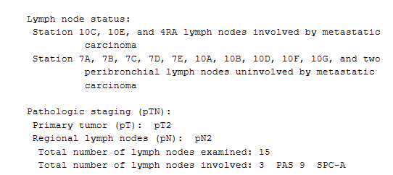
5.8 Audit
This one is compliant
Synoptic format, listing all examined nodal stations
There’s a station 4, 7, 8, 10 and 11 node examined
This one is not compliant
Synoptic format, listing all examined nodal stations
However, only stations 4, 7 and 10 were examined
Missing a 3rd mediastinal station

Slide 33
5.8 Tracking
Use your software or excel to track
Run report on both aspects
Path report in synoptic format with the nodal stations examined included
At least one hilar station node and three distinct mediastinal station nodes were resected
Report results to Cancer Committee quarterly
Total reviewed: (44) | Accreditation period (total) | 2022 |  | 2023 YTD
5.8 (Lung) - 80% compliance required for 2025 site visits | 82% | Total (39) | 82% | Total (5) | 80%

Slide 34
6.1 Cancer Registry Quality Control
Parts D, E and G of the standard
Evaluate the following activities for all cases each year
Casefinding
Abstracting timeliness
The percentage of information coded as unknown
Evaluate the fields below each year, a minimum of 10% of analytic caseload
Class of case
Primary site
Histology
Grade
AJCC Stage
First course of treatment
Follow-up information
Maintain documentation of the activity
Review criteria
Cases reviewed
Identified errors and resolutions
Reports the percentage of accuracy to cancer committee

Slide 35
6.1 Casefinding Evaluation
Annual death clearance from state
Report out on the number of reportable cases that were missed
Dig deeper – were they clinical diagnosis only?
How can we prevent missing them moving forward?
Annual caseload by site
Compare year over year
Focus on sites with sudden changes
Is there an explanation for a sudden drop off?
New hire?
Use their casefinding training as part of the evaluation

Slide 36
6.1 Abstracting Timeliness
CoC does not have a timeliness standard
Annual NCDB call for data
State Registry
Indiana’s P&P Manual states cases are due no later than 6 months following a confirmed diagnosis
Cancer Committee has final say as to what is put in your facility P&P
Concurrent sites ~3 months of first contact
Non-concurrent sites ~ 8 months of first contact

Slide 37
6.1 Percentage of Information Coded as Unknown
NCDB Data Completeness Reports
Look at anything under that shows up under the benchmark (hyperlink)
Example of report:
Histology (3.37% vs. CoC 2%)
45 cases coded to malignant, NOS
Clinically diagnosed cases, no biopsy (could be due to patient refusing further workup or bx done and not enough tissue to say more than malignant)
Behavior code (90.1% vs CoC 89%)
1202/1334 of cases were coded as invasive malignancy
CoC says this may mean inadequate case finding on in-situ or benign reportable cases.
Reviewed the case finding audit and everything seemed appropriate compared to historical numbers
Software vendor report

Slide 38
6.1 Minimum 10% Analytic Caseload Review
QA Role
Peer Review
Physician Review
Can review just the fields required by 6.1 or all fields
Educational experience for all involved
Can’t review your own cases
Only 6.1 fields reviewed
Good for 1-person registries
Great time to clarify things with physician that effect our coding
Physicians don’t know the specific rules/codes

Slide 39
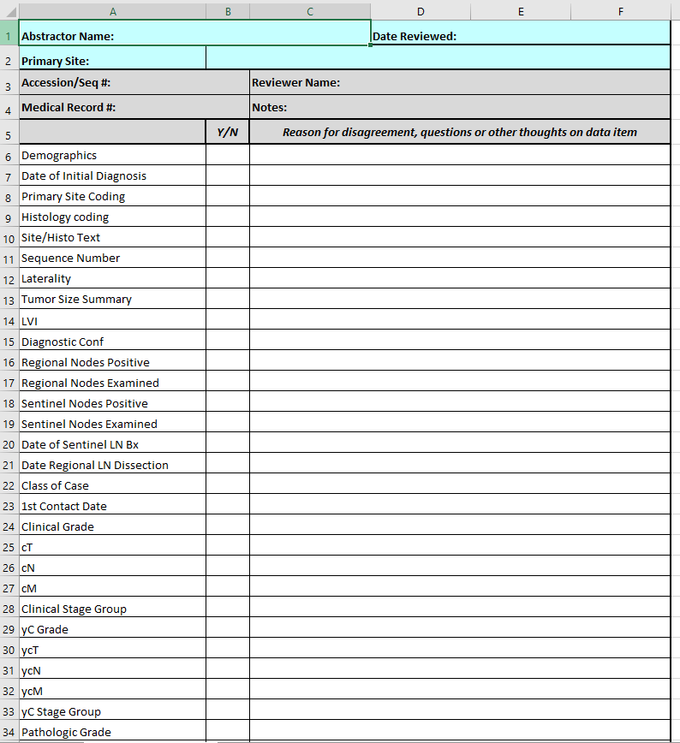
6.1 QA Role or Peer Review
Be specific in your reasoning for disagreeing with a code
Provide standard setter rules, definitions, clarifications, etc.
Never a personal attack!

Slide 40
6.1 Peer Review Example

Slide 41
6.1 Physician Review
Print/save abstract
Software vendor may have a 6.1 form print option that shows just the required fields!
If full abstract was printed/saved, edit and highlight the areas the reviewer needs to look at
Provide review form for reviewer to mark correct/incorrect
Print/save and highlight relevant documents from EMR to speed up the review*
Discuss findings

Slide 42
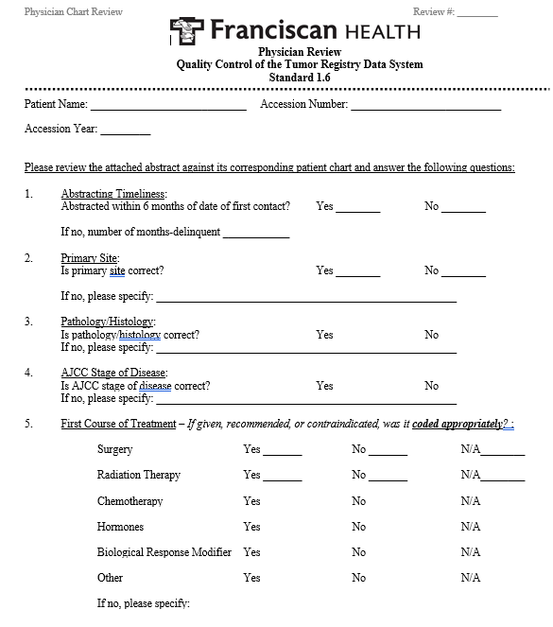
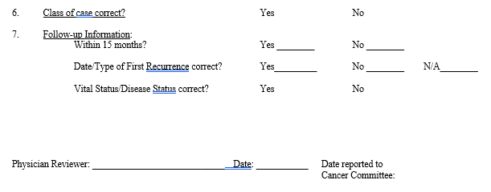
6.1 Physician Review Form

Slide 43
6.1 Tracking Results
Software Vendor
Easily run reports on the fields required by Standard 6.1
Used for Cancer Committee reporting

Slide 44
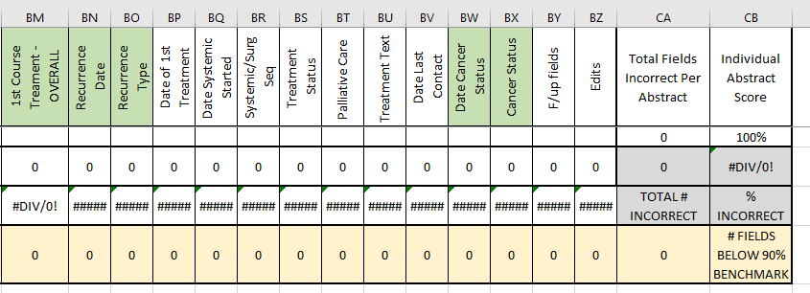
6.1 Tracking Results
Excel
Much more detailed and individualized

Slide 45
6.1 Reports
Annual cancer committee report
Quarterly director level reports

Slide 46
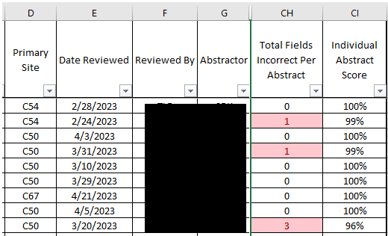
6.1 Reports
Individual Scores

Slide 47
6.1 Resolving Conflicts Found
Abstractor updates their own cases
Education
Immediate feedback on the form
Monthly/quarterly department webinars
Quizzes to gauge success
OneNote for all tips/tricks/clarifications

Slide 48
6.4 Rapid Cancer Reporting System: Data Submission
All new and updated cancer cases are submitted at least once each calendar month
All complete analytic cases for all disease sites are submitted via RCRS as specified by the annual Call for Data
RCRS data and required quality measure performance rates are reviewed by the Cancer Committee at least twice each calendar year
Notes:
Only touching on #3 in depth here, because NCDB and your software vendor have specific instructions on how to do #1 and 2. However, I do want to make it a point that the more concurrent you are in abstracting the sites collected by RCRS, the more meaningful your reports are.

Slide 49
6.4 RCRS
So much data!
New and old
Feedback to administration and treatment teams
Assistance with meeting quality measures
Comparison reports
The reports count towards CLP reporting requirements if they present it
Notes:
New data all depends on what cases you’re currently abstracting and submitting – the more concurrent you are, the more useful the data is

Slide 50
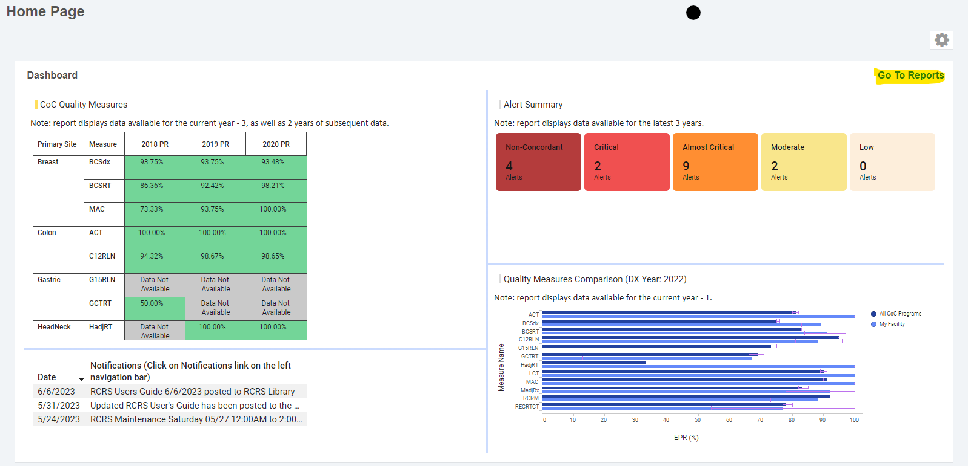
6.4 RCRS Dashboard
Notes:
Take note of the notifications – as you can see, on 6/6/23 an updated RCRS user guide was posted. This is something you should review at least annually – discusses the different reports available, what measures are being evaluated at the time of site reviews, when new measures are added, how to delete or update cases, etc.

Slide 51
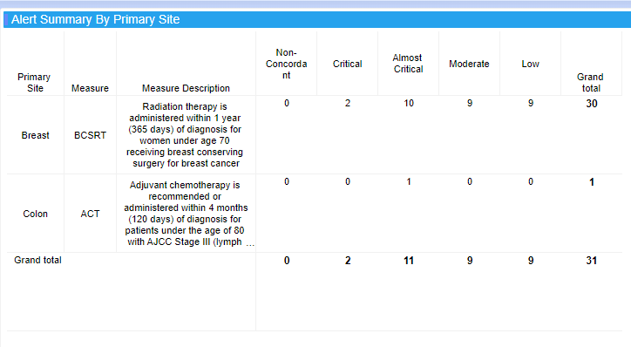
6.4 RCRS Alerts

Slide 52
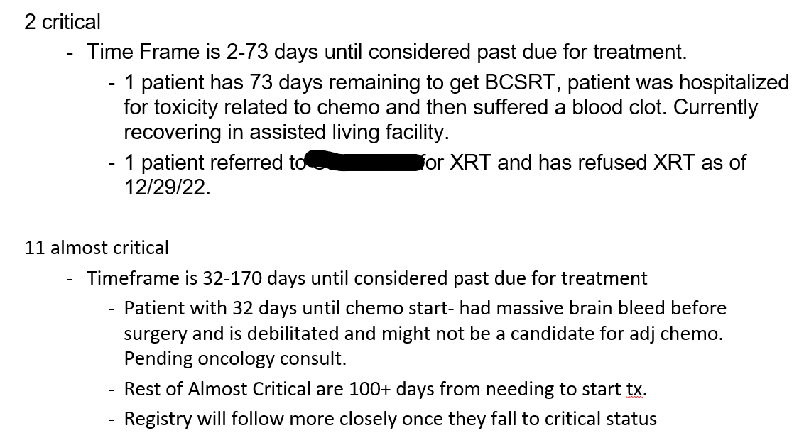
6.4 RCRS Alerts

Slide 53
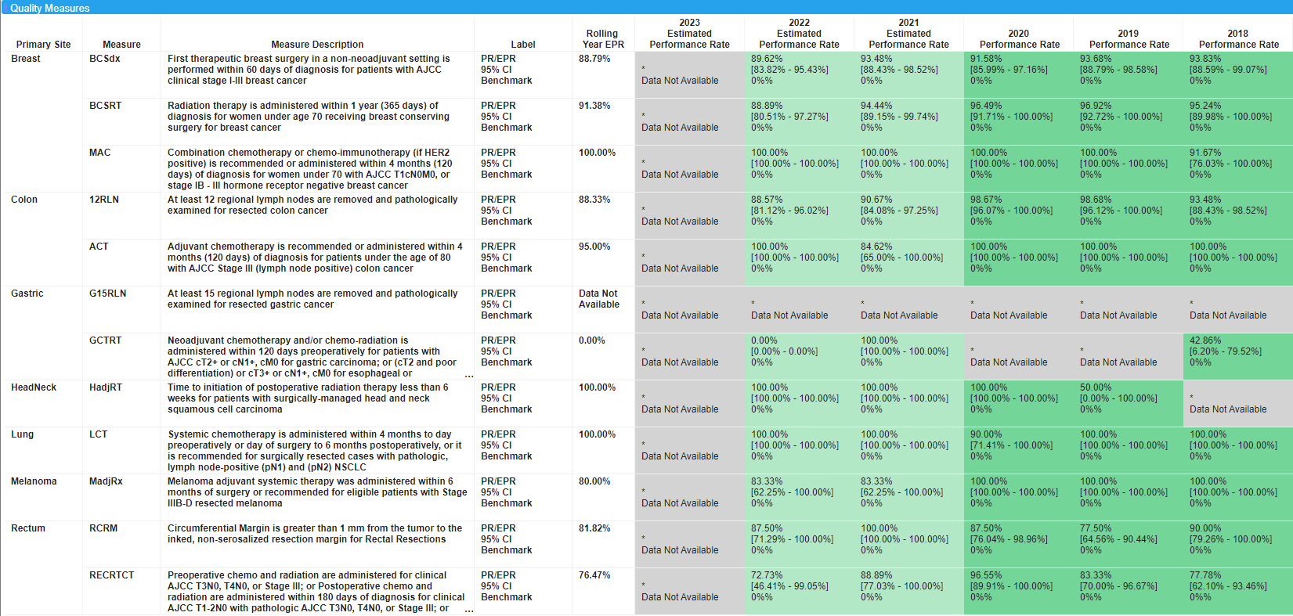
6.4 Quality Measures
Tied to 7.1
Beginning mid-January 2023, Standard 7.1 will not be evaluated any longer for site review

Slide 54
Questions?
Leslie.Woodard@franciscanalliance.org

Slide 55
Thank you!
NCRA CE certificate to be emailed to all that attended this live.

