Slide 1
Cancer Epidemiology
TAYLOR EISELE, MPH
CANCER EPIDEMIOLOGIST
11/09/2023

Slide 2
OUR MISSION:
To promote, protect, and improve the health and safety of all Hoosiers.
OUR VISION:
Every Hoosier reaches optimal health regardless of where they live, learn, work, or play.

Slide 3
Agenda
Responsibilities of the Indiana state cancer epidemiologist
Understanding cancer data availability and limitations
Cancer cluster process and new guideline updates
Recent data needs and interests

Slide 4
Responsibilities
Data analysis and data management
Data requests
    Public
    Research
    Local health departments, organizations, and hospitals.
    Cancer cluster inquiries
Cancer data subject matter expert
    Education
    Data Suppression/Data Availability/Patient Privacy etc.
Indiana Comprehensive Cancer Plan metrics

Slide 5
Types of Cancer Data
Cancer Prevention/Risk Factor Data: Behavioral Risk Factor Surveillance System (BRFSS)
    Smoking, obesity, and demographics
Cancer Screening Data: BRFSS
    Colorectal, lung, breast, prostate, and cervical cancer screening data
Cancer Incidence Data: Indiana State Cancer Registry
    Patient information, diagnosis data, and treatment data
Cancer Mortality Data: Indiana State Cancer Registry, Vital Records Data
    Date, cause, and location of death
Cancer Survivorship Data: BRFSS, Indiana State Cancer Registry
    BRFSS: Quality of life measures for survivors both for mental and physical health and smoking in survivors
    Indiana State Cancer Registry: length of survival and survival rates

Slide 6
Cancer Data Limitations
Data lag time
Variable incompleteness/optional variables
Lack of availability of desired variables
BRFSS data vs registry data

Slide 7
Cancer Clusters
A Cancer cluster is defined as a greater than expected number of the same or etiologically related cancer cases that occurs within a group of people in a geographic area over a defined period of time.
  A greater than expected number: Number of observed cases is more than typical in similar setting
  Same or etiologically related cancer cases: Cases are of the same type, within family of tumors, or have a known link to the same specific environmental or chemical exposure
  Within a group of people: Population in which the cases are occurring is defined by demographic factors (race, ethnicity, age, and sex)
  In a geographic area: The geographic area may be census tract, county, zip code or based on exposure boundaries. The geographic boundaries are used to determine the number of cases as they relate to the total population
  Over a period of time: Time frame used to establish the beginning and end dates for analysis (1)
https://www.cdc.gov/nceh/cancer-environment/guidelines/cancer-characteristics.html

Slide 8
Updated Cancer Cluster Guidelines
Can be found: https://www.cdc.gov/nceh/cancer-environment/pdfs/Guidelines-for-Examining-Unusual-Patterns-of-Cancer-and-Environmental-Concerns-h.pdf
Changes:
Expands to include examining patterns of cancer and environmental concerns
Revising definition of cancer cluster and introducing concept of “unusual patterns of cancer”
Add approaches to engage community members
Update process to identify and investigate unusual patterns of cancer, including proactive evaluation and routine monitoring (1)
https://www.cdc.gov/nceh/cancer-environment/guidelines/index.html

Slide 9
Indiana Cancer Cluster Inquiry Team
Led by the IDOH cancer section but is a multiagency work group that meets biweekly and consists of the following agencies and groups
IDOH Comprehensive Cancer
    Cancer section director
    Comprehensive cancer manager
    Cancer epidemiologist
IDOH Environmental Health
    Asthma environmental manager
    Lead and healthy homes representative
Indiana Department of Environmental Management (IDEM)
    Two senior environmental managers

Slide 10
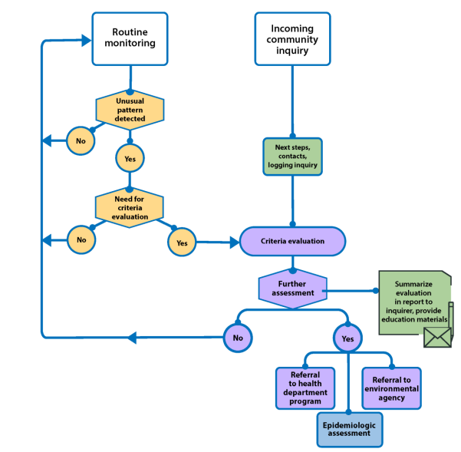
Cancer Cluster Process
Inquiry Intake
  How to report: email or phone
  Questionnaire
Data collection and analysis
Meet with team
Evaluate environmental scope
Compile information and decide if definitions are met of cancer cluster or to close inquiry
https://www.cdc.gov/nceh/cancer-environment/pdfs/Guidelines-for-Examining-Unusual-Patterns-of-Cancer-and-Environmental-Concerns-h.pdf

Slide 11
Inquiry Example
Cancer Rates Between Indiana and County of Concern 2015-2019
Call comes in regarding a concern of too much breast cancer in her neighborhood in Lake County
Questionnaire
Data: see tables
Discussion with team
Decision
 | Indiana |  | Lake county
 | Count | Rate | Count | Rate
Breast Cancer | 25,842 | 134.2 | 1,990 | 132.8
Data Source: Indiana State Cancer Registry
Rates are Age-adjusted to the US 2000 Standard Population
Excludes in situ and benign tumors
Standardized Incidence Ratios (SIR) 2015-2019
 | Lake county |  |  | Zip code (46402)
 | SIR | 95% CI | P-Value | SIR | 95% CI | P-Value
Breast Cancer | 0.99 | 0.95-1.04 | 0.92 | 0.81 | 0.47-1.15 | 0.28
Data Source: Indiana State Cancer Registry

Slide 12
New Interests in Indiana Cancer Epidemiology
Interests that the cancer epidemiologist has received:
COVID-19 data with cancer
Cancer survivorship
Lung cancer screening
LGBTQ+ specific data
Cancers in children
Relationships between cancer and other issues (other chronic diseases, suicide, etc.)

Slide 13
Questions?
Taylor Eisele, MPH
Cancer Epidemiologist
Teisele@health.in.gov

