Slide 1
Role of Radiation Therapy in Rectal Cancer
Sandeep R. Bhave, MD, MS, DABR
Radiation Oncologist, Cancer Care Group
Medical Director, Healthy Living Center
Franciscan Health Cancer Center
Notes:
Good morning, everyone my name is Dr. Sandeep Bhave, and I am a radiation oncologist at CCG. I also am medical director for the healthy living center at Franciscan Health, Indianapolis. I look forward to discussing with you this broad topic of the role of radiation therapy in rectal cancer.

Slide 2
Conflicts of Interest
None

Slide 3
Work-up
H&P:
N/V, diarrhea, constipation, stool change, BRBPR, pain, HNPCC, UC (20x ↑ risk)
-Exam:
Inguinals, abdomen, rectal, female pelvic; fixed/tethered, circumferential involvement, distance from verge, sphincter tone
Labs: CBC, CMP, LFTs, CEA
Imaging:
CT C/A/P w oral and IV contrast (PET not indicated per NCCN)
MRI pelvis w/ endorectal coil (for T staging; NCCN preferred.
Rectal protocol small FOV T2 perpendicular to plane of rectum
If no MRI, get EUS- cannot tell CRM or EMVI but better for telling between T1/T2
Procedures
Proctoscopy with biopsy
MMR /MSI 15% CRC
2. Full colonoscopy to look for synchronous lesions

Slide 4
T Stage
Tis: Lamina propria, muscularia mucosae
T1: submucousa
T2: muscularis propria
T3: pericolorectal tissue, through serosa
T4a: Visceral peritoneum
T4b: Adjacent organs
On exam:
T2 = mobile
T3 = tethered
T4 = fixed

Slide 5
Lymph Node Drainage
Lymph node drainage:
Proximal rectum: inferior mesenteric artery → porta hepatis → liver
Distal rectum: internal iliac artery → inferior vena cava → lung
Anus/sphincter (below dentate line) drains to inguinals ® external iliac
Rectum is ~16 cm long and starts at rectosigmoid junction (peritoneal reflection) → dentate line (S3) and ends at anorectal ring
Upper, middle, lower portions
Mesorectal fat surrounds to reflxn
Notes:
(covering inguinals is controversial)

Slide 6
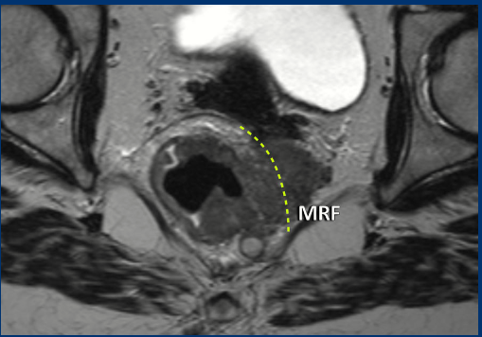
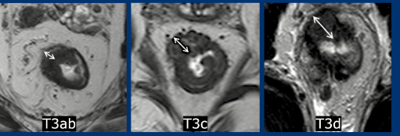
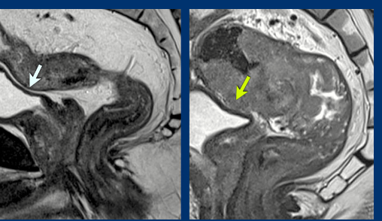
T stage
Notes:
L-R
Normal anatomy
T2
T3
T4
Second row
Normal peritoneal reflection
MRF involvement
MRF involvement
T3
No involvement of ant peritoneal and then on R its involved

Slide 7
N and M stage
Nodal staging
N1a: 1
N1b: 2-3
N1c: Tumor deposits in subserosa or mesentery w/o regional nodal mets
N2a: 4-6
N2b: 7+
M1a: 1 organ or single non-regional node
M1b: > 2 organs without peritoneal mets
M1c: peritoneal mets

Slide 8
Overall Stage
Stage I: T1-2 N0
Stage IIA: T3 N0
Stage IIB/C: T4a/T4b N0
Stage IIIA: T1-2N1/N1c or T1N2a
Stage IIIB: T3-4a N1/N1c or T2-3 N2a or T1-2 N2b
Stge IIIC: T4a N2a or T3-4a N2b or T4b N1-2
Stage IVA: M1a
Stage IVB: M1b
Stage IVC: M1c

Slide 9
Primary Management Stage 3

Slide 10
TME
sharp dissection of entire mesorectum (peri-rectal fat, pre-sacral space), ↓ (+) radial margins
improved LC (90 vs. 75%). ALL GET TME
4-5 cm margin (maybe only be 1-2 cm if low-lying
How many nodes? 12-14
LAR
(> 5 cm from verge): mid-upper lesions and spares sphincter
APR:
3-5 cm from verge): for low-lying lesions
Notes:
Goal 14 nodes for full eval (Tepper et al data suggests best OS/PFS w/ this); Kachnic (SR ’17) said 12)

Slide 11
Radiation therapy for rectal cancer

Slide 12
Can we avoid RT in some T3 tumors?

Slide 13
Short Course RT

Slide 14
High Risk Rectal Ca

Slide 15
TNT

Slide 16
Increased pCR with increasing cycles of FOLFOX

Slide 17
RAPIDO+PRODIGE-23
Notes:
RAPIDO did not mandate chemo in the standard arm < 50% got adjuvant chemo

Slide 18
OPRA

Slide 19
OPRA

Slide 20
OPRA
Notes:
Findings seem to indicate that concurrent CRT→ chemo has better TME free survival

Slide 21
Non-operative management continued

Slide 22
CT simulation with IV and oral contrast
Prone, arms up, belly board, wire scars (for APR), marker at anal verge, vaginal marker for female, full bladder.
CT from L1 to mid femur
Daily CBCT for bladder filling
CTV_45 Gy: all gross disease, entire mesorectum, presacral, internal iliac nodes (external lilacs also if T4, anal canal)
CTV_50.4: GTV (or pre-op tumor) + 3 cm + presacral nodes and mesorectum/sacral hollow→

Slide 23
Acute toxicity of RT
Diarrhea
Acute proctitis
Thrombocytopenia
Leukopenia
Dysuria
5FU toxicity
Cardiac toxicity including CP, MI, A fib, myocarditis
Vasospasm STE
12 hrs after initiation to 1-2 d
Mechanism.
Altered DPD enzyme activity--> toxic fluroacetate--> ischmemia/Takasubo--> vasospasm
Prevention
Infusion rather than bolus
Imdur +CCB --> 12 min push with cardiologist present
12 hrs after repeat this
Penn Case series: 100% got through treatment (N <20)

Slide 24
Late Toxicity:
Peristent diarrhea, proctitis, frequent BMs
Anastamotic Strictures
SBO
Incontinence
Impotence/Sterility
Vaginal dilators for females!
Swedish 5x5 major complication was SBO, but also:
1) Bowel frequency
2) Fecal incontinence
3) Impaired social life

Slide 25
Thank you!
Questions?

