Slide 1
Rectal Cancer: Diagnosis, Staging, and Surgical Approach
Scott Dolejs, MD Msc

Slide 2
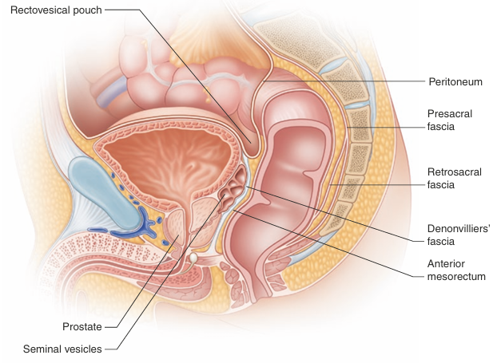
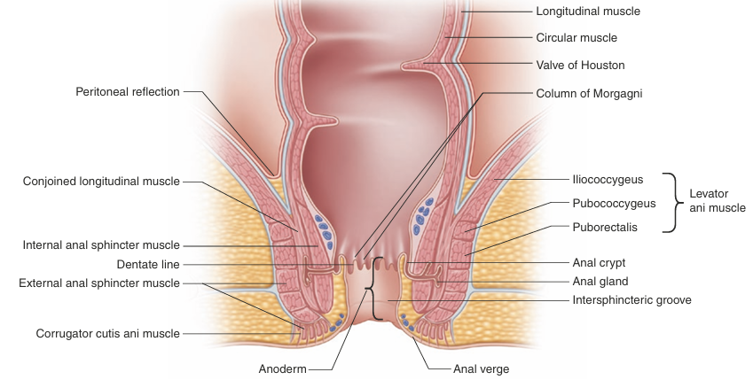
Anatomy of the Rectum

Slide 3
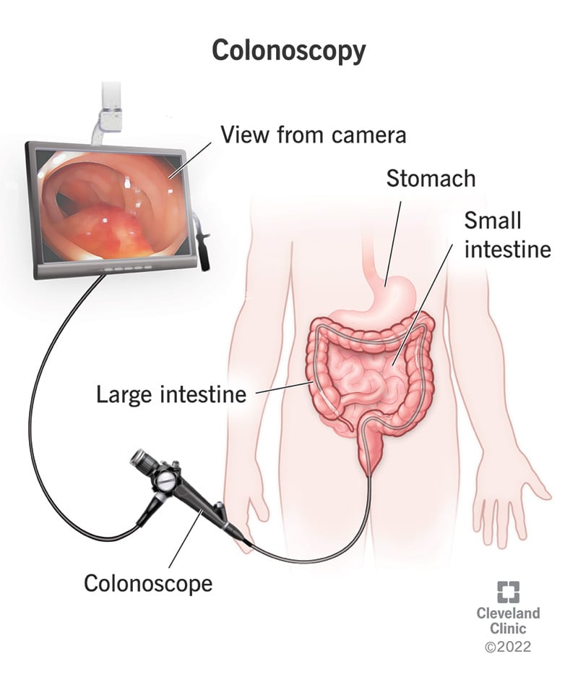
Diagnosis

Slide 4
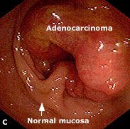
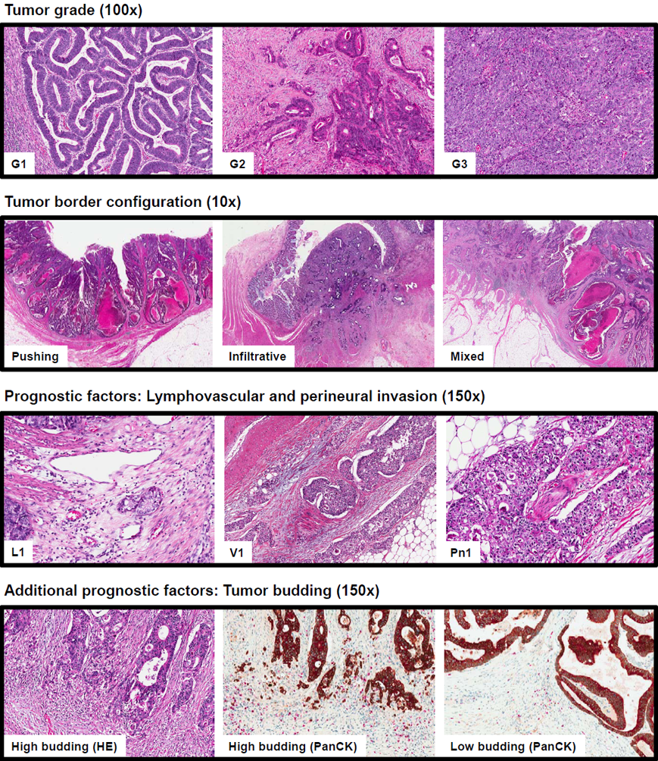
Diagnosis

Slide 5
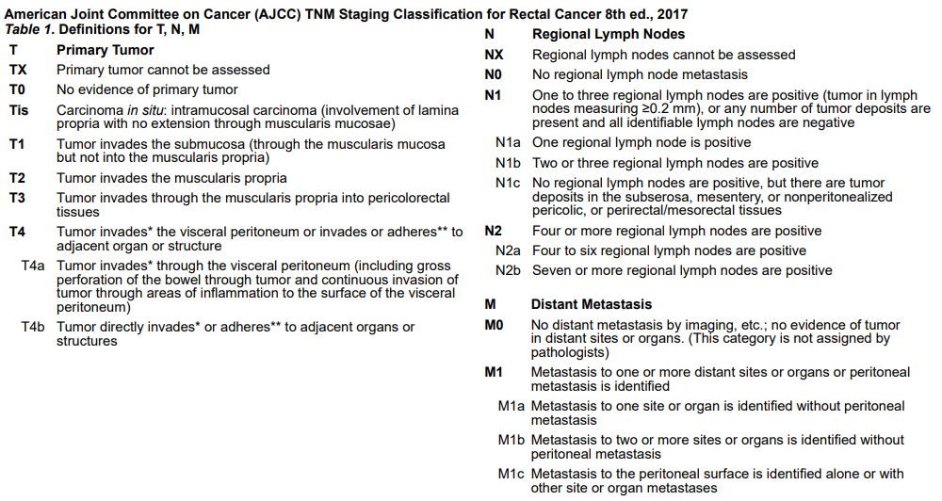
Staging

Slide 6
Staging: T-Stage

Slide 7
Staging
Locoregional Extent of Disease:
MRI
T1/2 vs T3/4: Sensitivity of 87% and Specificity of 71%
Lymph Node Involvement: Sensitivity 77% and Specificity of 71%
Circumferential Resection Margin Status: Sensitivity 77% and Specificity 94%
Transrectal US
BETTER SENSITIVITY AND SPECIFICITY FOR T1, T2, T3, and T4 disease (in the 90% range)
Similar for lymph node involvement
CANNOT detect circumferential resection margin status
Metastatic Work-Up:
CT chest/abdomen/pelvis
CEA
Genetic Counseling and Genetic Panels

Slide 8
Changes in Treatment

Slide 9
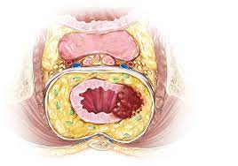
Changes in Treatment
Pure resectional management, no anatomic planes, all abdominoperineal resections, tons of morbidity
Rates of recurrence and morbidity
dropped with holy plane
Recurrence 15-45% to 7-10%

Slide 10
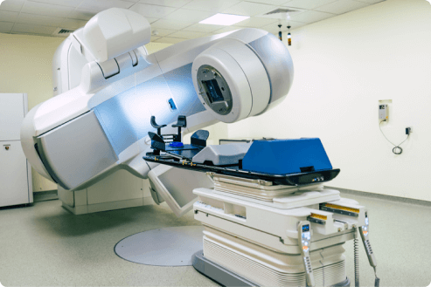
Changes in Treatment
Preoperative Radiation Therapy
Preoperative RT compared to postoperative RT reduced risk of recurrence from 13% to 6% in German Rectal Cancer Study
Preoperative RT versus good surgery in patients with T3 or N+ patients reduced risk of recurrence from 11% to 6% in Dutch TME trial
Selective withholding of RT in recent PROSPECT trial

Slide 11
Changes in Treatment

Slide 12
Changes in Treatment

Slide 13
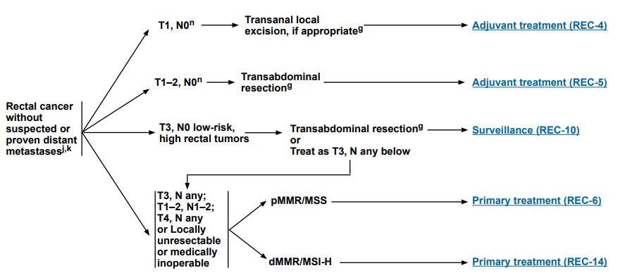
Surgical Approaches:
TAMIS, TEM, LAR, APR, DLI, WW

Slide 14
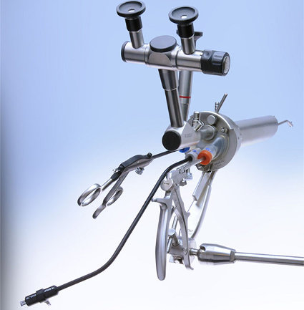
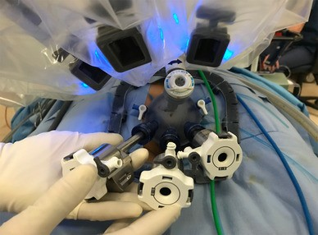
Surgical Approaches: TAMIS and TEM
Transanal Minimally Invasive Surgery
Transanal Endoscopic Microsurgery

Slide 15
Surgical Approaches: TAMIS and TEM

Slide 16
Surgical Approaches: TAMIS

Slide 17
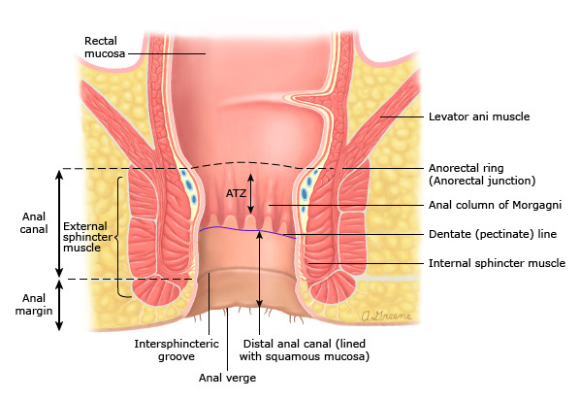
Surgical Approaches: LAR versus APR

Slide 18
Surgical Approaches: The Holy Plane

