Slide 1
Treatment of Non metastatic rectal cancer- Medical Oncology perspective
Dr. Nibal saad
Medical oncologist
Oncology & hematology specialists, FRANCISCAN health

Slide 2
Colon vs rectal cancer
Although pathology of rectal cancer is similar to colon cancer, the anatomic location of rectum made local recurrence big challenge.
That makes multidisciplinary approach very important to decrease local recurrence rate and improve cancer control
Staging:
MRI pelvis vs EUS
CT CAP
No PET scan

Slide 3
Surgery
Surgery alone is appropriate for T1 disease, otherwise chemotherapy and radiation therapy are needed
With multidisciplinary approach, 5 yrs local recurrence rate dropped to 5-10%
Preferred surgery is TME

Slide 4
To improve over surgery alone, two approaches were used
PreOperative Short course RT 5 Gyx 5 days (compared with surgery alone, Swedish trial: local recurrence 11 vs 27%, 5yrs-OS 58 vs 48%, another Dutch trial showed improved local recurrence but not OS), or
PreOperarive Concurrent Chemo radiation with 50.4 Gy (45+ 5.4 Gy local boost) over 5-6 weeks with radio sensitizing chemotherapy
Both approaches decreased loco regional failure
For sphincter preserving surgery however, only prolonged CRT approach showed enough tumor shrinkage
Prolonged CRT approach is the preferred one in USA

Slide 5
History of multimodality approach
Surgery < surgery + RT (short course or long course): combination therapy won
(Swedish trial:
local recurrence 11 vs 27%,
5yrs-OS 58 vs 48%
N Engl J Med 1997; 336:980-987
another Dutch trial showed improved local recurrence but not OS),

Slide 6
Surgery+ adj RT < Surgery+ adj CRT (5FU based chemo): tri modality won
local recurrence 25 vs 13%, distant mets 46 vs 29%,
Krook et al NEJM 1991

Slide 7
Surgery + CRT (5FU bolus) < surgery + CRT (5FU continuous)
relapse 53 vs 63%, OS 60 vs 70%
O'Connell et al NEGM 1994

Slide 8
Surgery + adj CRT continuous 5FU = Surgery + adj CRT Capcitabine.
(3 yrs DFS 67vs 75%, 5yr OS 67 VS76%)
Hofleinz et al Lancet oncol 2012
Currently either cont 5FU or Capecitabine with RT are acceptable standard of care

Slide 9
surgery + adj CRT < neoadj CRT+ surgery
Local recurrence 13 vs 6%, OS 74vs76 %, G3-4 tox 40 vs 27% .
Sauer et al NEJM 2004
Pt who gets upfront surgery for presumed T1 disease but ends up with more advanced disease should get adj CRT

Slide 10
Neoadj CRT + surgery vs Neoadj CRT (oxaliplatin based),
oxaliplatin was associated with more toxicity

Slide 11
Adjuvant chemotherapy after neoadjuvant CRT and surgery
Meta analysis did not show benefit of adjuvant chemo. That was done on old chemo regimens however
ADORE trial, 2019, a phase III Korean trial on patient who received neoadjuvant CRT and had postoperative stage II and III. Compared adj 5fU vs FOLFOX. 6 yr DFS 68% vs 57%
NCCN still recommend adj chemotherapy even in cPR patients

Slide 12
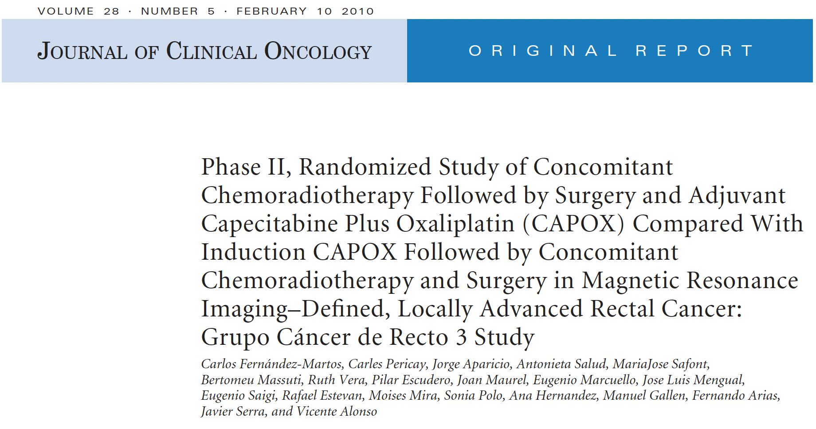
TNT
CAPOX+RT then Surgery then CAPOX x4 vs TNT (CAPOX x4 ->CAPOX+RT -> surgery.
cPR same, G3 tox was less in TNT 19 vs54%

Slide 14
CRT + 0, 2, 4, 6 cycles of FOLFOX
TNT improved cPR compared with no neoadj chemo 38 vs 18%

Slide 15
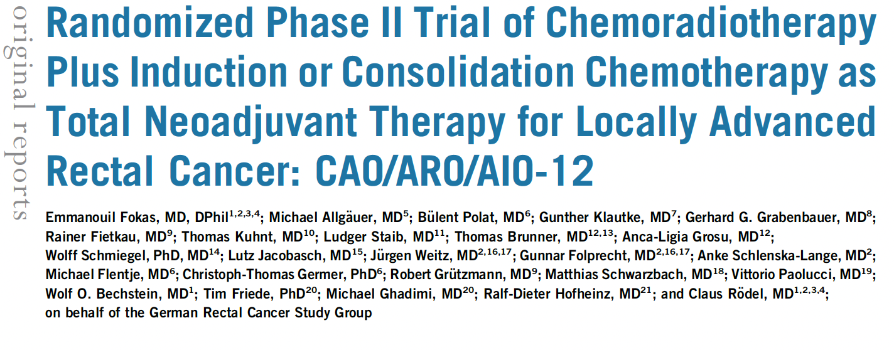
TNT
CAO/ARP/AIO-12 phase II trial : TNT with consolidative chemo (FOLFOX) vs TNT with induction chemo
Better cPR in consolidation chemo 25 vs 17%

Slide 16
OPRA trial : TNT with consolidative chemo vs TNT with induction chemo
3 yr total mesorectal free survival 41% (induction chemo)vs 53% in the consolidation group
3yr DFS similar

Slide 18
RAPIDO trial:
Short course RT then chemo then surgery vs CRT->Sx->chemo
TNT showed better cPR 28 vs14%, better 3 yrs distant met free survival 27 vs 20%, OS same

Slide 19
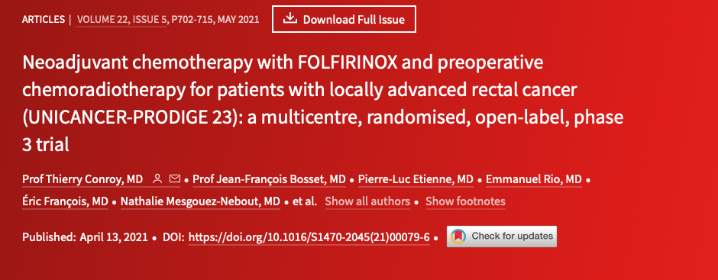
PRODIGE 23 trial: CRT->FOLFIRINOX x3m ->TME-> FOLFOX x3 m vs standard approach
cPR 27 vs11.7% improved DFS, Met FS,
OS is not mature

Slide 20
Omit surgery !
Meta analysis of 23 studies: 867 pts, with patient who has clinical complete remission
Local regrowth rate in non operative group 15-25%
Most of them can be successfully treated with salvage therapy
Non operative approach is still not standard of care, and it should be done only in centers with experienced multidisciplinary team

Slide 21
Omit radiation ?
FOWARC trial: phase III trial in China,
Neoadj FOLFOX vs CRT
Similar rate of local recurrence , 3 yr DFS, 3 yr OS
PROSPECT trial: 2023 ASCO standard of care vs FOLFOX with selective use of CRT
Include: cT2N+, cT3
Exclude: T4, distal tumor, threatened CRM, > 4 LN
Intervention group: FOLFOX x6 -> restage.
If regression >20% proceed with TME
If regression < 20% proceed with CRT then TME
Results: 9% of the intervention arm needed CRT
5yr DFS 78 % vs 80 meeting non inferiority cutoff

Slide 23
Immunotherapy
5% of rectal cancer are MSI-H
Single institution phase II study. Dostarlimab /PDL1i was used in 12 pts with locally advanced rectal ca with MSI-H
100% clinical complete response with median fu 12 months
Omit RT and surgery ? !

Slide 24
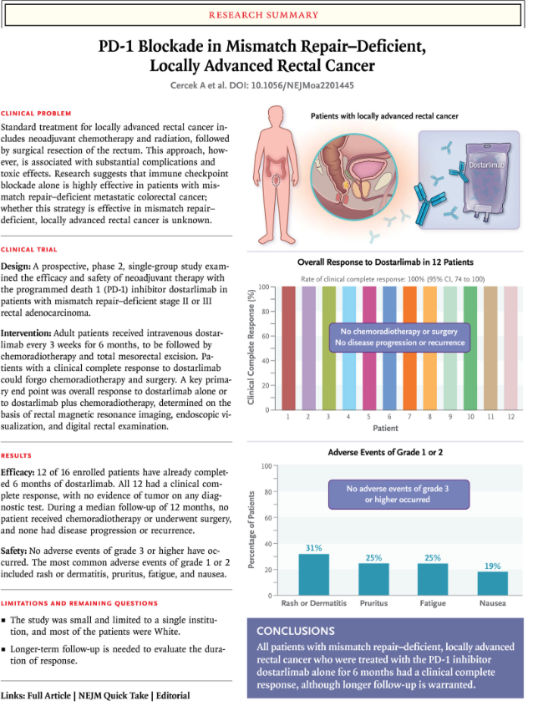

Slide 25
Biologic
VEGFi did show improved response rate but with more wound and healing complications
EGFR antibodies: did not show improved response rates

