Slide 1
Multidisciplinary Approach to Rectal Cancer
Dr. Scott dolejs, colorectal surgeon
Dr. Sandeep bhave, radiation oncologist
Dr. Nibal saad, medical oncologist
Leslie woodard, CTR

Slide 2
Rectal Cancer: Diagnosis, Staging, and Surgical Approach
Scott Dolejs, MD Msc

Slide 3
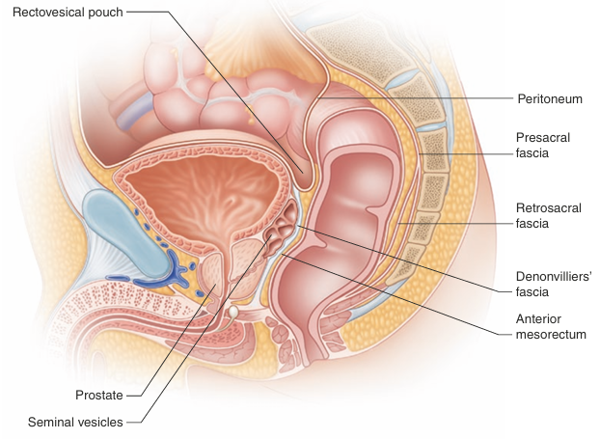
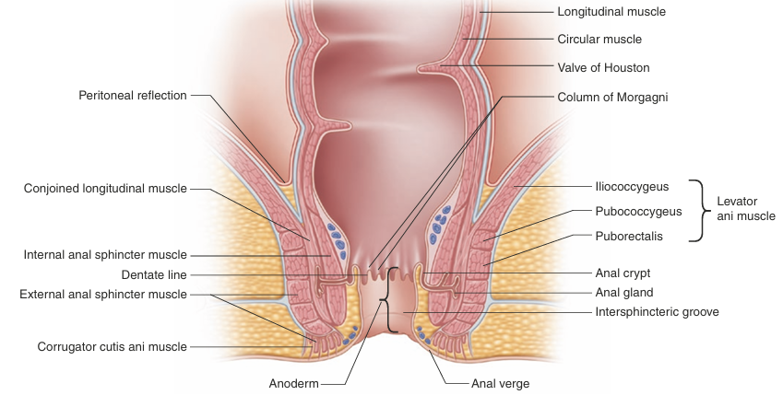
Anatomy of the Rectum

Slide 4
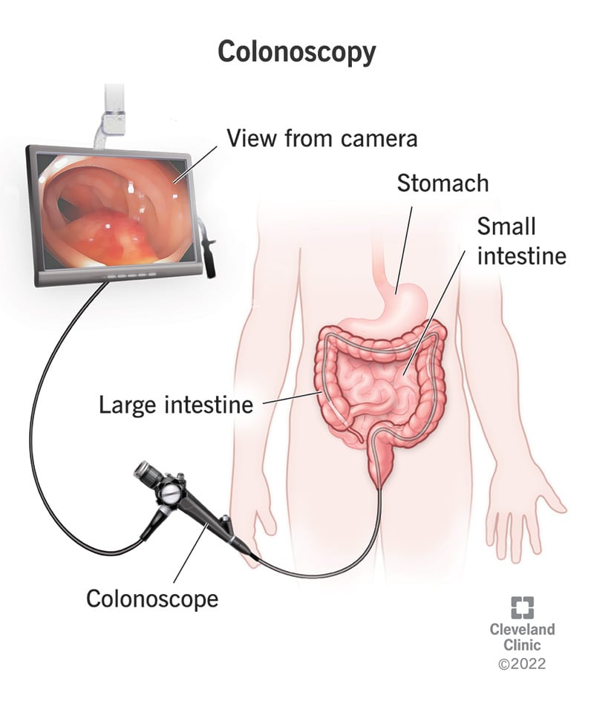
Diagnosis

Slide 5
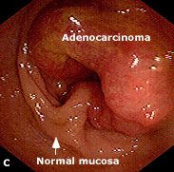
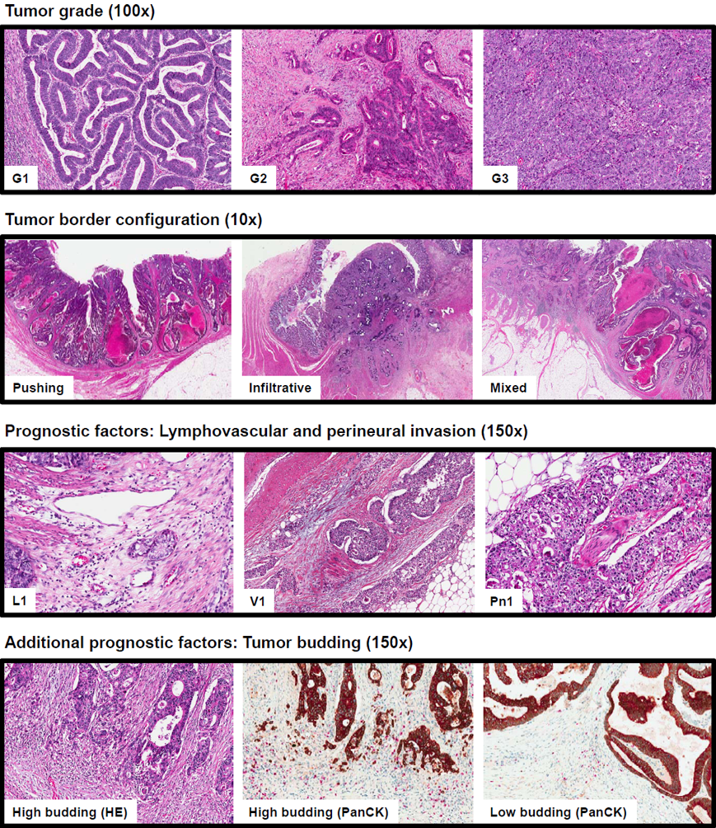
Diagnosis

Slide 6
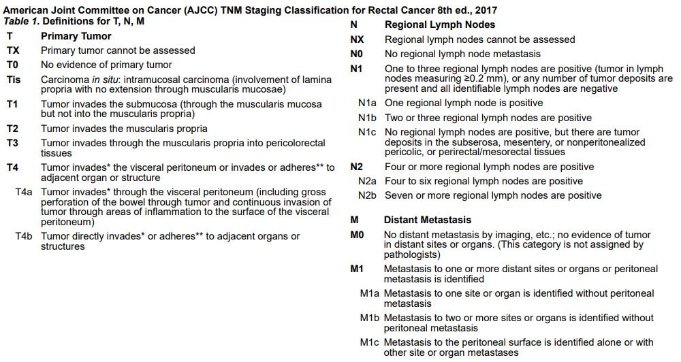
Staging

Slide 7
Staging: T-Stage

Slide 8
Staging
Locoregional Extent of Disease:
MRI
T1/2 vs T3/4: Sensitivity of 87% and Specificity of 71%
Lymph Node Involvement: Sensitivity 77% and Specificity of 71%
Circumferential Resection Margin Status: Sensitivity 77% and Specificity 94%
Transrectal US
BETTER SENSITIVITY AND SPECIFICITY FOR T1, T2, T3, and T4 disease (in the 90% range)
Similar for lymph node involvement
CANNOT detect circumferential resection margin status
Metastatic Work-Up:
CT chest/abdomen/pelvis
CEA
Genetic Counseling and Genetic Panels

Slide 9
Changes in Treatment

Slide 10
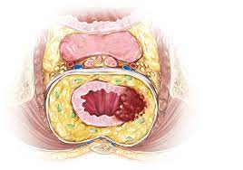
Changes in Treatment
Pure resectional management, no anatomic planes, all abdominoperineal resections, tons of morbidity
Rates of recurrence and morbidity
dropped with holy plane
Recurrence 15-45% to 7-10%

Slide 11
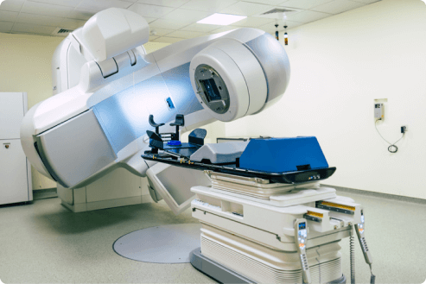
Changes in Treatment
Preoperative Radiation Therapy
Preoperative RT compared to postoperative RT reduced risk of recurrence from 13% to 6% in German Rectal Cancer Study
Preoperative RT versus good surgery in patients with T3 or N+ patients reduced risk of recurrence from 11% to 6% in Dutch TME trial
Selective withholding of RT in recent PROSPECT trial

Slide 12
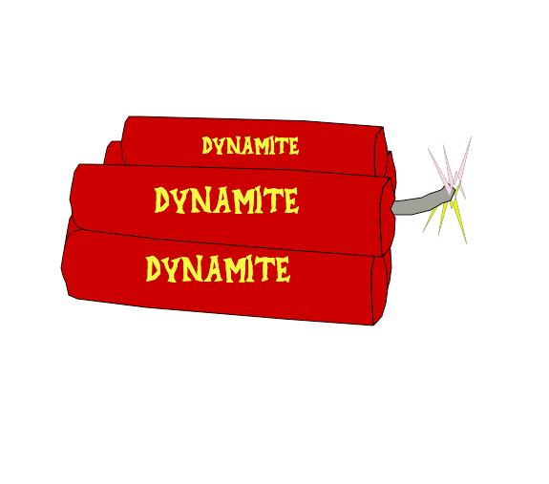
Changes in Treatment

Slide 13
Changes in Treatment

Slide 14
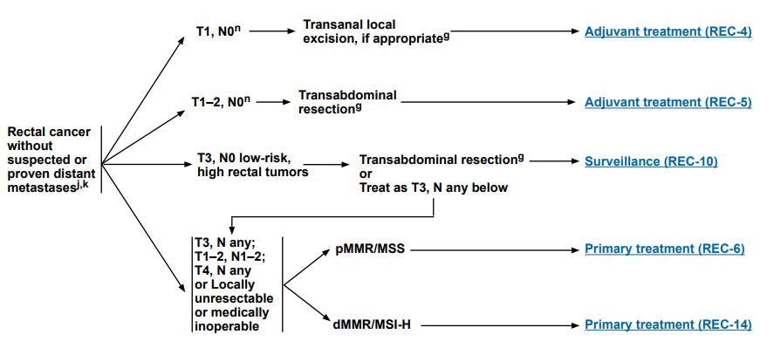
Surgical Approaches:
TAMIS, TEM, LAR, APR, DLI, WW

Slide 15
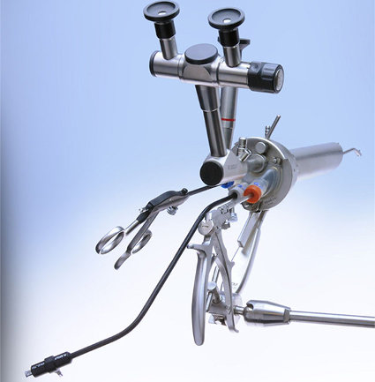
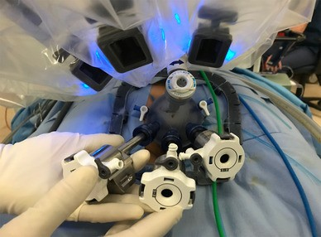
Surgical Approaches: TAMIS and TEM
Transanal Minimally Invasive Surgery
Transanal Endoscopic Microsurgery

Slide 16
Surgical Approaches: TAMIS and TEM

Slide 17
Surgical Approaches: TAMIS

Slide 18
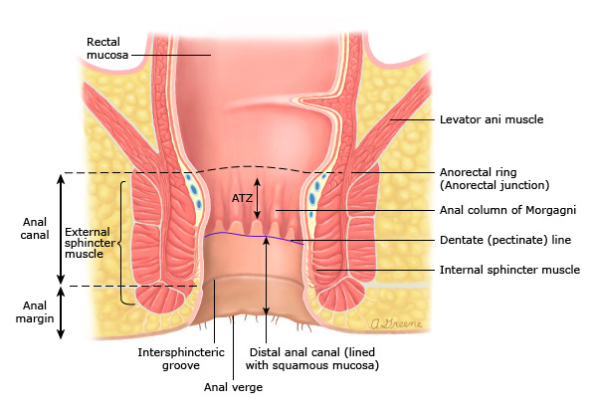
Surgical Approaches: LAR versus APR

Slide 19
Surgical Approaches: The Holy Plane

Slide 20
Role of Radiation Therapy in Rectal Cancer
Sandeep R. Bhave, MD, MS, DABR
Radiation Oncologist, Cancer Care Group
Medical Director, Healthy Living Center
Franciscan Health Cancer Center
Notes:
Good morning, everyone my name is Dr. Sandeep Bhave, and I am a radiation oncologist at CCG. I also am medical director for the healthy living center at Franciscan Health, Indianapolis. I look forward to discussing with you this broad topic of the role of radiation therapy in rectal cancer.

Slide 21
Conflicts of Interest
None

Slide 22
Work-up
H&P:
N/V, diarrhea, constipation, stool change, BRBPR, pain, HNPCC, UC (20x ↑ risk)
-Exam:
Inguinals, abdomen, rectal, female pelvic; fixed/tethered, circumferential involvement, distance from verge, sphincter tone
Labs: CBC, CMP, LFTs, CEA
Imaging:
CT C/A/P w oral and IV contrast (PET not indicated per NCCN)
MRI pelvis w/ endorectal coil (for T staging; NCCN preferred.
Rectal protocol small FOV T2 perpendicular to plane of rectum
If no MRI, get EUS- cannot tell CRM or EMVI but better for telling between T1/T2
Procedures
Proctoscopy with biopsy
MMR /MSI 15% CRC
2. Full colonoscopy to look for synchronous lesions

Slide 23
T Stage
Tis: Lamina propria, muscularia mucosae
T1: submucousa
T2: muscularis propria
T3: pericolorectal tissue, through serosa
T4a: Visceral peritoneum
T4b: Adjacent organs
On exam:
T2 = mobile
T3 = tethered
T4 = fixed

Slide 24
Lymph Node Drainage
Lymph node drainage:
Proximal rectum: inferior mesenteric artery → porta hepatis → liver
Distal rectum: internal iliac artery → inferior vena cava → lung
Anus/sphincter (below dentate line) drains to inguinals ® external iliac
Rectum is ~16 cm long and starts at rectosigmoid junction (peritoneal reflection) → dentate line (S3) and ends at anorectal ring
Upper, middle, lower portions
Mesorectal fat surrounds to reflxn
Notes:
(covering inguinals is controversial)

Slide 25
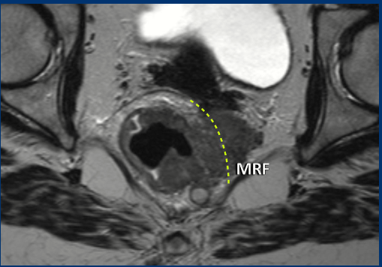
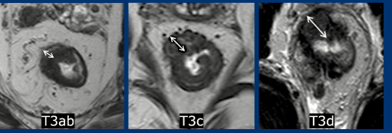
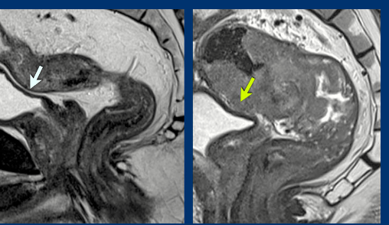
T stage
Notes:
L-R
Normal anatomy
T2
T3
T4
Second row
Normal peritoneal reflection
MRF involvement
MRF involvement
T3
No involvement of ant peritoneal and then on R its involved

Slide 26
N and M stage
Nodal staging
N1a: 1
N1b: 2-3
N1c: Tumor deposits in subserosa or mesentery w/o regional nodal mets
N2a: 4-6
N2b: 7+
M1a: 1 organ or single non-regional node
M1b: > 2 organs without peritoneal mets
M1c: peritoneal mets

Slide 27
Overall Stage
Stage I: T1-2 N0
Stage IIA: T3 N0
Stage IIB/C: T4a/T4b N0
Stage IIIA: T1-2N1/N1c or T1N2a
Stage IIIB: T3-4a N1/N1c or T2-3 N2a or T1-2 N2b
Stge IIIC: T4a N2a or T3-4a N2b or T4b N1-2
Stage IVA: M1a
Stage IVB: M1b
Stage IVC: M1c

Slide 28
Primary Management Stage 3

Slide 29
TME
sharp dissection of entire mesorectum (peri-rectal fat, pre-sacral space), ↓ (+) radial margins
improved LC (90 vs. 75%). ALL GET TME
4-5 cm margin (maybe only be 1-2 cm if low-lying
How many nodes? 12-14
LAR
(> 5 cm from verge): mid-upper lesions and spares sphincter
APR:
3-5 cm from verge): for low-lying lesions
Notes:
Goal 14 nodes for full eval (Tepper et al data suggests best OS/PFS w/ this); Kachnic (SR ’17) said 12)

Slide 30
Radiation therapy for rectal cancer

Slide 31
Can we avoid RT in some T3 tumors?

Slide 32
Short Course RT

Slide 33
High Risk Rectal Ca

Slide 34
TNT

Slide 35
Increased pCR with increasing cycles of FOLFOX

Slide 36
RAPIDO+PRODIGE-23
Notes:
RAPIDO did not mandate chemo in the standard arm < 50% got adjuvant chemo

Slide 37
OPRA

Slide 38
OPRA

Slide 39
OPRA
Notes:
Findings seem to indicate that concurrent CRT→ chemo has better TME free survival

Slide 40
Non-operative management continued

Slide 41
CT simulation with IV and oral contrast
Prone, arms up, belly board, wire scars (for APR), marker at anal verge, vaginal marker for female, full bladder.
CT from L1 to mid femur
Daily CBCT for bladder filling
CTV_45 Gy: all gross disease, entire mesorectum, presacral, internal iliac nodes (external lilacs also if T4, anal canal)
CTV_50.4: GTV (or pre-op tumor) + 3 cm + presacral nodes and mesorectum/sacral hollow→

Slide 42
Acute toxicity of RT
Diarrhea
Acute proctitis
Thrombocytopenia
Leukopenia
Dysuria
5FU toxicity
Cardiac toxicity including CP, MI, A fib, myocarditis
Vasospasm STE
12 hrs after initiation to 1-2 d
Mechanism.
Altered DPD enzyme activity--> toxic fluroacetate--> ischmemia/Takasubo--> vasospasm
Prevention
Infusion rather than bolus
Imdur +CCB --> 12 min push with cardiologist present
12 hrs after repeat this
Penn Case series: 100% got through treatment (N <20)

Slide 43
Late Toxicity:
Peristent diarrhea, proctitis, frequent BMs
Anastamotic Strictures
SBO
Incontinence
Impotence/Sterility
Vaginal dilators for females!
Swedish 5x5 major complication was SBO, but also:
1) Bowel frequency
2) Fecal incontinence
3) Impaired social life

Slide 44
Thank you!
Questions?

Slide 45
Treatment of Non metastatic rectal cancer- Medical Oncology perspective
Dr. Nibal Saad
Oncology & Hematology Specialists
Franciscan Physician Network

Slide 46
Colon vs rectal cancer
Although pathology of rectal cancer is similar to colon cancer, the anatomic location of rectum made local recurrence big challenge.
That makes multidisciplinary approach very important to decrease local recurrence rate and improve cancer control
Staging:
MRI pelvis vs EUS
CT CAP
No PET scan

Slide 47
Surgery
Surgery alone is appropriate for T1 disease, otherwise chemotherapy and radiation therapy are needed
With multidisciplinary approach, 5 yrs local recurrence rate dropped to 5-10%
Preferred surgery is TME

Slide 48
To improve over surgery alone, two approaches were used
PreOperative Short course RT 5 Gyx 5 days (compared with surgery alone, Swedish trial: local recurrence 11 vs 27%, 5yrs-OS 58 vs 48%, another Dutch trial showed improved local recurrence but not OS), or
PreOperarive Concurrent Chemo radiation with 50.4 Gy (45+ 5.4 Gy local boost) over 5-6 weeks with radio sensitizing chemotherapy
Both approaches decreased loco regional failure
For sphincter preserving surgery however, only prolonged CRT approach showed enough tumor shrinkage
Prolonged CRT approach is the preferred one in USA

Slide 49
History of multimodality approach
Surgery < surgery + RT (short course or long course): combination therapy won
(Swedish trial:
local recurrence 11 vs 27%,
5yrs-OS 58 vs 48%
N Engl J Med 1997; 336:980-987
another Dutch trial showed improved local recurrence but not OS),

Slide 50
Surgery+ adj RT < Surgery+ adj CRT (5FU based chemo): tri modality won
local recurrence 25 vs 13%, distant mets 46 vs 29%,
Krook et al NEJM 1991

Slide 51
Surgery + CRT (5FU bolus) < surgery + CRT (5FU continuous)
relapse 53 vs 63%, OS 60 vs 70%
O'Connell et al NEGM 1994

Slide 52
Surgery + adj CRT continuous 5FU = Surgery + adj CRT Capcitabine.
(3 yrs DFS 67vs 75%, 5yr OS 67 VS76%)
Hofleinz et al Lancet oncol 2012
Currently either cont 5FU or Capecitabine with RT are acceptable standard of care

Slide 53
surgery + adj CRT < neoadj CRT+ surgery
Local recurrence 13 vs 6%, OS 74vs76 %, G3-4 tox 40 vs 27% .
Sauer et al NEJM 2004
Pt who gets upfront surgery for presumed T1 disease but ends up with more advanced disease should get adj CRT

Slide 54
Neoadj CRT + surgery vs Neoadj CRT (oxaliplatin based),
oxaliplatin was associated with more toxicity

Slide 55
Adjuvant chemotherapy after neoadjuvant CRT and surgery
Meta analysis did not show benefit of adjuvant chemo. That was done on old chemo regimens however
ADORE trial, 2019, a phase III Korean trial on patient who received neoadjuvant CRT and had postoperative stage II and III. Compared adj 5fU vs FOLFOX. 6 yr DFS 68% vs 57%
NCCN still recommend adj chemotherapy even in cPR patients

Slide 56
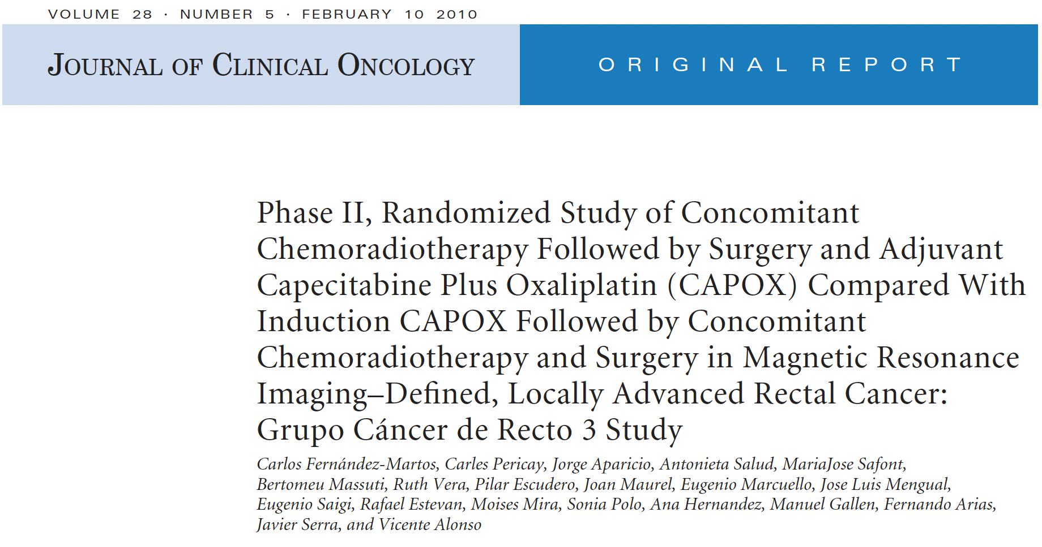
TNT
CAPOX+RT then Surgery then CAPOX x4 vs TNT (CAPOX x4 ->CAPOX+RT -> surgery.
cPR same, G3 tox was less in TNT 19 vs54%

Slide 58
CRT + 0, 2, 4, 6 cycles of FOLFOX
TNT improved cPR compared with no neoadj chemo 38 vs 18%

Slide 59
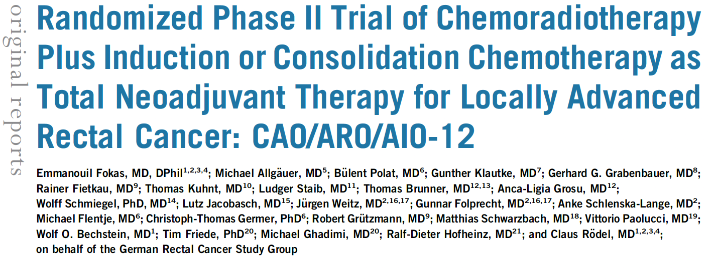
TNT
CAO/ARP/AIO-12 phase II trial : TNT with consolidative chemo (FOLFOX) vs TNT with induction chemo
Better cPR in consolidation chemo 25 vs 17%

Slide 60
OPRA trial : TNT with consolidative chemo vs TNT with induction chemo
3 yr total mesorectal free survival 41% (induction chemo)vs 53% in the consolidation group
3yr DFS similar

Slide 62
RAPIDO trial:
Short course RT then chemo then surgery vs CRT->Sx->chemo
TNT showed better cPR 28 vs14%, better 3 yrs distant met free survival 27 vs 20%, OS same

Slide 63
PRODIGE 23 trial: CRT->FOLFIRINOX x3m ->TME-> FOLFOX x3 m vs standard approach
cPR 27 vs11.7% improved DFS, Met FS,
OS is not mature

Slide 64
Omit surgery !
Meta analysis of 23 studies: 867 pts, with patient who has clinical complete remission
Local regrowth rate in non operative group 15-25%
Most of them can be successfully treated with salvage therapy
Non operative approach is still not standard of care, and it should be done only in centers with experienced multidisciplinary team

Slide 65
Omit radiation ?
FOWARC trial: phase III trial in China,
Neoadj FOLFOX vs CRT
Similar rate of local recurrence , 3 yr DFS, 3 yr OS
PROSPECT trial: 2023 ASCO standard of care vs FOLFOX with selective use of CRT
Include: cT2N+, cT3
Exclude: T4, distal tumor, threatened CRM, > 4 LN
Intervention group: FOLFOX x6 -> restage.
If regression >20% proceed with TME
If regression < 20% proceed with CRT then TME
Results: 9% of the intervention arm needed CRT
5yr DFS 78 % vs 80 meeting non inferiority cutoff

Slide 67
Immunotherapy
5% of rectal cancer are MSI-H
Single institution phase II study. Dostarlimab /PDL1i was used in 12 pts with locally advanced rectal ca with MSI-H
100% clinical complete response with median fu 12 months
Omit RT and surgery ? !

Slide 68
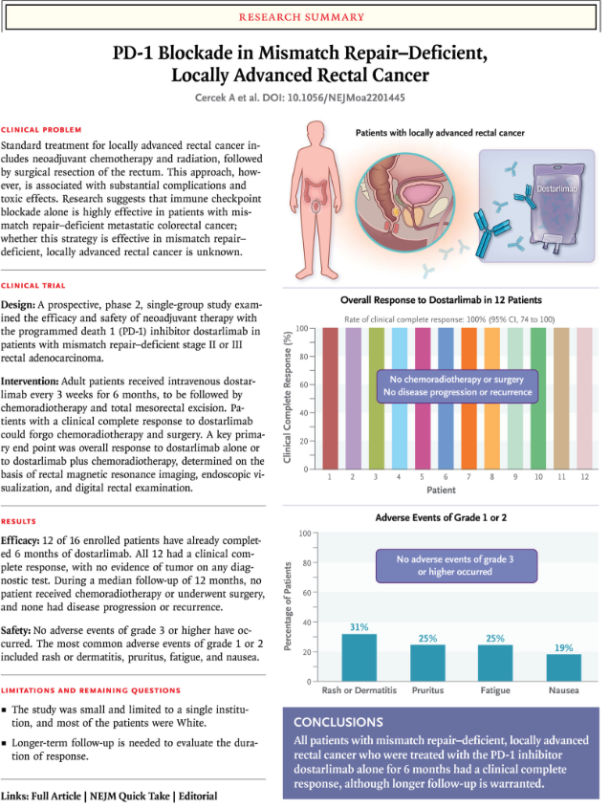

Slide 69
Biologic
VEGFi did show improved response rate but with more wound and healing complications
EGFR antibodies: did not show improved response rates

Slide 70
Abstracting Rectal Cancer
Leslie Woodard, CTR
ICRA Education Chair
Tumor registry Manager, Franciscan Health System
November 2023

Slide 71
Case #1
For the purposes of training/registry coding, we are following the store 2023 rules, even though the case was not diagnosed in 2023. if this was a case you were abstracting, you would follow the store manual from the year of diagnosis.

Slide 72
Presentation
4/9/21 Rectal bx @ Outside Facility = Adenocarcinoma, moderately well-differentiated. Negative for angiolymphatic invasion. IHC stable.
4/16/21 CT CAP: Circumferential rectal thickening with subtle perirectal stranding. No focal fluid collection or pelvic lymphadenopathy. No evidence for metastatic disease.
4/16/11 CEA: 8.7 (elevated)
4/23/21 Rectal cancer MRI: Tumor penetrates through surface of visceral peritoneum with no evidence for tumor invasion into pelvic organs or sacrum. T4a N2 rectal tumor with at least 7 suspicious mesorectal nodes.
5/12/21-8/25/21: 8 cycles FOLFOX @ my facility
9/20/21: Capecitabine w/ XRT @ my facility
Radiation:

Slide 73
Presentation
12/1/21 Rectal cancer MRI: Compared to 04/23/2021, the patient's semiannular rectal mass is significantly decreased in size. The mass is now characterized by areas of fibrosis with small volume of suspected residual viable tumor. Tumor/fibrosis extends beyond the muscularis propria with spiculations extending to the anterior peritoneal reflection, which is not clearly involved by residual tumor. Markedly decreased size of previously enlarged suspicious mesorectal lymph nodes. No suspicious mesorectal or extra mesorectal lymph nodes are identified.
1/4/22 Colonoscopy: Minimal residual tumor/scar in mid rectum, otherwise clear colon.
1/5/22-1/8/22 Robotic-assisted laparoscopic LAR @ My Facility: Grade 2 adenocarcinoma, 1.9 cm, invades through muscularis propria into pericolorectal tissue. No LVI pr PNI. Treatment effect present (partial response, score 2). Macroscopic evaluation of mesorectum complete. Margins all negative, distance from invasive carcinoma to radial margin is 1.3 cm. 0/17 lymph nodes. No tumor deposits. ypT3 N0 M N/A.
3/2/22 Dr. Bhave follow-up states NED
9/22/23 Dr. Bhave follow-up states doing well with interval CT scan and CEA showing NED

Slide 74
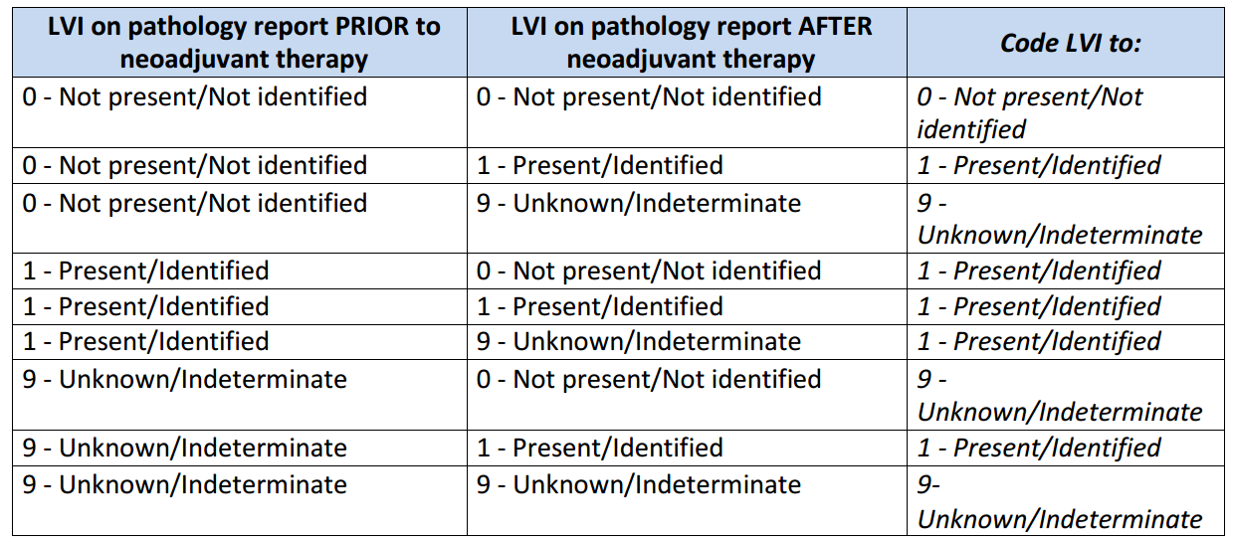
4/9/21 Rectal bx @ Outside Facility = Adenocarcinoma, moderately well-differentiated. Negative for angiolymphatic invasion. IHC stable.
1/5/22 Robotic-assisted laparoscopic LAR @ My Facility: Grade 2 adenocarcinoma, 1.9 cm, invades through muscularis propria into pericolorectal tissue. No LVI pr PNI. Treatment effect present (partial response, score 2). Macroscopic evaluation of mesorectum complete. Margins all negative, distance from invasive carcinoma to radial margin is 1.3 cm. 0/17 lymph nodes. No tumor deposits. ypT3 N0 M N/A.
Date of Initial Diagnosis
8140/3
Sequence Number
00
04/09/2021
Primary Site
Histology
C20.9
Laterality
Tumor Size Summary
0
Lymphovascular Invasion
999
Diagnostic Confirmation
0
1

Slide 75
1/5/22 Robotic-assisted laparoscopic LAR @ My Facility: Grade 2 adenocarcinoma, 1.9 cm, invades through muscularis propria into pericolorectal tissue. No LVI pr PNI. Treatment effect present (partial response, score 2). Macroscopic evaluation of mesorectum complete. Margins all negative, distance from invasive carcinoma to radial margin is 1.3 cm. 0/17 lymph nodes. No tumor deposits. ypT3 N0 M N/A.
Regional Lymph Nodes Positive
01/05/2022
Sentinel Lymph Nodes Positive
00
Regional Lymph Nodes Examined
Date of Regional Lymph Node Dissection
17
Sentinel Lymph Nodes Examined
Date of Sentinel Lymph Node Biopsy

Slide 76
Diagnosed via colonoscopy w/ biopsy outside facility 4/9/21
Chemoradiation at my facility 5/12/21-10/27/21
Surgery at my facility 1/5/22
Class of Case
Date of First Contact
22
05/12/2021

Slide 77
AJCC Staging
4/9/21 Rectal bx @ Outside Facility = Adenocarcinoma, moderately well-differentiated. Negative for angiolymphatic invasion. IHC stable.
4/16/21 CT CAP: Circumferential rectal thickening with subtle perirectal stranding. No focal fluid collection or pelvic lymphadenopathy. No evidence for metastatic disease.
4/16/11 CEA: 8.7 (elevated)
4/23/21 Rectal cancer MRI: T4a N2 rectal tumor with at least 7 suspicious mesorectal nodes.
12/1/21 Rectal cancer MRI: Compared to 04/23/2021, the patient's semiannular rectal mass is significantly decreased in size. The mass is now characterized by areas of fibrosis with small volume of suspected residual viable tumor. Tumor/fibrosis extends beyond the muscularis propria with spiculations extending to the anterior peritoneal reflection, which is not clearly involved by residual tumor. Markedly decreased size of previously enlarged suspicious mesorectal lymph nodes. No suspicious mesorectal or extra mesorectal lymph nodes are identified.
1/4/22 Colonoscopy: Minimal residual tumor/scar in mid rectum, otherwise clear colon.
cT
4a
cN
2b
cM
Stage Group
Clinical
0
IIIC
Grade
2
Post Therapy Clinical
ycT
ycN
0
ycM
0
Stage Group
N/A
3
Grade
9

Slide 78
AJCC Staging
1/5/22 Robotic-assisted laparoscopic LAR @ My Facility: Grade 2 adenocarcinoma, 1.9 cm, invades through muscularis propria into pericolorectal tissue. No LVI pr PNI. Treatment effect present (partial response, score 2). Macroscopic evaluation of mesorectum complete. Margins all negative, distance from invasive carcinoma to radial margin is 1.3 cm. 0/17 lymph nodes. No tumor deposits. ypT3 N0 M N/A.
pT
pN
pM
Stage Group
Pathological
Grade
9
Post Therapy Pathological
ypT
ypN
0
ypM
0
Stage Group
IIA
3
Grade
2

Slide 79
Summary Stage
4/9/21 Rectal bx @ Outside Facility = Adenocarcinoma, moderately well-differentiated. Negative for angiolymphatic invasion. IHC stable.
4/16/21 CT CAP: Circumferential rectal thickening with subtle perirectal stranding. No focal fluid collection or pelvic lymphadenopathy. No evidence for metastatic disease.
4/16/11 CEA: 8.7 (elevated)
4/23/21 Rectal cancer MRI: Tumor penetrates through surface of visceral peritoneum with no evidence for tumor invasion into pelvic organs or sacrum. T4a N2 rectal tumor with at least 7 suspicious mesorectal nodes.
1/5/22 Robotic-assisted laparoscopic LAR @ My Facility: Grade 2 adenocarcinoma, 1.9 cm, invades through muscularis propria into pericolorectal tissue. No LVI pr PNI. Treatment effect present (partial response, score 2). Macroscopic evaluation of mesorectum complete. Margins all negative, distance from invasive carcinoma to radial margin is 1.3 cm. 0/17 lymph nodes. No tumor deposits. ypT3 N0 M N/A.
4 Regional by BOTH direct extension AND regional lymph node(s) involved

Slide 80
SSDIs
4/9/21 Rectal bx @ Outside Facility = Adenocarcinoma, moderately well-differentiated. Negative for angiolymphatic invasion. IHC stable.
4/16/11 CEA: 8.7 (elevated)
1/5/22 Robotic-assisted laparoscopic LAR @ My Facility: Grade 2 adenocarcinoma, 1.9 cm, invades through muscularis propria into pericolorectal tissue. No LVI pr PNI. Treatment effect present (partial response, score 2). Macroscopic evaluation of mesorectum complete. Margins all negative, distance from invasive carcinoma to radial margin is 1.3 cm. 0/17 lymph nodes. No tumor deposits. ypT3 N0 M N/A.
CEA PreTX Lab Value
8.7
CEA PreTX Interpretation
1
Tumor Deposits
00
Perineural Invasion
0
Circumferential Resection Margin
13.0
KRAS
9

Slide 81
SSDIs
4/9/21 Rectal bx @ Outside Facility = Adenocarcinoma, moderately well-differentiated. Negative for angiolymphatic invasion. IHC stable.
4/16/11 CEA: 8.7 (elevated)
1/5/22 Robotic-assisted laparoscopic LAR @ My Facility: Grade 2 adenocarcinoma, 1.9 cm, invades through muscularis propria into pericolorectal tissue. No LVI pr PNI. Treatment effect present (partial response, score 2). Macroscopic evaluation of mesorectum complete. Margins all negative, distance from invasive carcinoma to radial margin is 1.3 cm. 0/17 lymph nodes. No tumor deposits. ypT3 N0 M N/A.
Microsatellite Instability (MSI)
0
BRAF Mutational Analysis
9
NRAS Mutational Analysis
9
*Macroscopic Evaluation of the Mesorectum
30
*Not a SSDI

Slide 82
Surgery
4/9/21 Rectal bx @ Outside Facility = Adenocarcinoma, moderately well-differentiated. Negative for angiolymphatic invasion. IHC stable.
1/5/22-1/8/22 Robotic-assisted laparoscopic LAR @ My Facility: Grade 2 adenocarcinoma, 1.9 cm, invades through muscularis propria into pericolorectal tissue. No LVI pr PNI. Treatment effect present (partial response, score 2). Macroscopic evaluation of mesorectum complete. Margins all negative, distance from invasive carcinoma to radial margin is 1.3 cm. 0/17 lymph nodes. No tumor deposits. ypT3 N0 M N/A.
Reason for No Surgery of Primary Site
0
Date 1st Surgical Procedure
01/05/2022
Date of Most Definitive Surgical Resection
01/05/2022
Date of Surgical Discharge
01/08/2022
Surgical Diagnostic and Staging Procedure
02
Date of Surgical Diagnostic and Staging Procedure
04/09/2021

Slide 83
Surgery
4/9/21 Rectal bx @ Outside Facility = Adenocarcinoma, moderately well-differentiated. Negative for angiolymphatic invasion. IHC stable.
1/5/22-1/8/22 Robotic-assisted laparoscopic LAR @ My Facility: Grade 2 adenocarcinoma, 1.9 cm, invades through muscularis propria into pericolorectal tissue. No LVI pr PNI. Treatment effect present (partial response, score 2). Macroscopic evaluation of mesorectum complete. Margins all negative, distance from invasive carcinoma to radial margin is 1.3 cm. 0/17 lymph nodes. No tumor deposits. ypT3 N0 M N/A.
Surgical Margins of the Primary Site
A300
Rx Summ – Surg 2023
A300
0
Scope of Regional LN Surgery
Rx Hosp – Surg 2023
5
Approach – Surgery of the Primary Site at this Facility
1

Slide 84
Treatment
4/9/21 Rectal bx @ Outside facility
5/12/21-8/25/21: 8 cycles FOLFOX @ my facility
9/20/21: Capecitabine w/ XRT @ my facility
1/5/22 LAR @ my facility
Date of First Course of Treatment
05/12/2021
Date Systemic Therapy Started
05/12/2021
Systemic/Surgery Sequence
2
Chemotherapy
03
Immunotherapy
00
Hormone Therapy
00
Rx Summ – Treatment Status
1

Slide 85
Radiation
Reason for No Radiation
0 Radiation was administered
Date Radiation Started
09/20/2021
Date Radiation Ended
10/27/2021
Radiation Treatment Discontinued Early
01 Radiation treatment completed as prescribed
Radiation Course Total Dose
005040
Number of Phases of Radiation Treatment
02

Slide 86
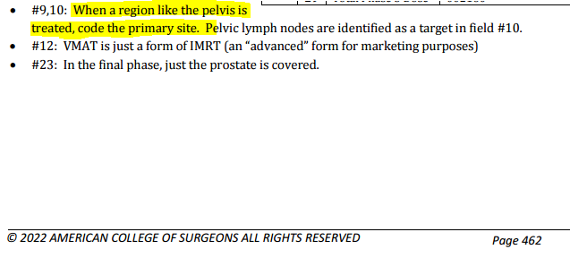
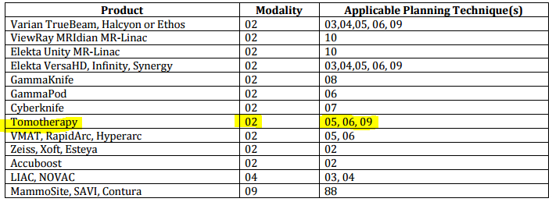
Phase I
Radiation Primary Treatment Volume
54 Rectum
Radiation to Draining Lymph Nodes
06 Pelvic lymph nodes
Radiation Treatment Modality
02 External beam, photons
External beam Radiation Planning Technique
05 Intensity modulated therapy
Dose per Fraction
00180
Number of Fractions
025
Total Dose
004500

Slide 87
Phase II
Radiation Primary Treatment Volume
54 Rectum
Radiation to Draining Lymph Nodes
00
Radiation Treatment Modality
02 External beam, photons
External beam Radiation Planning Technique
05 Intensity modulated therapy
Dose per Fraction
00180
Number of Fractions
003
Total Dose
000540

Slide 88
Phase III
Radiation Primary Treatment Volume
Radiation to Draining Lymph Nodes
Radiation Treatment Modality
External beam Radiation Planning Technique
Dose per Fraction
Number of Fractions
Total Dose
LEAVE BLANK

Slide 89
Outcomes
1/5/22-1/8/22 Robotic-assisted laparoscopic LAR @ My Facility: Grade 2 adenocarcinoma, 1.9 cm, invades through muscularis propria into pericolorectal tissue. No LVI pr PNI. Treatment effect present (partial response, score 2). Macroscopic evaluation of mesorectum complete. Margins all negative, distance from invasive carcinoma to radial margin is 1.3 cm. 0/17 lymph nodes. No tumor deposits. ypT3 N0 M N/A.
3/2/22 Dr. Bhave follow-up states NED
9/22/23 Dr. Bhave follow-up states doing well with interval CT scan and CEA showing NED
Date of First Recurrence
Type of First Recurrence
00
Date of Last Cancer (tumor) Status
01/05/2022
Cancer Status
1
Vital Status
1

Slide 90
Case #2
For the purposes of training/registry coding, we are following the store 2023 rules, even though the case was not diagnosed in 2023. if this was a case you were abstracting, you would follow the store manual from the year of diagnosis.

Slide 91
Presentation
9/30/21 Screening Colonoscopy @ Outside Hospital = In the distal rectum there was an ulcerated sizable approximately 3 cm mass with a central ulceration. The edges were friable, and the central area appeared necrotic. This is consistent with a rectal cancer.
9/30/21 Biopsy of rectal mass @ Outside Hospital = Fragments of tubular adenoma, positive for high-grade dysplasia
10/11/21 CT CAP [Clinical indication: Malignant neoplasm of rectum] @ Outside Hospital = Asymmetric rectal wall thickening raising concern for rectal neoplasm given the current setting; no destructive fatty infiltration or pelvic lymphadenopathy. Negative chest CT.
10/14/21 Sigmoidoscopy w/ rectal bx @ My Facility = Superficial disrupted fragments of adenomatous epithelium with at least high-grade dysplasia. The patient's clinical history of a "rectal mass clinically suspicious for rectal cancer" is noted. Histologic sections demonstrate only superficial fragments of glandular type mucosa with adenomatous change and high-grade dysplasia. No definitive evidence of invasion and/or desmoplastic response is identified in the sections examined.
10/15/21 MRI Pelvis = T2/early T3 rectal cancer. No tumor deposits or lymph nodes.
Surgeon notes: Stage II rectal cancer based on all current available imaging.
11/3/21 Consult @ Outside facility #2 = Rectal mass concerning for rectal adenocarcinoma on endoscopic exam. Repeated biopsy. MRI consistent with T3 N0 disease, recommend TNT.
11/3/21 Rectal mass bx @ Outside facility #2 = Invasive adenocarcinoma, well differentiated, arising from tubulovillous adenoma. Mismatch Repair Protein Immunohistochemistry = Normal expression of MLH1, MSH2, MSH6, and PMS2
11/30/21 CEA = 2.4 (normal)

Slide 92
Presentation
FOLFOX 11/17/21-2/23/22 for T3 rectal cancer @ Outside facility
Xeloda + radiation 3/28/22-5/4/22 @ Outside facility. No radiation details available.
6/22/22 Sigmoidoscopy @ My facility = Flat scar noted in the rectum, smooth, consistent with complete clinical response.
6/22/22 Post-treatment MRI = No residual tumor. Discussed watch ‘n wait vs. surgery. Plan on repeat FFS and MRI in 3-4 months.

Slide 93
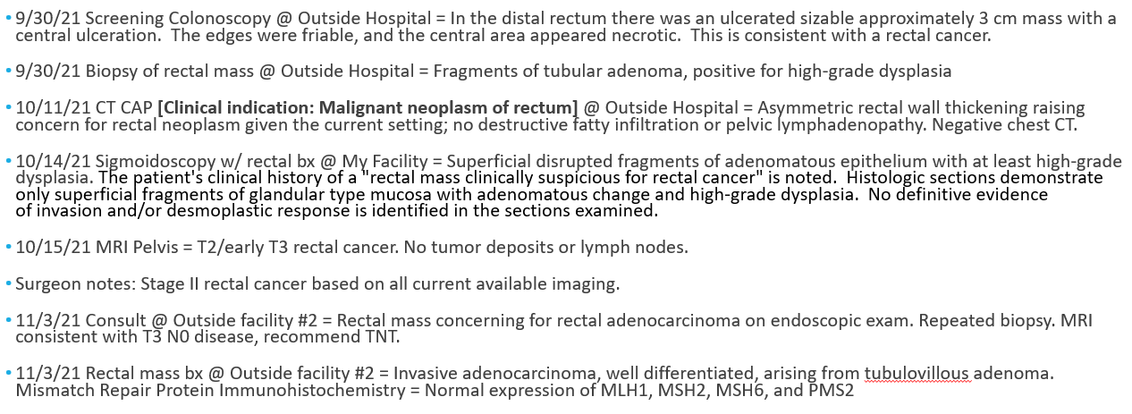
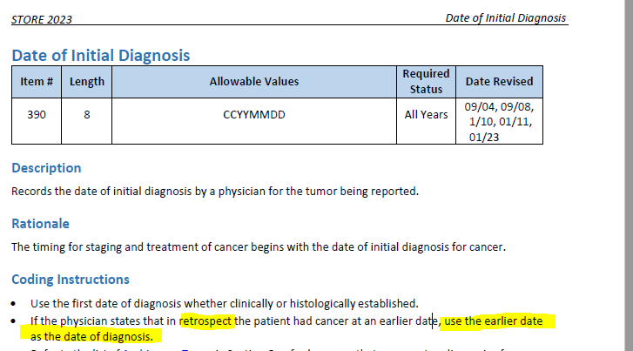
Date of Initial Diagnosis
8140/3
Sequence Number
00
09/30/2021
Primary Site
Histology
C20.9
Laterality
Tumor Size Summary
0
Lymphovascular Invasion
030
Diagnostic Confirmation
9
1

Slide 94
Regional Lymph Nodes Positive
Sentinel Lymph Nodes Positive
98
Regional Lymph Nodes Examined
Date of Regional Lymph Node Dissection
00
Sentinel Lymph Nodes Examined
Date of Sentinel Lymph Node Biopsy

Slide 95
Class of Case
Date of First Contact
30
10/14/2021
https://cancerbulletin.facs.org/forums/node/111546
https://cancerbulletin.facs.org/forums/node/130846#post130877

Slide 96
AJCC Staging
cT
3
cN
0
cM
Stage Group
Clinical
0
IIA
Grade
1
Post Therapy Clinical
ycT
ycN
0
ycM
0
Stage Group
N/A
0
Grade
9

Slide 97
AJCC Staging
pT
pN
pM
Stage Group
Pathological
Grade
9
Post Therapy Pathological
Grade
ypN
ypM
Stage Group
ypT

Slide 98
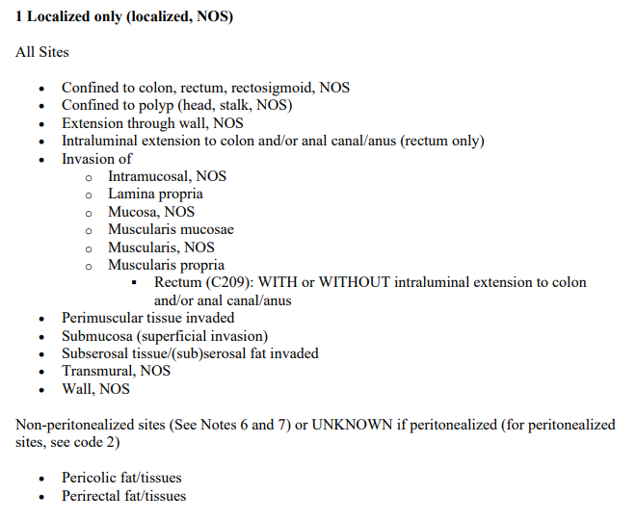
Summary Stage
10/15/21 MRI Pelvis = T2/early T3 low rectal cancer (the muscularis propria appears invaded and indistinct at several sites. Depth of extramural invasion is less than 1 mm). No tumor deposits or lymph nodes.
1

Slide 99
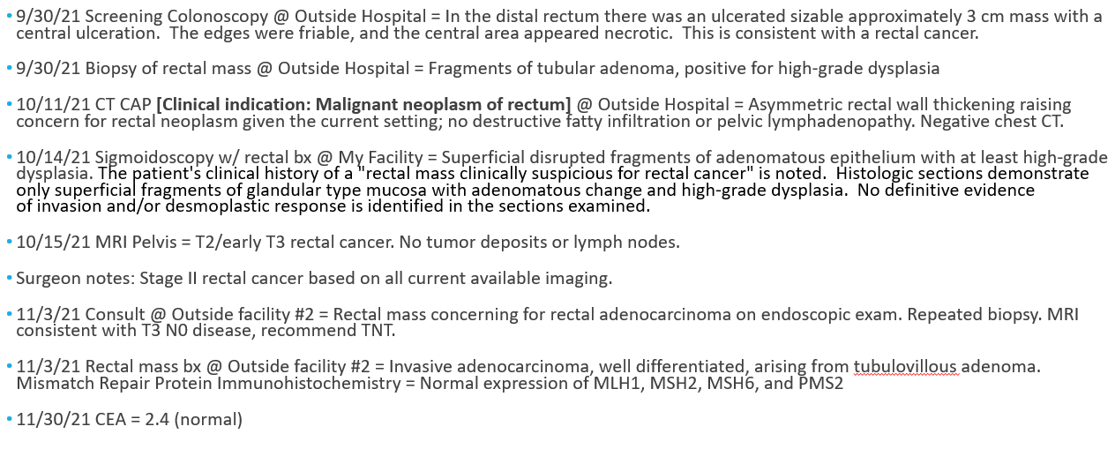
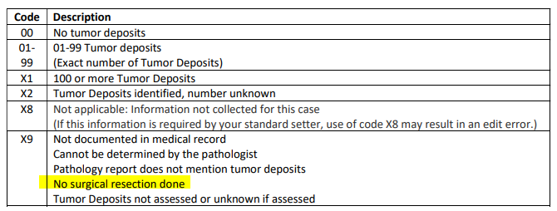
SSDIs
SSDIs
CEA PreTX Lab Value
XXXX.9
CEA PreTX Interpretation
9
Tumor Deposits
X9
Perineural Invasion
9
Circumferential Resection Margin
XX.7
KRAS
9

Slide 100
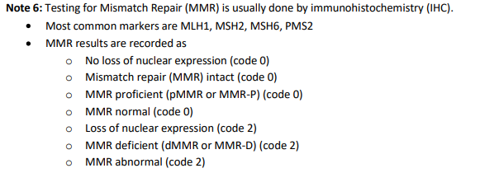
SSDIs
Microsatellite Instability (MSI)
0
BRAF Mutational Analysis
9
NRAS Mutational Analysis
9
*Macroscopic Evaluation of the Mesorectum
00
*Not a SSDI

Slide 101
Surgery
9/30/21 Biopsy of rectal mass @ Outside Hospital = Fragments of tubular adenoma, positive for high-grade dysplasia
10/14/21 Sigmoidoscopy w/ rectal bx @ My Facility = Superficial disrupted fragments of adenomatous epithelium with at least high-grade dysplasia. The patient's clinical history of a "rectal mass clinically suspicious for rectal cancer" is noted. Histologic sections demonstrate only superficial fragments of glandular type mucosa with adenomatous change and high-grade dysplasia. No definitive evidence of invasion and/or desmoplastic response is identified in the sections examined.
11/3/21 Rectal mass bx @ Outside facility #2 = Invasive adenocarcinoma, well differentiated, arising from tubulovillous adenoma. Mismatch Repair Protein Immunohistochemistry = Normal expression of MLH1, MSH2, MSH6, and PMS2
Surgical Diagnostic and Staging Procedure
1
Date 1st Surgical Procedure
Date of Most Definitive Surgical Resection
Date of Surgical Discharge
02
Date of Surgical Diagnostic and Staging Procedure
Reason for No Surgery of Primary Site
11/03/2021

Slide 102
Surgery
Surgical Margins of the Primary Site
A000
Rx Summ – Surg 2023
A000
8
Scope of Regional LN Surgery
Rx Hosp – Surg 2023
0
Approach – Surgery of the Primary Site at this Facility
0

Slide 103
Treatment
Date of First Course of Treatment
11/17/2021
Date Systemic Therapy Started
11/17/2021
Systemic/Surgery Sequence
0
Chemotherapy
03
Immunotherapy
00
Hormone Therapy
00
Rx Summ – Treatment Status
1

Slide 104
Radiation
Contacted outside facility CTR for details:
3/28/22 to 5/4/22: 3D Conformal/Photons to rectum/pelvis, total 5040 cGy in 28 fx. Initial dose of 4500 cGy in 25 fx to rectum/pelvis, boost to rectum of 540 cGy in 3 fx.
Reason for No Radiation
0 Radiation was administered
Date Radiation Started
03/28/2022
Date Radiation Ended
05/04/2022
Radiation Treatment Discontinued Early
01 Radiation treatment completed as prescribed
Radiation Course Total Dose
005040
Number of Phases of Radiation Treatment
002

Slide 105
Phase I
Contacted outside facility CTR for details:
3/28/22 to 5/4/22: 3D Conformal/Photons to rectum/pelvis, total 5040 cGy in 28 fx. Initial dose of 4500 cGy in 25 fx to rectum/pelvis, boost to rectum of 540 cGy in 3 fx.
Radiation Primary Treatment Volume
54 Rectum
Radiation to Draining Lymph Nodes
06 Pelvic Nodes
Radiation Treatment Modality
02 External beam, photons
External beam Radiation Planning Technique
04 Conformal or 3-D conformal therapy
Dose per Fraction
00180
Number of Fractions
025
Total Dose
004500

Slide 106
Phase II
Contacted outside facility CTR for details:
3/28/22 to 5/4/22: 3D Conformal/Photons to rectum/pelvis, total 5040 cGy in 28 fx. Initial dose of 4500 cGy in 25 fx to rectum/pelvis, boost to rectum of 540 cGy in 3 fx.
Radiation Primary Treatment Volume
54 Rectum
Radiation to Draining Lymph Nodes
00 No radiation treatment to lymph nodes
Radiation Treatment Modality
02 External beam, photons
External beam Radiation Planning Technique
04 Conformal or 3-D conformal therapy
Dose per Fraction
00180
Number of Fractions
003
Total Dose
000540

Slide 107
Phase III
Radiation Primary Treatment Volume
Radiation to Draining Lymph Nodes
Radiation Treatment Modality
External beam Radiation Planning Technique
Dose per Fraction
Number of Fractions
Total Dose
LEAVE BLANK

Slide 108
Outcomes
Date of First Recurrence
Type of First Recurrence
00
Date of Last Cancer (tumor) Status
06/22/2022
Cancer Status
1
Vital Status
1

Slide 109
Use Your Resources!
CTR Guide for Coding Radiation
STORE
Physicians
CAnswer Forum
Webinars

Slide 110
Questions?

