Slide 1
Abstracting Rectal Cancer
Leslie Woodard, CTR
ICRA Education Chair
Tumor registry Manager, Franciscan Health System
November 2023

Slide 2
Case #1
For the purposes of training/registry coding, we are following the store 2023 rules, even though the case was not diagnosed in 2023. if this was a case you were abstracting, you would follow the store manual from the year of diagnosis.

Slide 3
Presentation
4/9/21 Rectal bx @ Outside Facility = Adenocarcinoma, moderately well-differentiated. Negative for angiolymphatic invasion. IHC stable.
4/16/21 CT CAP: Circumferential rectal thickening with subtle perirectal stranding. No focal fluid collection or pelvic lymphadenopathy. No evidence for metastatic disease.
4/16/11 CEA: 8.7 (elevated)
4/23/21 Rectal cancer MRI: Tumor penetrates through surface of visceral peritoneum with no evidence for tumor invasion into pelvic organs or sacrum. T4a N2 rectal tumor with at least 7 suspicious mesorectal nodes.
5/12/21-8/25/21: 8 cycles FOLFOX @ my facility
9/20/21: Capecitabine w/ XRT @ my facility
Radiation:

Slide 4
Presentation
12/1/21 Rectal cancer MRI: Compared to 04/23/2021, the patient's semiannular rectal mass is significantly decreased in size. The mass is now characterized by areas of fibrosis with small volume of suspected residual viable tumor. Tumor/fibrosis extends beyond the muscularis propria with spiculations extending to the anterior peritoneal reflection, which is not clearly involved by residual tumor. Markedly decreased size of previously enlarged suspicious mesorectal lymph nodes. No suspicious mesorectal or extra mesorectal lymph nodes are identified.
1/4/22 Colonoscopy: Minimal residual tumor/scar in mid rectum, otherwise clear colon.
1/5/22-1/8/22 Robotic-assisted laparoscopic LAR @ My Facility: Grade 2 adenocarcinoma, 1.9 cm, invades through muscularis propria into pericolorectal tissue. No LVI pr PNI. Treatment effect present (partial response, score 2). Macroscopic evaluation of mesorectum complete. Margins all negative, distance from invasive carcinoma to radial margin is 1.3 cm. 0/17 lymph nodes. No tumor deposits. ypT3 N0 M N/A.
3/2/22 Dr. Bhave follow-up states NED
9/22/23 Dr. Bhave follow-up states doing well with interval CT scan and CEA showing NED

Slide 5
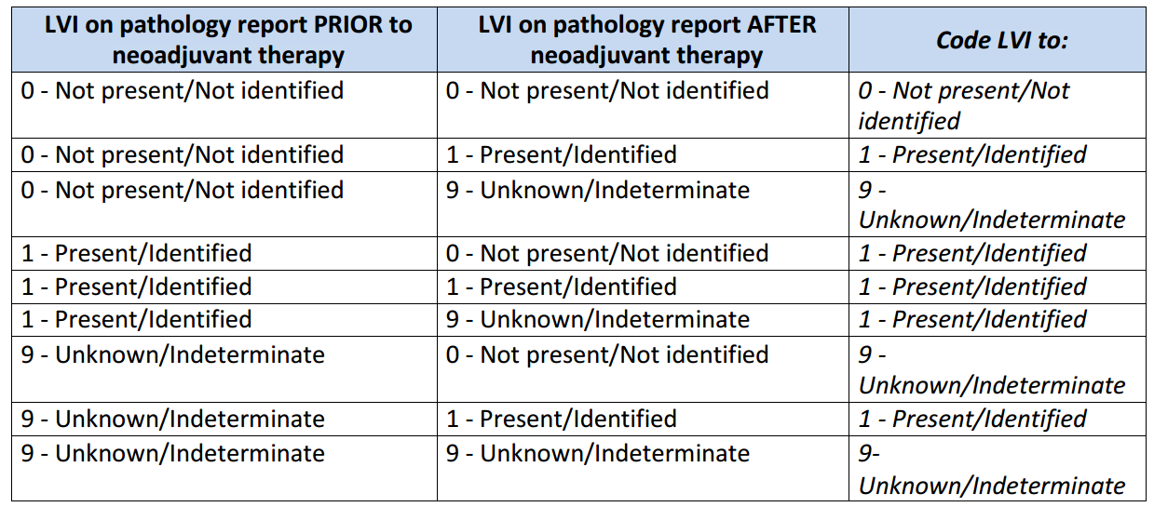
4/9/21 Rectal bx @ Outside Facility = Adenocarcinoma, moderately well-differentiated. Negative for angiolymphatic invasion. IHC stable.
1/5/22 Robotic-assisted laparoscopic LAR @ My Facility: Grade 2 adenocarcinoma, 1.9 cm, invades through muscularis propria into pericolorectal tissue. No LVI pr PNI. Treatment effect present (partial response, score 2). Macroscopic evaluation of mesorectum complete. Margins all negative, distance from invasive carcinoma to radial margin is 1.3 cm. 0/17 lymph nodes. No tumor deposits. ypT3 N0 M N/A.
Date of Initial Diagnosis
8140/3
Sequence Number
00
04/09/2021
Primary Site
Histology
C20.9
Laterality
Tumor Size Summary
0
Lymphovascular Invasion
999
Diagnostic Confirmation
0
1

Slide 6
1/5/22 Robotic-assisted laparoscopic LAR @ My Facility: Grade 2 adenocarcinoma, 1.9 cm, invades through muscularis propria into pericolorectal tissue. No LVI pr PNI. Treatment effect present (partial response, score 2). Macroscopic evaluation of mesorectum complete. Margins all negative, distance from invasive carcinoma to radial margin is 1.3 cm. 0/17 lymph nodes. No tumor deposits. ypT3 N0 M N/A.
Regional Lymph Nodes Positive
01/05/2022
Sentinel Lymph Nodes Positive
00
Regional Lymph Nodes Examined
Date of Regional Lymph Node Dissection
17
Sentinel Lymph Nodes Examined
Date of Sentinel Lymph Node Biopsy

Slide 7
Diagnosed via colonoscopy w/ biopsy outside facility 4/9/21
Chemoradiation at my facility 5/12/21-10/27/21
Surgery at my facility 1/5/22
Class of Case
Date of First Contact
22
05/12/2021

Slide 8
AJCC Staging
4/9/21 Rectal bx @ Outside Facility = Adenocarcinoma, moderately well-differentiated. Negative for angiolymphatic invasion. IHC stable.
4/16/21 CT CAP: Circumferential rectal thickening with subtle perirectal stranding. No focal fluid collection or pelvic lymphadenopathy. No evidence for metastatic disease.
4/16/11 CEA: 8.7 (elevated)
4/23/21 Rectal cancer MRI: T4a N2 rectal tumor with at least 7 suspicious mesorectal nodes.
12/1/21 Rectal cancer MRI: Compared to 04/23/2021, the patient's semiannular rectal mass is significantly decreased in size. The mass is now characterized by areas of fibrosis with small volume of suspected residual viable tumor. Tumor/fibrosis extends beyond the muscularis propria with spiculations extending to the anterior peritoneal reflection, which is not clearly involved by residual tumor. Markedly decreased size of previously enlarged suspicious mesorectal lymph nodes. No suspicious mesorectal or extra mesorectal lymph nodes are identified.
1/4/22 Colonoscopy: Minimal residual tumor/scar in mid rectum, otherwise clear colon.
cT
4a
cN
2b
cM
Stage Group
Clinical
0
IIIC
Grade
2
Post Therapy Clinical
ycT
ycN
0
ycM
0
Stage Group
N/A
3
Grade
9

Slide 9
AJCC Staging
1/5/22 Robotic-assisted laparoscopic LAR @ My Facility: Grade 2 adenocarcinoma, 1.9 cm, invades through muscularis propria into pericolorectal tissue. No LVI pr PNI. Treatment effect present (partial response, score 2). Macroscopic evaluation of mesorectum complete. Margins all negative, distance from invasive carcinoma to radial margin is 1.3 cm. 0/17 lymph nodes. No tumor deposits. ypT3 N0 M N/A.
pT
pN
pM
Stage Group
Pathological
Grade
9
Post Therapy Pathological
ypT
ypN
0
ypM
0
Stage Group
IIA
3
Grade
2

Slide 10
Summary Stage
4/9/21 Rectal bx @ Outside Facility = Adenocarcinoma, moderately well-differentiated. Negative for angiolymphatic invasion. IHC stable.
4/16/21 CT CAP: Circumferential rectal thickening with subtle perirectal stranding. No focal fluid collection or pelvic lymphadenopathy. No evidence for metastatic disease.
4/16/11 CEA: 8.7 (elevated)
4/23/21 Rectal cancer MRI: Tumor penetrates through surface of visceral peritoneum with no evidence for tumor invasion into pelvic organs or sacrum. T4a N2 rectal tumor with at least 7 suspicious mesorectal nodes.
1/5/22 Robotic-assisted laparoscopic LAR @ My Facility: Grade 2 adenocarcinoma, 1.9 cm, invades through muscularis propria into pericolorectal tissue. No LVI pr PNI. Treatment effect present (partial response, score 2). Macroscopic evaluation of mesorectum complete. Margins all negative, distance from invasive carcinoma to radial margin is 1.3 cm. 0/17 lymph nodes. No tumor deposits. ypT3 N0 M N/A.
4 Regional by BOTH direct extension AND regional lymph node(s) involved

Slide 11
SSDIs
4/9/21 Rectal bx @ Outside Facility = Adenocarcinoma, moderately well-differentiated. Negative for angiolymphatic invasion. IHC stable.
4/16/11 CEA: 8.7 (elevated)
1/5/22 Robotic-assisted laparoscopic LAR @ My Facility: Grade 2 adenocarcinoma, 1.9 cm, invades through muscularis propria into pericolorectal tissue. No LVI pr PNI. Treatment effect present (partial response, score 2). Macroscopic evaluation of mesorectum complete. Margins all negative, distance from invasive carcinoma to radial margin is 1.3 cm. 0/17 lymph nodes. No tumor deposits. ypT3 N0 M N/A.
CEA PreTX Lab Value
8.7
CEA PreTX Interpretation
1
Tumor Deposits
00
Perineural Invasion
0
Circumferential Resection Margin
13.0
KRAS
9

Slide 12
SSDIs
4/9/21 Rectal bx @ Outside Facility = Adenocarcinoma, moderately well-differentiated. Negative for angiolymphatic invasion. IHC stable.
4/16/11 CEA: 8.7 (elevated)
1/5/22 Robotic-assisted laparoscopic LAR @ My Facility: Grade 2 adenocarcinoma, 1.9 cm, invades through muscularis propria into pericolorectal tissue. No LVI pr PNI. Treatment effect present (partial response, score 2). Macroscopic evaluation of mesorectum complete. Margins all negative, distance from invasive carcinoma to radial margin is 1.3 cm. 0/17 lymph nodes. No tumor deposits. ypT3 N0 M N/A.
Microsatellite Instability (MSI)
0
BRAF Mutational Analysis
9
NRAS Mutational Analysis
9
*Macroscopic Evaluation of the Mesorectum
30
*Not a SSDI

Slide 13
Surgery
4/9/21 Rectal bx @ Outside Facility = Adenocarcinoma, moderately well-differentiated. Negative for angiolymphatic invasion. IHC stable.
1/5/22-1/8/22 Robotic-assisted laparoscopic LAR @ My Facility: Grade 2 adenocarcinoma, 1.9 cm, invades through muscularis propria into pericolorectal tissue. No LVI pr PNI. Treatment effect present (partial response, score 2). Macroscopic evaluation of mesorectum complete. Margins all negative, distance from invasive carcinoma to radial margin is 1.3 cm. 0/17 lymph nodes. No tumor deposits. ypT3 N0 M N/A.
Reason for No Surgery of Primary Site
0
Date 1st Surgical Procedure
01/05/2022
Date of Most Definitive Surgical Resection
01/05/2022
Date of Surgical Discharge
01/08/2022
Surgical Diagnostic and Staging Procedure
02
Date of Surgical Diagnostic and Staging Procedure
04/09/2021

Slide 14
Surgery
4/9/21 Rectal bx @ Outside Facility = Adenocarcinoma, moderately well-differentiated. Negative for angiolymphatic invasion. IHC stable.
1/5/22-1/8/22 Robotic-assisted laparoscopic LAR @ My Facility: Grade 2 adenocarcinoma, 1.9 cm, invades through muscularis propria into pericolorectal tissue. No LVI pr PNI. Treatment effect present (partial response, score 2). Macroscopic evaluation of mesorectum complete. Margins all negative, distance from invasive carcinoma to radial margin is 1.3 cm. 0/17 lymph nodes. No tumor deposits. ypT3 N0 M N/A.
Surgical Margins of the Primary Site
A300
Rx Summ – Surg 2023
A300
0
Scope of Regional LN Surgery
Rx Hosp – Surg 2023
5
Approach – Surgery of the Primary Site at this Facility
1

Slide 15
Treatment
4/9/21 Rectal bx @ Outside facility
5/12/21-8/25/21: 8 cycles FOLFOX @ my facility
9/20/21: Capecitabine w/ XRT @ my facility
1/5/22 LAR @ my facility
Date of First Course of Treatment
05/12/2021
Date Systemic Therapy Started
05/12/2021
Systemic/Surgery Sequence
2
Chemotherapy
03
Immunotherapy
00
Hormone Therapy
00
Rx Summ – Treatment Status
1

Slide 16
Radiation
Reason for No Radiation
0 Radiation was administered
Date Radiation Started
09/20/2021
Date Radiation Ended
10/27/2021
Radiation Treatment Discontinued Early
01 Radiation treatment completed as prescribed
Radiation Course Total Dose
005040
Number of Phases of Radiation Treatment
02

Slide 17
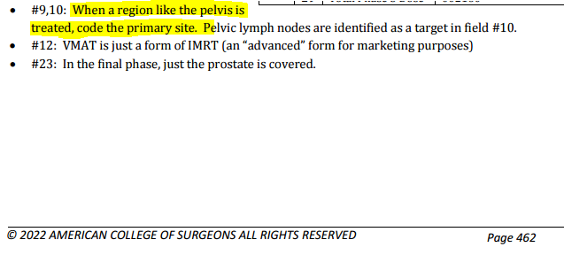
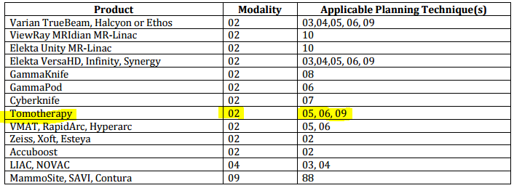
Phase I
Radiation Primary Treatment Volume
54 Rectum
Radiation to Draining Lymph Nodes
06 Pelvic lymph nodes
Radiation Treatment Modality
02 External beam, photons
External beam Radiation Planning Technique
05 Intensity modulated therapy
Dose per Fraction
00180
Number of Fractions
025
Total Dose
004500

Slide 18
Phase II
Radiation Primary Treatment Volume
54 Rectum
Radiation to Draining Lymph Nodes
00
Radiation Treatment Modality
02 External beam, photons
External beam Radiation Planning Technique
05 Intensity modulated therapy
Dose per Fraction
00180
Number of Fractions
003
Total Dose
000540

Slide 19
Phase III
Radiation Primary Treatment Volume
Radiation to Draining Lymph Nodes
Radiation Treatment Modality
External beam Radiation Planning Technique
Dose per Fraction
Number of Fractions
Total Dose
LEAVE BLANK

Slide 20
Outcomes
1/5/22-1/8/22 Robotic-assisted laparoscopic LAR @ My Facility: Grade 2 adenocarcinoma, 1.9 cm, invades through muscularis propria into pericolorectal tissue. No LVI pr PNI. Treatment effect present (partial response, score 2). Macroscopic evaluation of mesorectum complete. Margins all negative, distance from invasive carcinoma to radial margin is 1.3 cm. 0/17 lymph nodes. No tumor deposits. ypT3 N0 M N/A.
3/2/22 Dr. Bhave follow-up states NED
9/22/23 Dr. Bhave follow-up states doing well with interval CT scan and CEA showing NED
Date of First Recurrence
Type of First Recurrence
00
Date of Last Cancer (tumor) Status
01/05/2022
Cancer Status
1
Vital Status
1

Slide 21
Case #2
For the purposes of training/registry coding, we are following the store 2023 rules, even though the case was not diagnosed in 2023. if this was a case you were abstracting, you would follow the store manual from the year of diagnosis.

Slide 22
Presentation
9/30/21 Screening Colonoscopy @ Outside Hospital = In the distal rectum there was an ulcerated sizable approximately 3 cm mass with a central ulceration. The edges were friable, and the central area appeared necrotic. This is consistent with a rectal cancer.
9/30/21 Biopsy of rectal mass @ Outside Hospital = Fragments of tubular adenoma, positive for high-grade dysplasia
10/11/21 CT CAP [Clinical indication: Malignant neoplasm of rectum] @ Outside Hospital = Asymmetric rectal wall thickening raising concern for rectal neoplasm given the current setting; no destructive fatty infiltration or pelvic lymphadenopathy. Negative chest CT.
10/14/21 Sigmoidoscopy w/ rectal bx @ My Facility = Superficial disrupted fragments of adenomatous epithelium with at least high-grade dysplasia. The patient's clinical history of a "rectal mass clinically suspicious for rectal cancer" is noted. Histologic sections demonstrate only superficial fragments of glandular type mucosa with adenomatous change and high-grade dysplasia. No definitive evidence of invasion and/or desmoplastic response is identified in the sections examined.
10/15/21 MRI Pelvis = T2/early T3 rectal cancer. No tumor deposits or lymph nodes.
Surgeon notes: Stage II rectal cancer based on all current available imaging.
11/3/21 Consult @ Outside facility #2 = Rectal mass concerning for rectal adenocarcinoma on endoscopic exam. Repeated biopsy. MRI consistent with T3 N0 disease, recommend TNT.
11/3/21 Rectal mass bx @ Outside facility #2 = Invasive adenocarcinoma, well differentiated, arising from tubulovillous adenoma. Mismatch Repair Protein Immunohistochemistry = Normal expression of MLH1, MSH2, MSH6, and PMS2
11/30/21 CEA = 2.4 (normal)

Slide 23
Presentation
FOLFOX 11/17/21-2/23/22 for T3 rectal cancer @ Outside facility
Xeloda + radiation 3/28/22-5/4/22 @ Outside facility. No radiation details available.
6/22/22 Sigmoidoscopy @ My facility = Flat scar noted in the rectum, smooth, consistent with complete clinical response.
6/22/22 Post-treatment MRI = No residual tumor. Discussed watch ‘n wait vs. surgery. Plan on repeat FFS and MRI in 3-4 months.

Slide 24
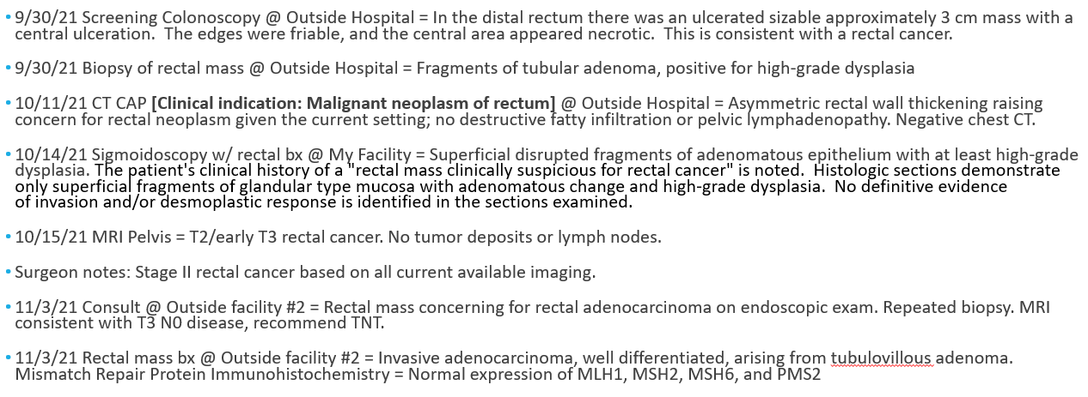
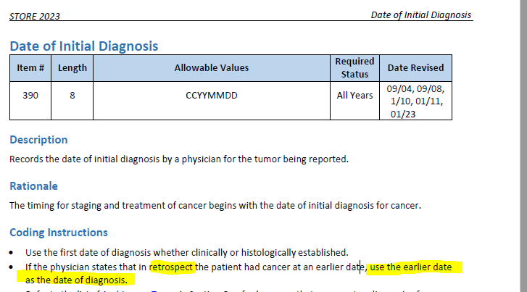
Date of Initial Diagnosis
8140/3
Sequence Number
00
09/30/2021
Primary Site
Histology
C20.9
Laterality
Tumor Size Summary
0
Lymphovascular Invasion
030
Diagnostic Confirmation
9
1

Slide 25
Regional Lymph Nodes Positive
Sentinel Lymph Nodes Positive
98
Regional Lymph Nodes Examined
Date of Regional Lymph Node Dissection
00
Sentinel Lymph Nodes Examined
Date of Sentinel Lymph Node Biopsy

Slide 26
Class of Case
Date of First Contact
30
10/14/2021
https://cancerbulletin.facs.org/forums/node/111546
https://cancerbulletin.facs.org/forums/node/130846#post130877

Slide 27
AJCC Staging
cT
3
cN
0
cM
Stage Group
Clinical
0
IIA
Grade
1
Post Therapy Clinical
ycT
ycN
0
ycM
0
Stage Group
N/A
0
Grade
9

Slide 28
AJCC Staging
pT
pN
pM
Stage Group
Pathological
Grade
9
Post Therapy Pathological
Grade
ypN
ypM
Stage Group
ypT

Slide 29
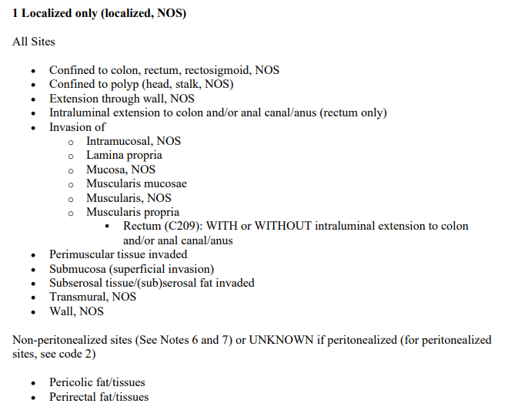
Summary Stage
10/15/21 MRI Pelvis = T2/early T3 low rectal cancer (the muscularis propria appears invaded and indistinct at several sites. Depth of extramural invasion is less than 1 mm). No tumor deposits or lymph nodes.
1

Slide 30
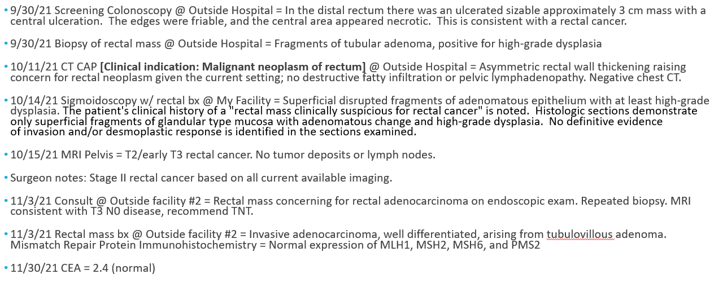
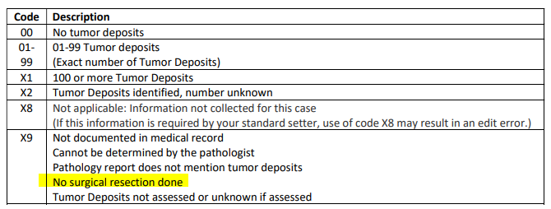
SSDIs
SSDIs
CEA PreTX Lab Value
XXXX.9
CEA PreTX Interpretation
9
Tumor Deposits
X9
Perineural Invasion
9
Circumferential Resection Margin
XX.7
KRAS
9

Slide 31
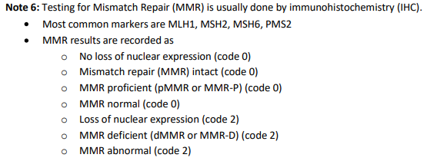
SSDIs
Microsatellite Instability (MSI)
0
BRAF Mutational Analysis
9
NRAS Mutational Analysis
9
*Macroscopic Evaluation of the Mesorectum
00
*Not a SSDI

Slide 32
Surgery
9/30/21 Biopsy of rectal mass @ Outside Hospital = Fragments of tubular adenoma, positive for high-grade dysplasia
10/14/21 Sigmoidoscopy w/ rectal bx @ My Facility = Superficial disrupted fragments of adenomatous epithelium with at least high-grade dysplasia. The patient's clinical history of a "rectal mass clinically suspicious for rectal cancer" is noted. Histologic sections demonstrate only superficial fragments of glandular type mucosa with adenomatous change and high-grade dysplasia. No definitive evidence of invasion and/or desmoplastic response is identified in the sections examined.
11/3/21 Rectal mass bx @ Outside facility #2 = Invasive adenocarcinoma, well differentiated, arising from tubulovillous adenoma. Mismatch Repair Protein Immunohistochemistry = Normal expression of MLH1, MSH2, MSH6, and PMS2
Surgical Diagnostic and Staging Procedure
1
Date 1st Surgical Procedure
Date of Most Definitive Surgical Resection
Date of Surgical Discharge
02
Date of Surgical Diagnostic and Staging Procedure
Reason for No Surgery of Primary Site
11/03/2021

Slide 33
Surgery
Surgical Margins of the Primary Site
A000
Rx Summ – Surg 2023
A000
8
Scope of Regional LN Surgery
Rx Hosp – Surg 2023
0
Approach – Surgery of the Primary Site at this Facility
0

Slide 34
Treatment
Date of First Course of Treatment
11/17/2021
Date Systemic Therapy Started
11/17/2021
Systemic/Surgery Sequence
0
Chemotherapy
03
Immunotherapy
00
Hormone Therapy
00
Rx Summ – Treatment Status
1

Slide 35
Radiation
Contacted outside facility CTR for details:
3/28/22 to 5/4/22: 3D Conformal/Photons to rectum/pelvis, total 5040 cGy in 28 fx. Initial dose of 4500 cGy in 25 fx to rectum/pelvis, boost to rectum of 540 cGy in 3 fx.
Reason for No Radiation
0 Radiation was administered
Date Radiation Started
03/28/2022
Date Radiation Ended
05/04/2022
Radiation Treatment Discontinued Early
01 Radiation treatment completed as prescribed
Radiation Course Total Dose
005040
Number of Phases of Radiation Treatment
002

Slide 36
Phase I
Contacted outside facility CTR for details:
3/28/22 to 5/4/22: 3D Conformal/Photons to rectum/pelvis, total 5040 cGy in 28 fx. Initial dose of 4500 cGy in 25 fx to rectum/pelvis, boost to rectum of 540 cGy in 3 fx.
Radiation Primary Treatment Volume
54 Rectum
Radiation to Draining Lymph Nodes
06 Pelvic Nodes
Radiation Treatment Modality
02 External beam, photons
External beam Radiation Planning Technique
04 Conformal or 3-D conformal therapy
Dose per Fraction
00180
Number of Fractions
025
Total Dose
004500

Slide 37
Phase II
Contacted outside facility CTR for details:
3/28/22 to 5/4/22: 3D Conformal/Photons to rectum/pelvis, total 5040 cGy in 28 fx. Initial dose of 4500 cGy in 25 fx to rectum/pelvis, boost to rectum of 540 cGy in 3 fx.
Radiation Primary Treatment Volume
54 Rectum
Radiation to Draining Lymph Nodes
00 No radiation treatment to lymph nodes
Radiation Treatment Modality
02 External beam, photons
External beam Radiation Planning Technique
04 Conformal or 3-D conformal therapy
Dose per Fraction
00180
Number of Fractions
003
Total Dose
000540

Slide 38
Phase III
Radiation Primary Treatment Volume
Radiation to Draining Lymph Nodes
Radiation Treatment Modality
External beam Radiation Planning Technique
Dose per Fraction
Number of Fractions
Total Dose
LEAVE BLANK

Slide 39
Outcomes
Date of First Recurrence
Type of First Recurrence
00
Date of Last Cancer (tumor) Status
06/22/2022
Cancer Status
1
Vital Status
1

Slide 40
Use Your Resources!
CTR Guide for Coding Radiation
STORE
Physicians
CAnswer Forum
Webinars

Slide 41
Questions?

