Slide 1
Abstracting Hematopoietic and lymphoma cases
Leslie Woodard, ODS-C
ICRA Education Chair
March 2024
Notes:
A big thank you to Registry Partners for continuing to host our webinar series. As always, the live presentation has been awarded NCRA approval for 1 category A CE, in which a certificate will be emailed out later this week. Those viewing the recording are not eligible for the CE.

Slide 2
AGENDA
Default values
ICD-O Histology
ICD-O Site Code
Diagnostic confirmation
Staging
SSDIs
Treatment
Recurrence
Case Examples

Slide 3
Default values
Tumor size summary (999)
LVI (8)
Regional nodes positive/examined (99)
Grade (8)
Mets at Dx
8 for C42 primary site
8 for mets at dx – distant nodes for C77 primary site
Margins
9 for hemeretic and C77 primary site
Scope of Regional Lymph Node Surgery (9)

Slide 4
Icd-o
You can’t be successful without the Hematopoietic & Lymphoid Neoplasm Database and Coding Manual
https://seer.cancer.gov/tools/heme/
Step 1: Working histology
Step 2: Site code assignment
Notes:
If your new to heme and lymphoma cases, start with reviewing the heme manual

Slide 5
histology
Search the heme database
< Be sure ‘show alternate names’ is checked!
Notes:
Reportability
Diagnosis year
Current histology code
Module to look at in heme manual

Slide 6
histology
Always check abstractor notes, alternate names, genetics data and immunophenotyping
Need to code the most specific, and genetics data or immunophenotyping can change the histology code
When ambiguous terminology is used for a specific histology, but a NOS histology is separately listed:
Must use NOS unless physician documents he/she is treating for the specific histology
If more than one histology, check the transformations and same primary sections
Use Multiple Primary Rules to determine number of primaries
Review Primary Site and Histology Rules (PH rules) to finalize histology code

Slide 7
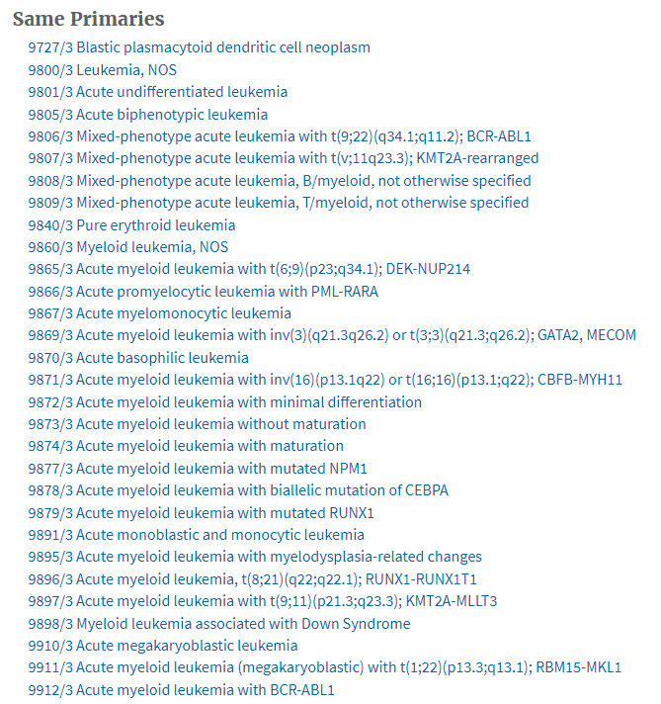
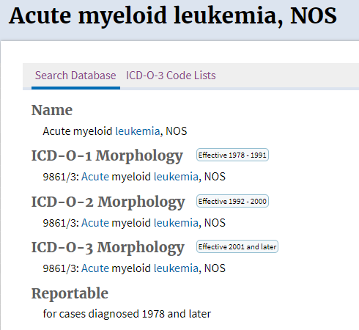
Histology example
AML vs. AML BCR-ABL1+

Slide 8
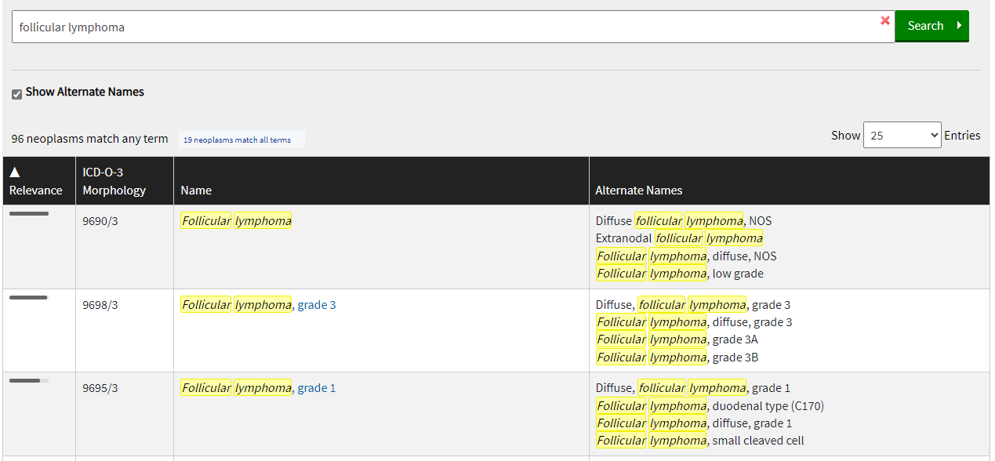
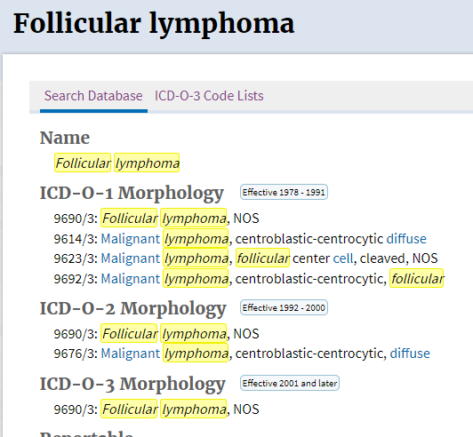
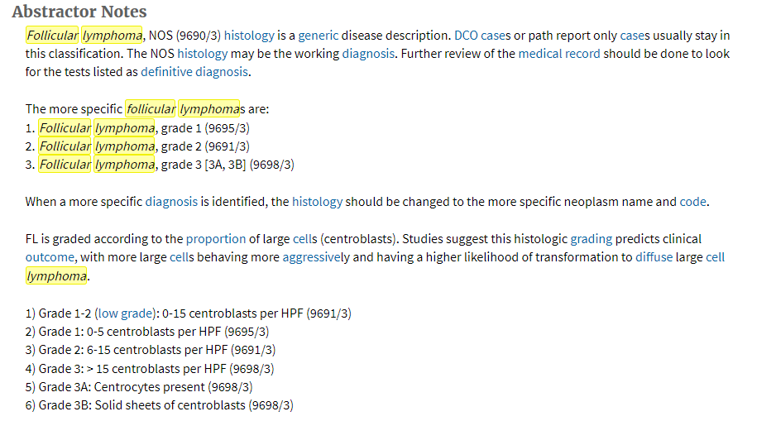
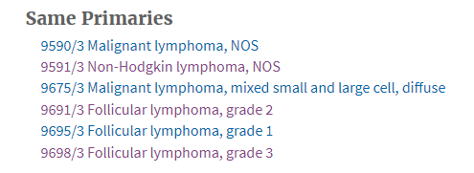
Histology example
FOLLICULAR LYMPHOMA vs. FOLLICULAR LYMPHOMA GRADE 1

Slide 9
Histology example
B-CELL LYMPHOMA vs.
DIFFUSE LARGE B-CELL LYMPHOMA
Notes:
B-cell lymphoma NOS is more difficult to find, as it doesn’t show up on the search screen until halfway down the screen. DLBCL shows up first, but that is not equivalent to b-cell lymphoma NOS. So, don’t always go with the first histology code that appears!

Slide 10
Site code
Use the primary site coding instructions, PH rules and the heme database to determine correct primary site (in that order)
Many histologies have default site codes
If the heme database only lists one option under primary site, that’s what you must use
Others have the most common sites listed, along with the PH/module rules to view in the manual
Big things often overlooked
Biopsy site primary site
Secondary involvement of distant sites isn’t used for primary site coding (effects staging only)

Slide 11
Modules and ph rules
Modules
PH Rules
9 modules
Not hierarchical
Database directs you to the appropriate module
31 rules
Hierarchical within each module
Pay attention to the notes!

Slide 12
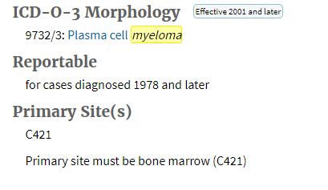
Site code example

Slide 13
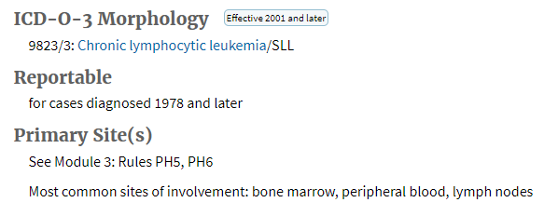
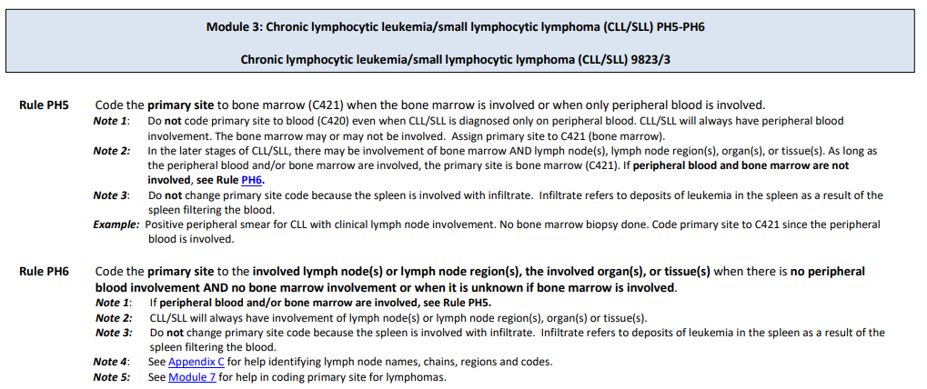
Site code example

Slide 14
Diagnostic confirmation

Slide 15
Diagnostic confirmation – code 1
Leukemia diagnosed via CBC or WBC
Do not use code 1 if the provisional diagnosis was based on tissue, bone marrow, or blood and the immunophenotyping or genetic testing on that same tissue, bone marrow, or blood identified the specific disease (see Code 3)
Immunophenotyping/genetic testing is NEGATIVE
Additional testing results in one or more provisional diagnosis
Ambiguous terminology used on the more specific diagnosis

Slide 16
Code 1 examples
CBC = 32% myeloid blasts, diagnostic of AML
Lymph node biopsy = Non-Hodgkin lymphoma. Due to the scant amount of tissue, IHC studies unable to be ran

Slide 17
Diagnostic confirmation – Code 2
Rarely used
Fluid aspirations, such as pleural fluid
EXAMPLE:
Patient presented with large pleural effusion. Thoracentesis diagnostic of DLBCL. Patient declined further workup and treatment.

Slide 18
Diagnostic confirmation – code 3
Most common for these cases
Histology plus positive immunophenotyping/genetic testing
Heme database doesn’t list ALL possibilities for each histology. If there’s positive testing that led to the specific histo, use code 3
Manual includes histologies that will always be 3 or never be 3
Notes:
Peripheral blood smear w/ flow cytometry

Slide 19
Code 3 examples
Bone marrow bx = AML . IHC testing pending. IHC resulted showing BCR-ABL1 presence
Lymph node biopsy = Non-Hodgkin lymphoma, CD5+, CD43+, ATM gene deletion consistent with mantle cell lymphoma. Physicians progress note states patient has/is being treated for MCL.
Peripheral blood flow cytometry = Polycythemia vera. Genetic testing showing JAK2+

Slide 20
Diagnostic confirmation – code 4
Rarely used
Known to be histologically confirmed, but unknown which code (1-3) it falls into
Class 20s and 30s
EXAMPLE:
Patient presents to your hospital with disease progression. Med onc notes history of biopsy proven MDS, no further information available from time of diagnosis.

Slide 21
Diagnostic confirmation – code 5
Positive lab test/marker
No histologic confirmation, but immunophenotyping or genetic testing was diagnostic of the histology

Slide 22
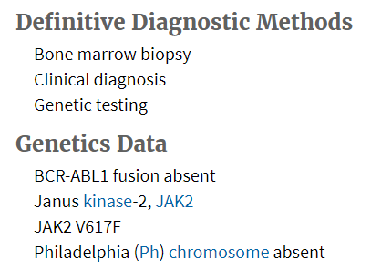
Code 5 examples
Patient was diagnosed with lambda myeloma based on the M spike found on serum protein electrophoresis (SPEP). A bone marrow biopsy was performed, but it was an insufficient sample.
Patient with JAK2+, no blood smear or bone marrow done. Physician diagnosed her with PV based off the JAK2 and blood test results.
https://seer.cancer.gov/seer-inquiry/inquiry-detail/20210044/
https://seer.cancer.gov/seer-inquiry/inquiry-detail/20180010/

Slide 23
Diagnostic confirmation – code 6
Rarely used
Direct visualization without microscopic confirmation
EXAMPLE: Patient undergoing surgery for SBO and found to have enlarged nodes throughout the abdomen and pelvis, stated to be suspicious for lymphoma by the surgeon. No biopsy done due to an unexpected heart attack, abruptly ending the surgery.

Slide 24
Diagnostic confirmation – code 7
Rare, but personally feel it to be more common than 4 and 6
Radiology diagnosis without microscopic confirmation
EXAMPLE: Patient undergoes imaging that reveals lytic lesions suspicious for myeloma. Refuses further workup.

Slide 25
Diagnostic confirmation – code 8
Clinical diagnosis that doesn’t fit codes 5-7
Still no microscopic confirmation
The diagnosis is determined based on the physician’s clinical expertise, combined with the information from the biopsy, equivocal or negative tests, and the clinical symptoms. This is called a “diagnosis of exclusion” because the physician’s judgment and the work-up literally exclude all other possible diagnoses, leaving one diagnosis. Ambiguous terminology may precede the diagnosis.
Notes:
Of course there’s also code 9 for when you have no clue how the case was diagnosed.

Slide 26
Code 8 example
Bone marrow biopsy is reported as plasma cell neoplasm. Physician is treating the patient for plasma cell myeloma.
Plasma cell neoplasm is not a reportable diagnosis, as it covers a range of things from MGUS through myeloma
https://seer.cancer.gov/seer-inquiry/inquiry-detail/20200045/

Slide 27
staging

Slide 28
staging – lymphoma (Lugano)
A and B classification is used for Hodgkin-lymphoma only, effective with AJCC 8th Edition.
Stage group only, no TNM
Depends on the number of lymph node regions you have involved
Each side (left vs. right) is a separate region
The location of the diaphragm in relation to the node region (above/below) affects stage
Notes:
B symptoms are still a SSDI for all lymphoma cases.
B symptoms = fever, night sweats, unintentional weight loss of greater than 10% of bodyweight
S was removed from stage grouping with AJCC 8th edition, as spleen is no longer part of stage grouping (now looked at similar to lymph node region).

Slide 29
staging – lymphoma (Lugano)
Waldeyer’s ring, thymus and spleen are considered nodal sites.
Criteria for organ involvement is spelled out in the AJCC chapter – physical exam and PET criteria; MRI; bone marrow biopsy
Extranodal: Blood, bone, bone marrow, CNS, GI tract, etc. Noted in stage groups I and II with an E.
Bulky: Varies according to histology (>10 cm for HL and >5 cm for NHL)
The ONLY way you can pathologically stage is if there is a staging laparotomy done – very rare
Notes:
Waldeyer’s ring = tonsil structures and lymphatic tissue area of the pharynx
Stage III and IV don’t apply E suffix, even when there is extranodal organ involvement.
Bulky measurements provided are not for all histologies, it varies more than just HL vs NHL.

Slide 30
staging – lymphoma (Lugano)
https://link.springer.com/chapter/10.1007/978-3-030-39457-8_23
Notes:
Appendix C heme manual

Slide 31
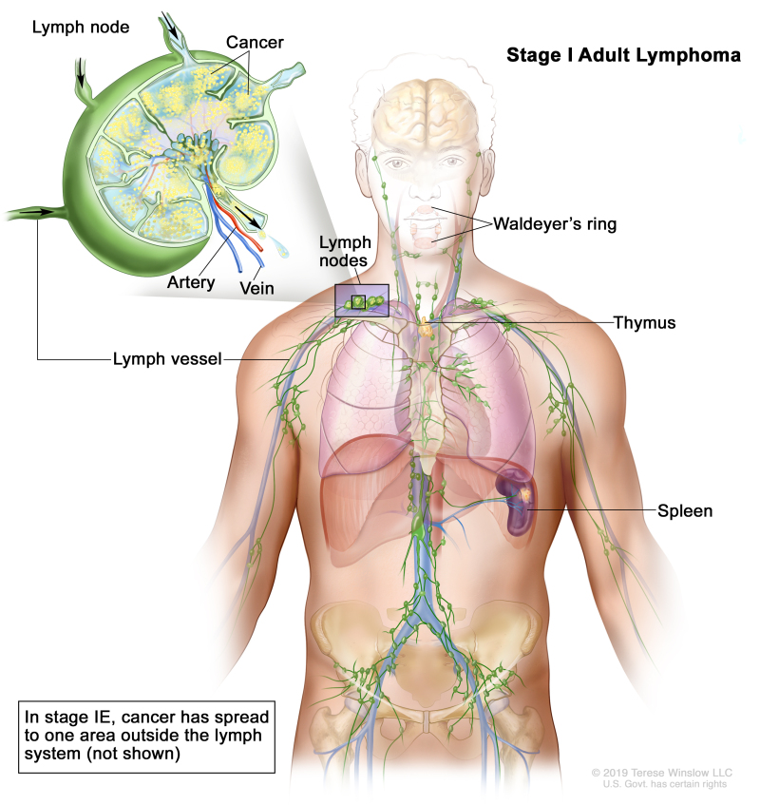
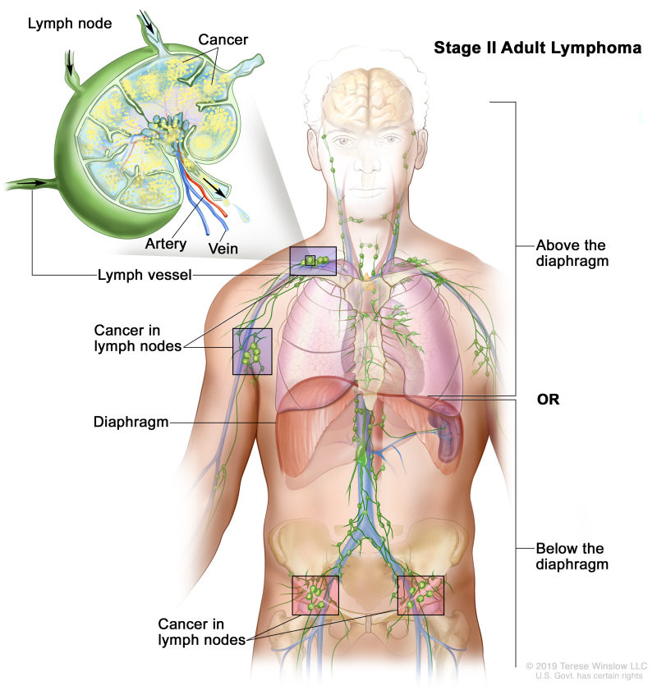
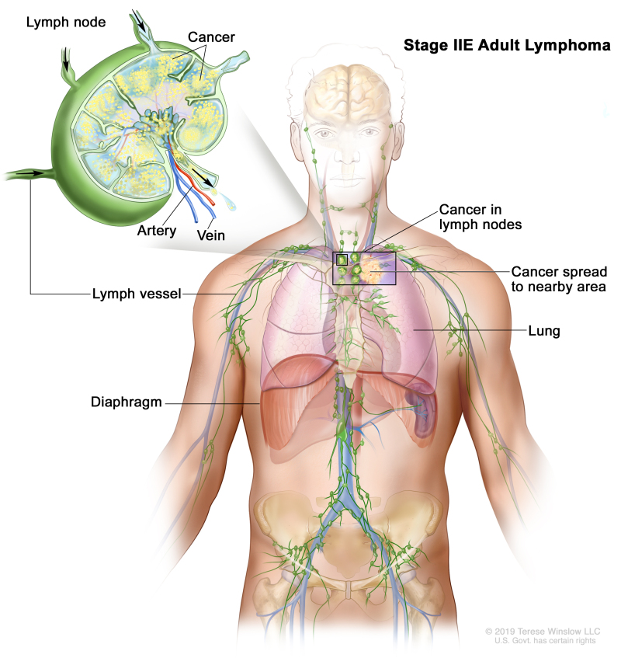
staging – lymphoma (Lugano)
Stage I: Single lymphatic site
Stage IE: Single extralymphatic site; no nodal disease
Stage II: Involvement of two or more lymph node regions; same side of diaphragm
Stage IIE: Contiguous extralymphatic extension from a nodal site with or without other nodal regions on the same side of the diaphragm
Stage II Bulky: Stage II criteria, but nodal mass is greater than 5-10cm
Picture Source: https://www.ncbi.nlm.nih.gov/books/NBK66038/table/CDR0000062675__176/

Slide 32
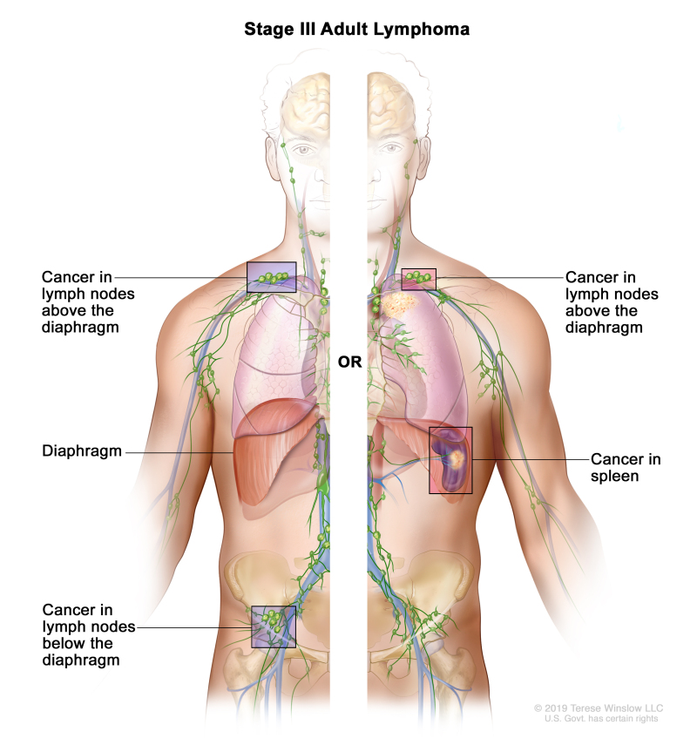
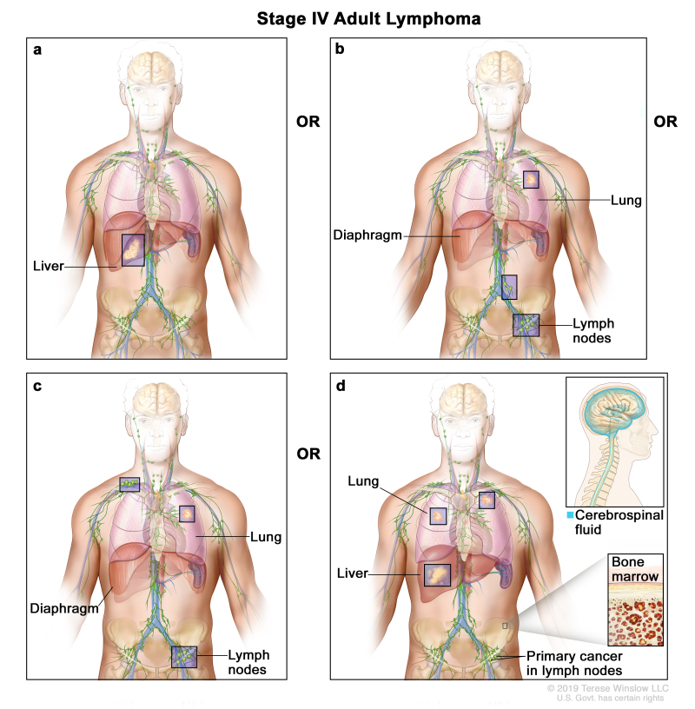
staging – lymphoma (Lugano)
Stage III: Involvement of lymph node regions on both sides of the diaphragm OR nodes above the diaphragm with spleen involvement
Stage IV: Diffuse involvement of one or more extralymphatic organs; noncontiguous extralymphatic organ involvement with nodal stage II; any extralymphatic involvement with nodal stage III; Any involvement of CSF, bone marrow, liver or multiple lung lesions.
Picture Source: https://www.ncbi.nlm.nih.gov/books/NBK66038/table/CDR0000062675__176/

Slide 33
staging – lymphoma (Lugano)
https://www.lls.org/lymphoma/hodgkin-lymphoma/diagnosis/hodgkin-lymphoma-staging

Slide 34
staging – cll/sll (Lugano and rai)
RAI Staging System
Risk | Stage | Findings
Low | 0 | Lymphoctosis only
Intermediate | 1 | 0+ Adenopathy
Intermediate | 2 | 0+ Enlarged spleen and/or liver
High | 3 | Lymphocytosis + Anemia
High | 4 | Lymphocytosis + Thrombocytopenia
AJCC Stage Group is Lugano, following all other lymphoma staging just reviewed.
Blood only = stage group 99
RAI staging is determined by the SSDIs
No RAI stage is assigned by us in the abstract
Personally, this is what I see physicians assigning most often
Notes:
Lymphocytosis = high lymphocyte count
Anemia = low hemoglobin or Hgb <11 g/dL
Thrombocytopenia = low platelet counts, as in Plt <100,000 µL or 100 dL

Slide 35
staging - myeloma
Starting with 2022+ diagnosed cases, AJCC clinical stage group now assigned
Same as RISS, not ISS
Will be 1-3 or 99
Excludes smoldering myeloma
RISS Stage Group (AJCC)
Stage I | Serum β2-microglobulin <3.5 mg/L
 | +serum albumin ≥3.5 g/dL
 | +no high-risk cytogenetics
 | +normal LDH
Stage II | Not stage I or III
Stage III | Serum β2-microglobulin ≥5.5 mg/L and either
 | High-risk cytogenetics
 | And/OR high LDH
Notes:
ISS = International staging system
RISS = REVISED international staging system

Slide 36
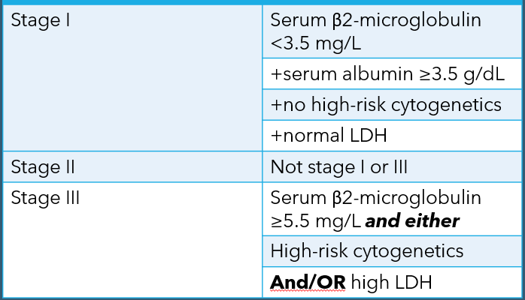
staging - myeloma
Make sure your units of measurements match before assigning stage (and SSDIs)
Use google for a conversion calculator if needed
Albumin must be serum
Albumin from SPEP is acceptable
High-risk cytogenetics include only the three below
del17p; t(4;14) or t(14;16)
SSDI Multiple Myeloma Serum Albumin - CAnswer Forum (facs.org)
Notes:
Beta globulin is not the same as beta-2 microglobulin
SPEP = serum protein electrophoresis
Albumin can be found in comprehensive metabolic panel

Slide 37
staging - myeloma
Beta-2 microglobulin 3.2 mg/L, serum albumin 3.5 g/dL, normal LDH and unknown cytogenetics = Stage 99
Negative cytogenetics = Stage I
Beta-2 microglobulin 5.8 mg/L with high LDH and unknown cytogenetics = Stage III
Beta-2 microglobulin 5.5 mg/L, normal LDH and normal cytogenetics = Stage II

Slide 38
staging – leukemia
No AJCC staging

Slide 39
Summary stage
Lymphoma (1, 2, 7, 9)
Similar to AJCC – depends on location of node involvement and/or organ involvement
1 and 2 = everything same side of diaphragm
Myeloma/Plasma Cell Disorders (1, 3, 7, 9)
9731 or 9734 are the only histologies that can be assigned something other than 7
Hemeretic (1, 7, 9)
Majority are 7
Notes 2 and 3 tell you what histologies can be 1

Slide 40
Site specific data items (SSDI)

Slide 41
Lymphoma – excluding cll/sll
B Symptoms
Fever, night sweats, weight loss (>10%)
HIV Status (or AIDS)
Can’t assume negative
Follow general instructions on timing
But, if there’s any history of HIV, code to 1
NCCN International Prognostic Index (IPI)
Not the same as FLIPI
NHL only (X9 for Hodgkin’s)
ODS cannot assign points/risk themselves
Schema Discriminator 1: Histology Discriminator for 9591/3
9591 covers different histologies
The discriminator gets you to the right AJCC Stage Group and SSDI schemas in the abstract
Leukemia vs. Lymphoma
Hiv ssdi - CAnswer Forum (facs.org)
FLIPI score - CAnswer Forum (facs.org)
SSDI: HIV Timing - CAnswer Forum (facs.org)
Notes:
x 9591/3: Splenic B-cell lymphoma/leukemia, unclassifiable (see code 1)
Abstracted and staged as a leukemia
x 9591/3: Hairy cell leukemia variant (see code 2)
Abstracted and staged as a leukemia
x 9591/3: Splenic diffuse red pulp small B-cell lymphoma (see code 3)
Abstracted and staged as a lymphoma
x 9591/3: Non-Hodgkin lymphoma, NOS (see code 9)
Abstracted and staged as a lymphoma
B Symptoms: must be addressed in the chart, otherwise code 9. This can be from the H&P, PE or even statement of stage ‘A’

Slide 42
Lymphoma – cll/sll
Rai Classification
If all you have is the RAI Stage, and no information on the SSDIs, there’s a table in the SSDI manual showing how to code each SSDI
Derived Rai Stage
Software completes automatically based off SSDI values
Rai Stage | Definition | Lymphocytosis | Adenopathy | Organomegaly | Anemia | Thrombocytopenia
0 | Lymphocytosis only Absolute Lymphocyte count > 5,000 cell/uL | 6 | 0 | 0 | 0 | 0
1 | Lymphocytosis and Adenopathy | 6 | 1 | 0 | 0 | 0
2 | Lymphocytosis AND Enlarged spleen and/or liver (organomegaly) | 6 | 9 | 1 | 0 | 0
3 | Lymphocytosis AND Hemoglobin less than 11g/dL (anemia) | 6 | 9 | 9 | 6 | 0
4 | Lymphocytosis AND Platelt count <100,000/uL (thrombocytopenia) | 6 | 9 | 9 | 9 | 6

Slide 43
Lymphoma – cll/sll
Lymphocytosis
You’re looking for absolute lymphocyte count (ALC) or a physician statement of lymphocytosis
Check the CBC blood test results
Lymphocytosis is present if ALC is greater than 5,000 cells/µL
10*9 L = 10*3 (1000 µL)
Example: Absolute lymphocytes = 12.3 10*3/µL = 12,300 µL
Adenopathy
Physician statement is #1
Comes from physical exam (nodes >1.5 cm), not imaging
Unless patient’s obesity prevents a thorough PE and physician interprets adenopathy on imaging as involved
HEME SSDI - CAnswer Forum (facs.org)
Notes:
Always make sure your unit of measurement matches the SSDI requirement!
Don’t assume anything is negative – if nothing available to support as positive or negative, code as 9
SSDI notes for all CLL/SSL SSDIs: The physician’s stated Rai stage always takes priority when there is conflicting information.
Lymphocytosis: When we are only given a percentage for lymphocytes, that is not enough for US to determine the correct code for lymphocytosis. However, pay attention to the physician statements

Slide 44
Lymphoma – cll/sll continued
Organomegaly
Like adenopathy – physician statement is #1 and must come from physical exam (exception: obesity limiting the PE)
Anemia
Hemoglobin <11.0 g/dL or <110 g/L
Rely on SSDI manual cutpoints and not your lab’s reference range
Could be in CBC, H&H or free standing hemoglobin test
Notes:
Don’t assume anything is negative – if nothing available to support as positive or negative, code as 9
SSDI notes for all CLL/SSL SSDIs: The physician’s stated Rai stage always takes priority when there is conflicting information.

Slide 45
Lymphoma – cll/sll continued
Thrombocytopenia
Platelets <100,000/µL
Found in CBC
Same conversion as lymphocytes (10^3/µL = 100,000/µL)
Reminders!
Always make sure your unit of measurement matches the SSDI requirement!
Don’t assume anything is negative – if nothing available to support as positive or negative, code as 9
SSDI notes for all CLL/SSL SSDIs: The physician’s stated Rai stage always takes priority when there is conflicting information.
Thrombocytopenia conversion - CAnswer Forum (facs.org)

Slide 46
Plasma cell myeloma
RISS Stage
Determined by the 4 SSDI codes
If schema discriminator is anything other than 0, there is no RISS Stage
Schema Discriminator 1: Plasma Cell Myeloma Terminology
Code | Description | Stage Table
0 | Plasma cell myeloma (PCM) Multiple myeloma Myeloma, NOS Non-secretory myeloma Ultra-High-Risk Smoldering MM (SMM) | RISS Stage
1 | Smoldering plasma cell myeloma (SPCM) Asymptomatic plasma cell myeloma Early myeloma Evolving myeloma | No RISS Stage
9 | Other terminology describing myeloma Unknown terminology used | No RISS Stage

Slide 47
Plasma cell myeloma
Serum Beta-2 Microglobulin Pretreatment Level
Serum Albumin Pretreatment Level
Both of the above, use the range from SSDI manual over the lab’s reference range.
Must be serum (blood) and not urine test.
High Risk Cytogenetics
Same as AJCC: t(4;14), t(14;16), or del 17p identified from FISH test results
LDH Level
Pretreatment, even with it not in the title
Use your lab’s range
9 if not mentioned
Again, check units of measurement!

Slide 48
hemeretic
JAK2
Any hematopoietic neoplasm, but most commonly used for
Polycythemia vera
Primary myelofibrosis
Essential thrombocytopenia
Chronic myelomonocytic leukemia
Different codes based on where the mutation is found (which exon)
Don’t assume negative

Slide 49
treatment
Any treatment given for leukemia, prior to the first remission, is first course. 2nd course doesn’t start until there’s a relapse.
All other cases follow first course of treatment rules applies to solid tumors
Active surveillance is a form of treatment

Slide 50
surgery
Surgical Diagnostic and Staging Procedures
Surgery
Code 01 vs. 02
Based on site code!
A (+) bone marrow biopsy for a lymphoma of cervical nodes would be code 01
But, a bone marrow biopsy for a leukemia with site code of C42 would be code 02
Lymphoma
A lymph node biopsy with more than one node involved is coded as 02.
If it’s the only node involved, moves to surgical procedure of primary site
Rx Summ – Surg 2023
Code A980 for all hemeretic (C42) cases
Lymphoma’s can have surgery, regardless of primary site
If a solid organ, use those surgery codes
If C77, surgery codes based off the number of nodes/chains dissected
Surgical Procedure/Other Site
Code 1 for any cases with C42 or C77 site code and a surgery is done
Notes:
For surgical margins of primary site, it is automatic code 9 for C42 and C77 site codes
Scope of regional lymph node surgery, automatic code 9

Slide 51
Radiation therapy
Treatment for lymphomas, plasmacytomas
Pre-transplant total body irradiation
Example #12 in radiation coding guide
If nodal regions are being treated, be sure to capture in the correct field
Primary treatment volume vs. Draining lymph nodes
If primary treatment volume = nodes, draining lymph nodes = 88

Slide 52
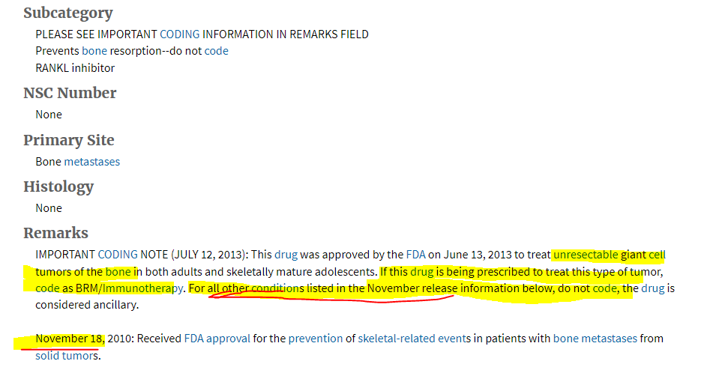
Systemic therapy
Chemo
Sometimes given intrathecally (doesn’t change how we report)
Remember to code as multiagent chemo when 2 different single agent chemotherapies are given at separate times
BRM
Donor leukocyte infusions (DLI)
CAR-T Cell Therapy
Xgeva/prolia is NOT reportable
SEER*Rx - Cancer Registrar's Interactive Antineoplastic Drugs Database - SEER Tools

Slide 53
Systemic therapy
Hormonal Therapy
Part of regimens (R-CHOP)
When prednisone or dexamethasone is given by itself, it’s often not reportable as treatment (SEER*RX remarks)
Make sure the treatment is documented as being given for the malignancy, and not something else
Biggest example: Graft versus host disease (GVHD) treatment is sometimes a chemo drug (Jakafi is what I’ve seen)

Slide 54
Systemic therapy
Hematologic Transplant and Endocrine Procedures
Bone marrow or stem cell transplant
Is considered systemic therapy
No date associated with the field
The harvest doesn’t count, it is the reinfusion of bone marrow or stem cells that is the treatment

Slide 55
transplants
Induction
Systemic therapy
To maintain remission
Conditioning
Bone marrow is 11 or 12
Post-transplant maintenance therapy
Not always given
Meant to get patient to remission or VGPR
Chemo +/- HR or BRM
Revlimid and daratumumab most common (that I see)
Consolidation
Transplant
High dose chemo
Few days leading up to the transplant
Stem cell is code 20
Notes:
This is not the guaranteed steps you’ll see, but it is the most common from my knowledge.

Slide 56
Other therapy
Phlebotomy
Polycythemia vera ONLY
Blood-thinners and/or anti-clotting agents
Essential thrombocythemia ONLY
Antibiotics (Metronidazole, Clarithromycin)
For MALT lymphoma ONLY
Notes:
Blood transfusions are never collected as treatment

Slide 57
Recurrence
Code 59 (systemic recurrence) is to be used for all lymphoma and leukemia cases that have relapsed.
Notes:
Remember, anything after a recurrence in subsequent therapy.

Slide 58
Case #1
Notes:
Plasmacytoma to myeloma

Slide 59
Case #1 multiple primary rules
Originally diagnosed as a plasmacytoma 8/30/22, but imaging with multiple bony lesions
Bone marrow biopsy 9/5/22 showing myeloma
Plasmacytoma is under ‘Transformations From’ (chronic neoplasm)
Myeloma is under ‘Transformations To’ (acute neoplasm)
Per rule M11, exception note: single primary myeloma 9732/3
Notes:
Two biopsies, within 21 days of one another
Acute and chronic neoplasms present
Myeloma, the acute dx, was found during initial workup
Per rule M11, exception note: single primary myeloma 9732/3

Slide 60
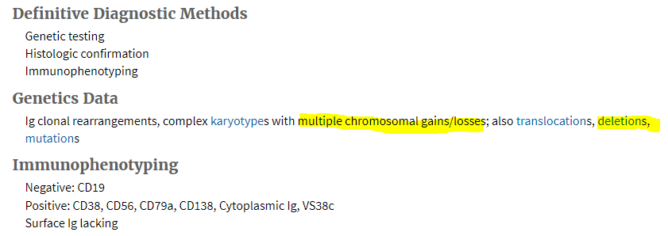
Case #1 diagnostic confirmation
Code 3: Positive histology plus positive genetic studies
Even if the bone marrow biopsy would have said plasma cell neoplasm (not positive as a reportable diagnosis by itself), 3 still would have been used due to the left femoral head and neck resection pathology.
60

Slide 61
Case #1 stage group and ssdis
Remember, stage is based off the labs collected in the SSDIs
Beta2-microglobulin
Serum albumin
LDH
High risk cytogenetics
Stage Group III
Clinical only, no pathological staging
Physicians stated Durie-Salmon Stage III, which is the old staging system that doesn’t always match new staging
Notes:
del17p; t(4;14) or t(14;16)

Slide 62
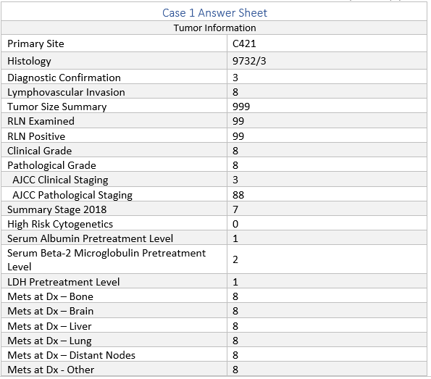
= default code

Slide 63
Case #1 surgery other reg/dis sites
Code 1
Patient underwent left total hip arthroplasty (replacement) 8/30/22
Left femoral head and neck were resected and submitted to pathology, positive for plasmacytoma
Notes:
Per STORE, code 1 is what is used when site code is C42 and there’s any surgery done.

Slide 64
Case #1 systemic therapy
Chemotherapy
Code 03
Velcade and melphalan
Initially would have been 02, for the single agent velcade, but melphalan was given pre-transplant. This is now multiple chemotherapy agents, so report accordingly.
Immunotherapy
Code 01
Revlimid and daratumumab
Hormone Therapy
Code 01
Dexamethasone, as part of the regimen
Chemo treatment code for agents given separately (all first course) - CAnswer Forum (facs.org)

Slide 65
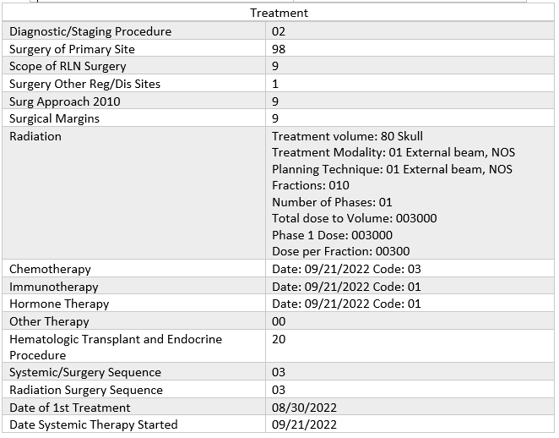
= default code

Slide 66
Case #2

Slide 67
Case #2 multiple primary rules
History of follicular lymphoma (years ago), now with node suspicious for large B-cell lymphoma
Physician confirms diagnosis of DLBCL and treats for that
Follicular lymphoma is under ‘Transformations From’ (chronic neoplasm)
DLBCL is under ‘Transformations To’ (acute neoplasm)

Slide 68
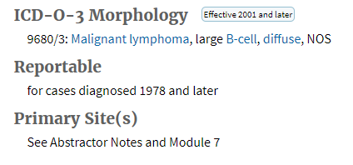
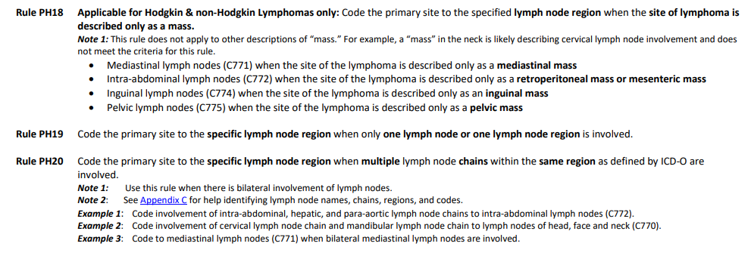
Case #2 primary site and histology
9680/3 per hematopoietic database
Also, per database, see abstractor notes and module 7
There are 10 rules in module 7 – stop at the first one that applies
Per imaging, we have neck nodes involved and no other sites of disease (retropharyngeal/submandibular area)
C770 Lymph nodes of head, face and neck

Slide 69
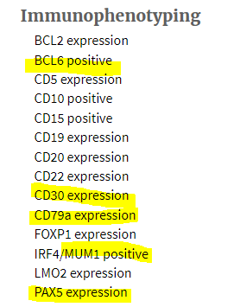
Case #2 diagnostic confirmation
Code 3: Positive histology plus positive genetic studies
Right neck node excision was suspicious for large b-cell lymphoma.
Immunophenotyping with staining positive for DLBCL
Physician confirmed DLBCL, interpreting the path report

Slide 70
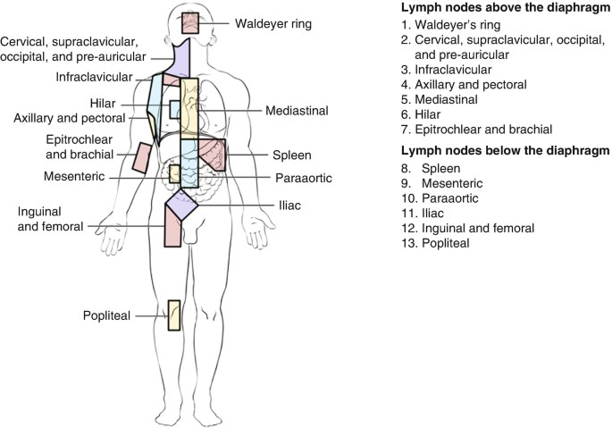
Case #2 stage group and ssdis
Neck nodes = single region
No other involvement
Clinical Stage I
Pathological Stage 99
B-Symptoms
Per H&P, denies fever, night sweats or weight loss
HIV Status
Not documented
NCCN IPI Score
Not documented
Notes:
Just because there was a node excision, doesn’t mean you have qualified for pathological stage. Remember, per AJCC, you must have a staging laparotomy done in order to path stage

Slide 71
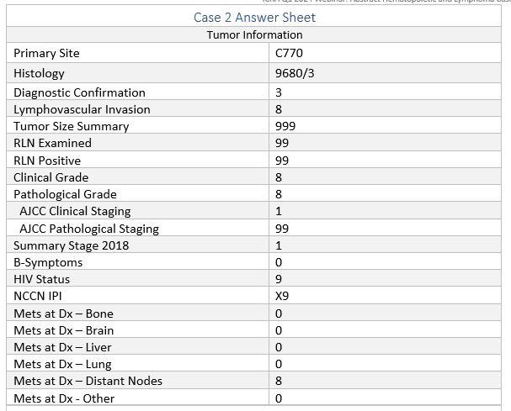
= default code

Slide 72
Case #2 surgical diagnostic/staging procedure and surgery of primary site
Multiple nodes involved
Discussed on CT, but also proven by post-excision imaging
Site code C770
Excisional biopsy gets coded as biopsy of primary site, since it was not the only node involved.
There was no removal of a lymph node chain and no other procedure done, so surgery code to 00
Notes:
del17p; t(4;14) or t(14;16)

Slide 73
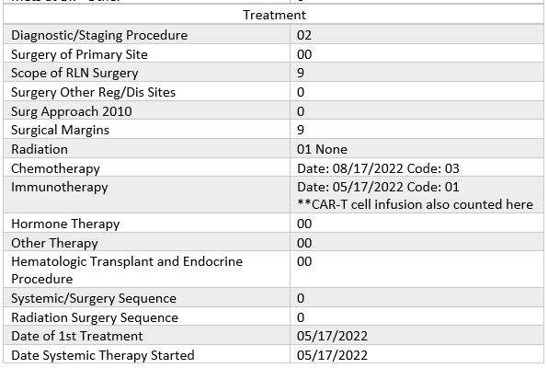
= default code

Slide 74
Pre-webinar questions
1. Patient was diagnosed with AML with MDS related changes in 2021 and presents in 2023 with a new diagnosis of MDS with excess blasts (9983/3).
a. How many primaries is this?
TWO
b. What rule did you use to determine this?
M13
Notes:
2021: Diagnosed with AML with MDS related changes (9895/3)
Treated for that.
2023: Diagnosed with MDS with excess blasts (9983/3)
AML w/ MDS related changes is an acute neoplasm (transformations to)
MDS with excess blasts is a chronic neoplasm (transformations from)

Slide 75
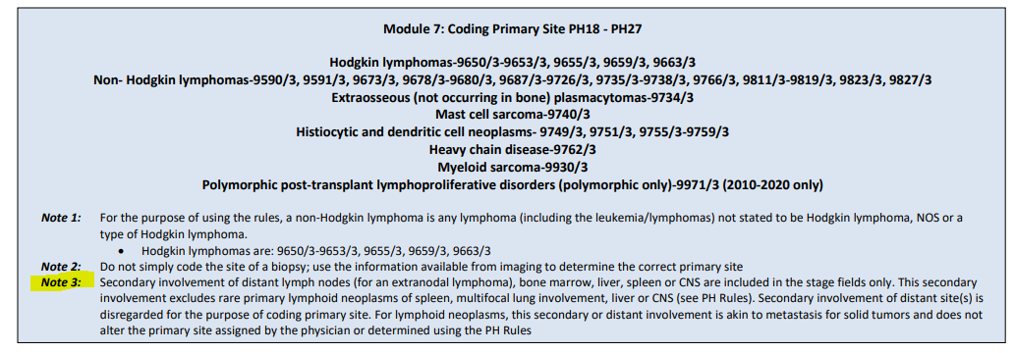
Pre-webinar questions
2. 6/2023 CT Abd & Pelvis: Multiple hepatic masses, largest measuring 3.4 cm in the right hepatic lobe concerning for hepatic metastatic disease. Bulky gastrohepatic, porta hepatis, retroperitoneal and retrocrural adenopathy. 6/24/21 Liver bx: DLBCL.
a. What is the primary site code?
C22.0
b. What rule did you use to determine this?
PH25
Notes:
Some people want to stop at PH22 here and code to C779, however, per Note 1 under PH22, we have an organ plus it’s regional nodes.
We also have non-regional nodes that are considered distant, due to the organ and regional node involvement.
PH25 note 3: Secondary involvement of distant lymph nodes and/or bone marrow are coded in stage.

Slide 76
Pre-webinar questions
3. A patient the presented with a pericardial effusion that was proven to be DLBCL. Full workup revealed no other involvement.
a. What is the primary site code?
C38.0
Notes:
Confirmed with Ask-A-SEER. They said since you only have a pericardial effusion and no other evidence of involvement, you would code to the pericardium. Same would apply to a pleural effusion lymphoma - with no other sites of involvement, site code would be C384. Peritoneal fluid = C48.2.

Slide 77
Pre-webinar questions
4. Patient found to have several scalp lesions during her annual skin check exam on 12/22/2020. Shave biopsy from her left temple, medial parietal scalp, right temple X2: Positive for atypical lymphoid infiltrate, consistent with large B-cell lymphoma. Molecular studies negative for translocation BCL 6 and c-Myc, positive for BCL-2 rearrangement. Her pathology was sent for second opinion 1/18/2021 and results were consistent with large B-cell lymphoma involving the skin.
PET/CT 1/26/2021: Widespread skeletal metastases.
Right external iliac chain and left inguinal lymph node metastases.
Deauville 4: Uptake slightly to moderately higher than liver.
PE: Skin: Several erythematous plaques in different areas in the scalp.
What is the primary site code?
C77.9
b. What rule did you use to determine this?
PH22
c. What is the histology code?
9680/3

Slide 78
Time permitting: Heme database walkthrough
https://seer.cancer.gov/seertools/hemelymph/
Notes:
Appendix C and D

Slide 79
Questions?

Slide 80
References
Ruhl J, Adamo M, Dickie L., Negoita, S. (August 2021). Hematopoietic and Lymphoid Neoplasm Coding Manual. National Cancer Institute, Bethesda, MD, 2021.
Ruhl JL, Callaghan C, Schussler N (eds.) Summary Stage 2018: Codes and Coding Instructions, National Cancer Institute, Bethesda, MD, 2023.
Ruhl JL, Callaghan C, Schussler N (eds.) Summary Stage 2018: Codes and Coding Instructions, National Cancer Institute, Bethesda, MD, 2023.
American College of Surgeons. (2024). STORE Standards for Oncology Registry Entry. American College of Surgeons, Chicago, IL, 2024.

Slide 81
THANK YOU
Leslie Woodard, ODS-C
ICRA Education Chair
Franciscan Health, System Tumor Registry Manager
Leslie.Woodard@franciscanalliance.org
Notes:
If you viewed the live webinar, a CE Certificate will be emailed out in the next week. The recording will be shared with all members and available to view for 30 days. Slides will be posted to ICRAs website, along with the completed answer sheet to the cases reviewed.

