Slide 1
Abstracting brain/cns cases (malignant and benign)
Leslie Woodard, CHCM, ODS-C
ICRA Education Chair
System Wide Tumor Registry Manager, Franciscan Health
June 2024
Notes:
I should’ve named it Abstracting malignant and non-malignant CNS neoplasms, as the standard setters no longer call it benign and borderline CNS neoplasms, rather non-malignant.

Slide 2
Agenda
Reportability
Manual Specifics for CNS Tumors
Case Scenarios

Slide 3
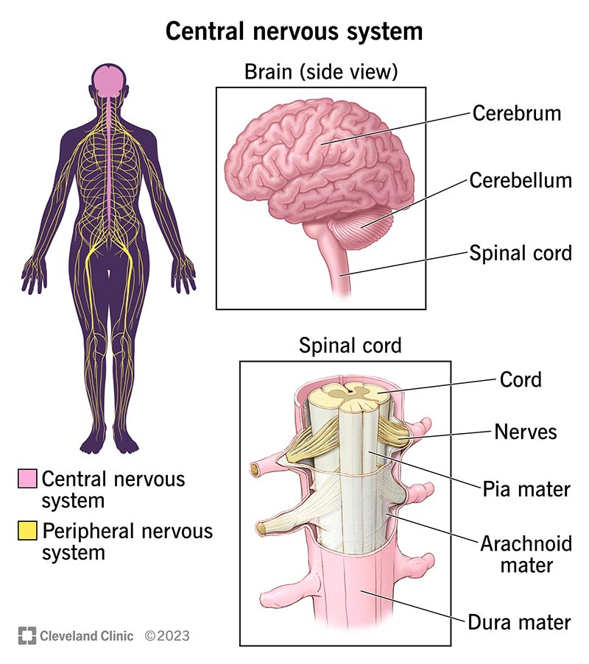
Central nervous system
https://my.clevelandclinic.org/health/body/central-nervous-system-cns

Slide 4
Reportability
Malignancies with an ICD-O-3 behavior code of 2 or 3
Note: Pilocytic astrocytoma (optic glioma)/juvenile pilocytic astrocytoma behavior changed to /1 in 2023
Intracranial and central nervous system tumors diagnosed 1/1/2004+ with a behavior of 0 or 1 for the following sites:
Meninges (C70)
Brain (C71)
Spinal Cord, cranial nerves and other parts of central nervous system (C72)
Pituitary Gland (C75.1)
Craniopharyngeal Duct (C75.2)
Pineal Gland (C75.3)
This Photo by Unknown Author is licensed under CC BY-SA
Notes:
Hx of a tumor in one of these sites that was present prior to 2004 = not reportable
Must arise in the dura or parenchyma of CNS; blood vessel/vein tumors are not part of the CNS and are not reportable if benign or borderline.

Slide 5
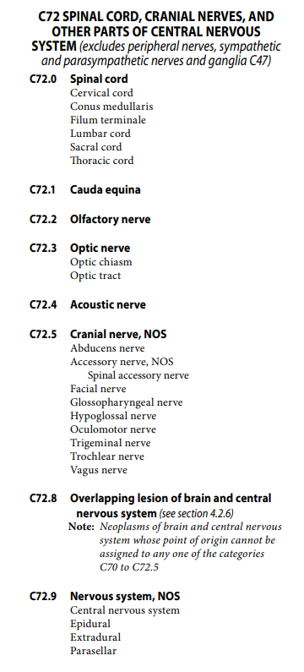
ICD-O-3
Avoid NOS code whenever possible – most common one is meninges
C70.0 (cerebral)
C70.1 (spinal)
C70.9 (NOS)

Slide 6
Reportable Terminology
Tumor and Neoplasm
Reportable 2004+
Site codes C70.0-C72.9, C751.-C75.3
Nonmalignant primary intracranial and central nervous system tumors only
https://drraoshospitals.com/brain-tumor-causes-and-treatmentdr-raos-hospital/

Slide 7
Reportable benign/borderline tumors
Indiana State Cancer Registry Manual
Appendix B, Part B

Slide 8
Reportability/Anatomy
Acoustic neuroma AKA vestibular schwannoma
Acoustic nerve tumor, C724
Reportable!
Venous angioma AKA venous anomaly
NOT reportable because primary site is C490
https://seer.cancer.gov/seer-inquiry/inquiry-detail/20130001/
Cavernoma AKA hemangioma or cavernous hemangioma
Must arise in dura or parenchyma to be reportable

Slide 9
Anatomy
Dura
Thick membrane of connective tissue surrounding the brain and spinal cord
Parenchyma
Functional tissue in the CNS (white and gray matter)
Notes:
Intradural = reportable, and can be intramedullary or extramedullary
Extradural = not reportable
SEER Inquiry System - Question 20210031 Details (cancer.gov)

Slide 10
Reportability
If unable to confirm site of origin, don’t report
https://seer.cancer.gov/seer-inquiry/inquiry-detail/20200041/
https://seer.cancer.gov/seer-inquiry/inquiry-detail/20150057/
https://seer.cancer.gov/seer-inquiry/inquiry-detail/20130203/

Slide 11
Casefinding Tip
Imaging Reports
Monthly/quarterly report of CT/MRI Brain from EMR, exported to excel
Apply conditional formatting for cells containing top reportable terms
Tumor
Neoplasm
Meningioma
Glioma
Malignancy
-oma

Slide 12
Manual specifics for cns cases

Slide 13
SOLID TUMOR RULES
https://seer.cancer.gov/tools/solidtumor/

Slide 14
Solid Tumor Rules
Two modules apply
Malignant CNS and Peripheral Nerves
Non-Malignant CNS Tumors
Both include very useful instructions beyond the normal multiple primary and histology coding rules
Section 1: Determine behavior code and appropriate module
Section 2: Confirm the primary site/histology combination is reportable
Section 3: Additional information for a complete abstract
Notes:
Section breakdown:
1: Priority order for behavior code and table 1 which includes the grade for select CNS neoplasms
2: Priority order for coding primary site; reportable primary site groups; reportable primary sites; non-reportable neoplasms; histology table; coding primary site
3: Priority order for conflicting information on path reports; paired sites; potential transforming tumors

Slide 15
Solid Tumor Rules
The following is NOT used to determine multiple primaries for CNS tumors
Timing
Laterality
There are multiple tables in the STR to assist in appropriately determining reportability
Component and phenotype are not equivalent to subtype/type/variant
Make sure you are using the correct module based off behavior!

Slide 16
Solid Tumor Rules

Slide 17
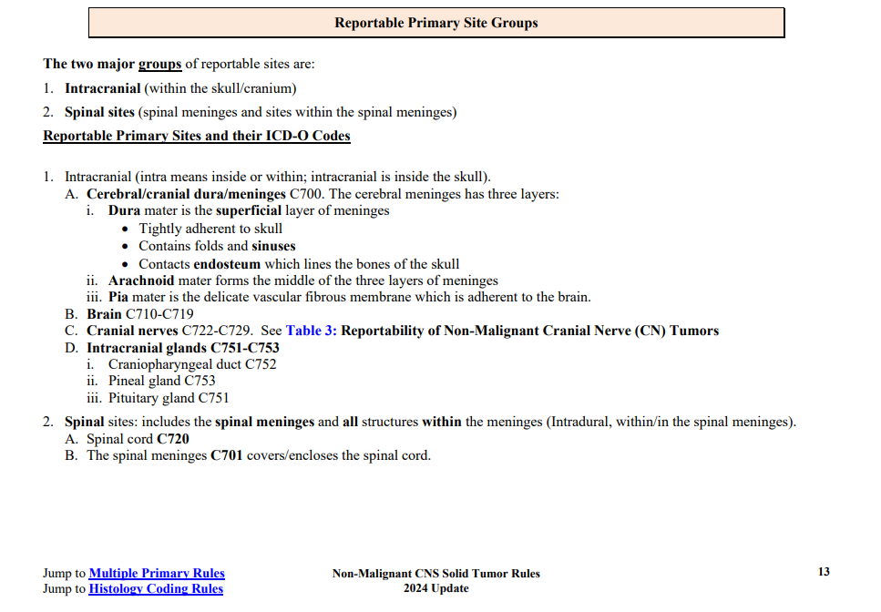
Solid Tumor Rules

Slide 18
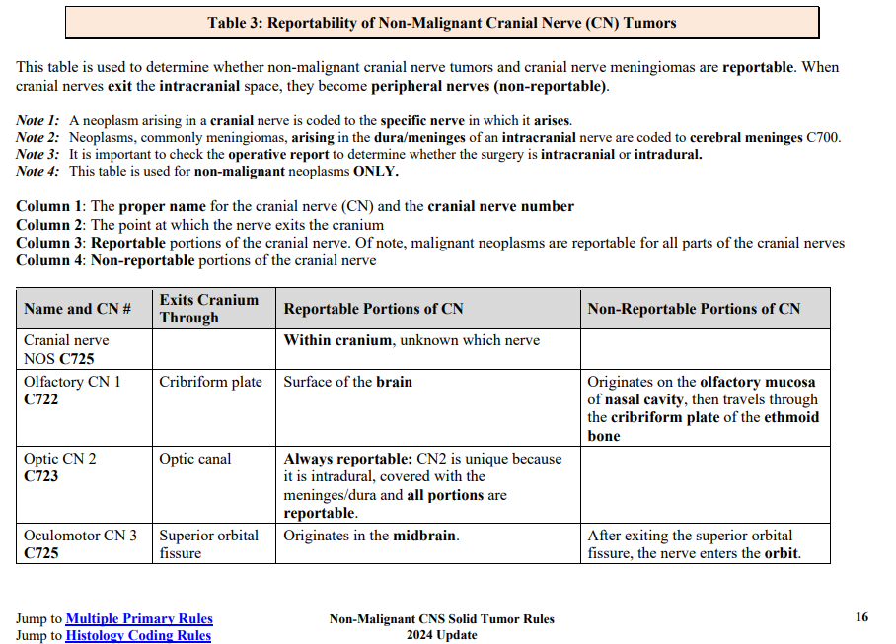
Solid Tumor Rules

Slide 19
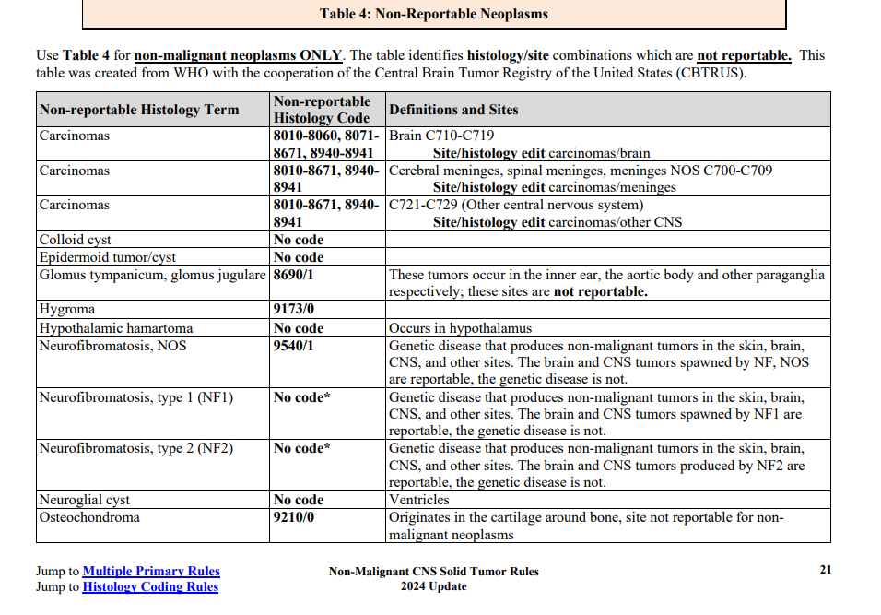
Solid Tumor Rules

Slide 20
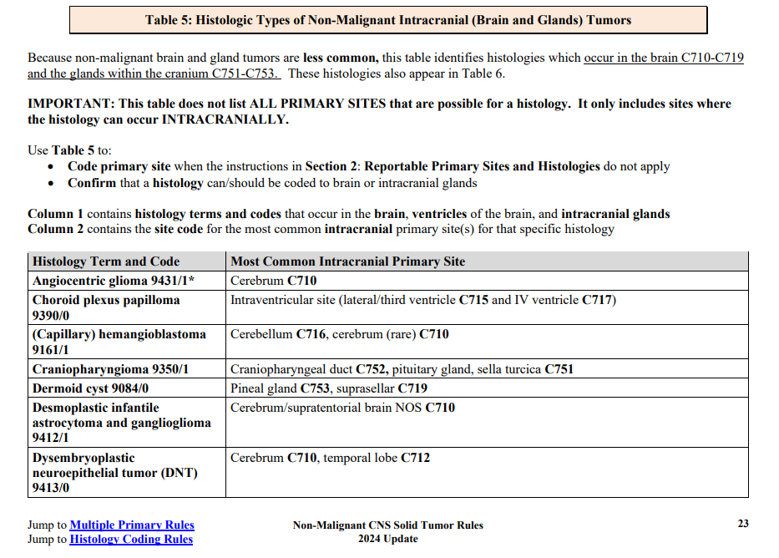
Solid Tumor Rules

Slide 21
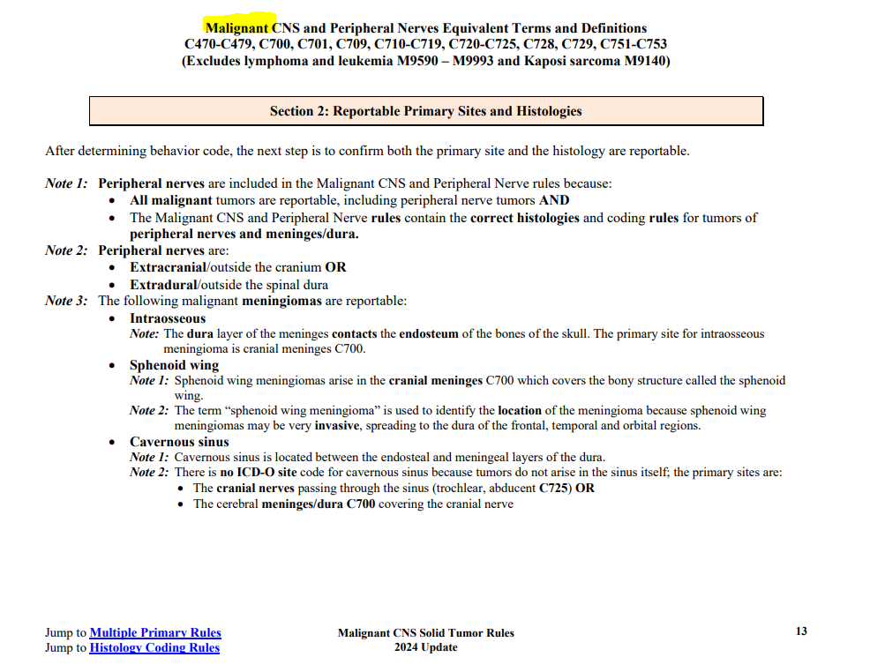
Solid Tumor Rules

Slide 22
Solid Tumor Rules
Pituitary adenoma is synonymous with:
Microadenoma
Macroadenoma
Specific ICD-O-3 histology code!
Not adenoma, NOS

Slide 23
STORE
https://www.facs.org/media/oldnkjba/store-2024-final-12192023.pdf

Slide 24
STORE
Sequence number
Codes 60-88 indicate neoplasms of non-malignant behavior (0 or 1)
Lymphovascular Invasion
Code 8 for all benign/borderline brain and CNS tumors
Mets at Diagnosis
Code 0 for benign brain or CNS tumor
Lymph Nodes
Use code 99 for all brain, CNS, intracranial gland sites for both nodes examined and positive
Scope of Regional Lymph Node Surgery is coded to 9
Notes:
60 is treated just like 00; if there are 2 non-malignant reportable tumors, you will have sequence 61 and 62

Slide 25
STORE
Laterality
Notes:
60 is treated just like 00; if there are 2 non-malignant reportable tumors, you will have sequence 61 and 62

Slide 26
GRADE
https://www.naaccr.org/wp-content/uploads/2023/10/Grade-Coding-Instructions-and-Tables-v3_printed.pdf?v=1717515751

Slide 27
Grade
Brain, CNS other, intracranial glands all follow the same grade instructions
Clinical grade can be assigned without histologic confirmation
Behavior of 0 = automatic grade of 1
Other default grades can be assigned
See STR, AJCC, or CAP
Source: Malignant CNS Solid Tumor Rules 2024 Update (cancer.gov)
Notes:
Path grade still requires resection of primary tumor

Slide 28
SSDI
https://www.naaccr.org/wp-content/uploads/2023/10/Site-Specific-Data-Item-SSDI-Manual_printed.pdf?v=1717515751

Slide 29
SSDI’s
Brain Molecular Markers
Only if histology is 9400/3, 9401/3, 9440/3, 9450/3, 9451/3, 9471/3 and 9478/3
85 if not one of the above histologies
86 for benign or borderline
99 if no microscopic confirmation
Brain Primary Tumor Location
New for 2024
C71.7 site code only, as it covers many subsites of the brain stem

Slide 30
SSDI’s
Loss of Heterozygosity: Chromosome 1p and 19q
Use EMR search function to look up 1p,19q, or loss of heterozygosity
Typically found in path comments
Code 6 for benign or borderline tumors
Methylation of 06-Methylguanine-Methyltransferase (MGMT)
6 for benign or borderline tumors
Notes:
SSDI manual provides a list of histologies that are most commonly tested for these, but search for all malignant histologies

Slide 31
AJCC
Version 9 Protocol Effective 1/1/2023

Slide 32
AJCC
Brain and Spinal Cord includes C70, C71, C72, C75
Staging applies to medulloblastoma ONLY
There is only a M category
As noted previously, AJCC provides a grade table based on histology

Slide 33
SUMMARY STAGE
https://seer.cancer.gov/tools/ssm/SSM2018-BRAIN.pdf

Slide 34
SUMMARY STAGE
4 sections under brain chapter
Brain
CNS Other
Intracranial Glands
Medulloblastoma
Code 0 is only applicable for intracranial glands
Codes 3 and 4 are not applicable
Code 8 used for all benign or borderline tumors
Brain: need to know infratentorial vs. supratentorial (location above or below the tentorium)

Slide 35
TREATMENT

Slide 36
TREATMENT TIPS
Stereotactic biopsy
Coded as surgery to primary site or diagnostic/staging procedure?
SEER and Indiana State Cancer Registry Educational Coordinator Code 20 or A200 depending on diagnosis year
BUT…NCDB says it is like a normal biopsy and gets coded under surgical diagnostic/staging procedure
Brain primary stereotactic bx - code in SDSP vs and/or surgery - CAnswer Forum (facs.org)
Regardless, it does NOT count towards pathologic eligibility for grade
Pay close attention to surgery codes
While all on the same page, some apply to brain only, while others are for spinal cord or nerves only
Notes:
Will make sure to send clarification when it is provided on stereotactic biopsies. According to the latest post, it is being taken to NCDB management and SEER for discussion.

Slide 37
TREATMENT TIPS
Radiation
Multiple brain tumors receiving (separate) radiation = multiple phases
Could be given on same days or different days (STORE XRT example 27)
SRS to Multiple Brain Mets on Multiple Days - CAnswer Forum (facs.org)
Cabergoline
Hormonal therapy for pituitary tumors
Tumor treatment fields (AKA Optune)
Other therapy, code 1
Notes:
3/7/22 R Superior Cerebral 1800 cGy in 1 fx, SRS 3/8/22 L Cerebral 1800 cGy in 1 fx, SRS 3/9/22 R Parietal 1800 cGy in 1 fx, SRS 3/10/22 R Superior Temporal 1800 cGy in 1 fx, SRS 3/11/22 R Superior Frontal 1800 cGy in 1 fx, SRS
= 5 phases, even through the treatment volume is partial brain, dose is same and fraction is same. It is 5 different anatomic sites.

Slide 38
TREATMENT TIPS
Active Surveillance or No Treatment
Date of 1st Treatment still needs coded
The date the decision is made for surveillance or no treatment

Slide 39
Case Scenarios

Slide 40
Case #1
Patient presented with dizziness, lightheadedness and just not feeling herself. MRI brain ordered. Has a history of breast cancer.
1/7/24 MRI Brain: Probable 7 mm pituitary adenoma. Consider pituitary MRI for further evaluation.
1/12/24 Pituitary MRI: 2 discrete pituitary lesions noted, most suspicious for pituitary adenomas. One centered to the left of the midline, extending into the suprasellar cistern, measuring 6mm x 7.5mm. The other is slightly to the right of the midline, measuring 9mm x 5.5mm.
1/27/24 Endocrinologist Visit: I described her pituitary adenomas in detail. They are like an incidental finding and unlikely to be causing any of her symptoms. Check thyroid function test, cortisol, ACTH, LH and FSH and IGF-I. Repeat pituitary MRI in 6 months. No further treatment warranted.
6/7/24 Endocrinologist Visit: Repeat MRI showed both adenomas to be stable in size. No further action is needed at this time. Repeat pituitary MRI in about a year.

Slide 41
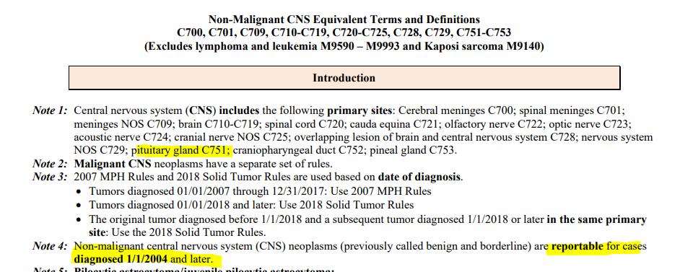
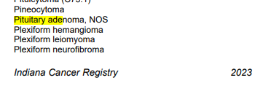
Case #1
Step 1:
Confirm pituitary gland is a reportable site for non-malignant tumors
Resources:
Indiana State Cancer Registry Manual
STORE
Solid Tumor Rules

Slide 42
Case #1
Step 2:
Check histology code for adenoma of the pituitary gland
Resources:
ICD-O-3
Solid Tumor Rules

Slide 43
Case #1
Step 3:
Determine number of primaries, as there are 2 separate tumors
Resources:
Solid Tumor Rules
Notes:
Start at M5 due to multiple tumors
Not M5 because we don’t have a malignant tumor
Not M6 because we don’t have bilateral acoustic neuromas or optic gliomas
Not M7 because we don’t fall under the primary sites lists (brain, meninges, spinal cord, nerves)
Not M8 because we have a single histology, no subtype
Not M9 as we aren’t dealing with meningiomas
Not M10 because we are dealing with an intracranial gland, not the brain

Slide 44
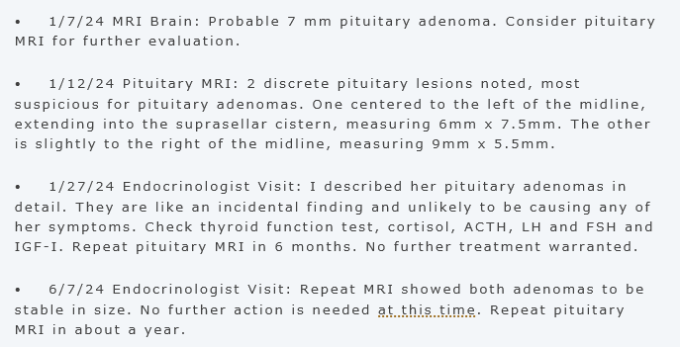
Case #1
Diagnosis Date | 01/07/2024
Site Code | C75.1
Histology Code | 8272/0
Sequence Number | 60
Tumor Size Summary | 009
Diagnostic Confirmation | 7
Laterality | 0
LVI | 8
Regional Nodes Positive | 99
Regional Nodes Examined | 99
Clinical Grade | 1
Pathological Grade | 9
Clinical Stage | 88
Pathological Stage | 88
Summary Stage | 8
Mets at Diagnosis | 0
Date of 1st Treatment | 01/27/2024
Treatment Status | 2
Recurrence Type | 70
Date Cancer Status | 01/27/2024
Cancer Status | 2
Notes:
Breast cancer hx doesn’t affect benign sequencing.

Slide 45
Case #2
Patient presents with having a seizure at the grocery store. Prior to this he reports a 1-week history of intermittent tingling on left side of face, left hand and lesser left leg. Today is his second seizure, he did lose consciousness, he was postictal for a period of time, but is better.
1/12/2024 CT Head: Mildly expansile T2 hyperintense cortical and subcortical white matter lesion in the right insula ~ 3.8 cm. Primary differential is neoplasm, versus infection or inflammatory encephalitis.
1/12/2024 MRI Brain: Intracranial structures demonstrates at least 2 distinct rim enhancing lesions of the right subinsular region measuring up to 1.0 cm and 0.6 cm with differential considerations favoring a neoplastic-metastatic process. Alternative considerations for an infectious-inflammatory etiology, as with a septic embolic process not entirely excluded.
1/12/2024 CT CAP: No evidence of malignancy in the chest, abdomen or pelvis. (Indication= brain tumor, rule out other primary sites)
1/15/2024: Right Frontotemporal craniotomy for resection insular tumor: I began debulking and resecting the tumor. There was 1 branch going over the tumor, which was preserved and I worked on both sides of it. Fluorescein showed significant fluorescence of the tumor. The tumor was debulked using the sonopet. We also utilized the ultrasound before and after the resection. Once we removed as much tumor as possible, hemostasis was obtained
Path: Glioblastoma, IDH-wildtype, CNS WHO Grade 4
2/3/2024: Concurrent chemoradiation began (radiosensitizing Temodar)
3/15/2024: IMRT to right insular completed via photon energy. 4600 cGy in 23 fractions, followed by boost of 1400 cGy in 7 fractions.
3/28/2024: Adjuvant Temodar
4/15/2024: Optune

Slide 46
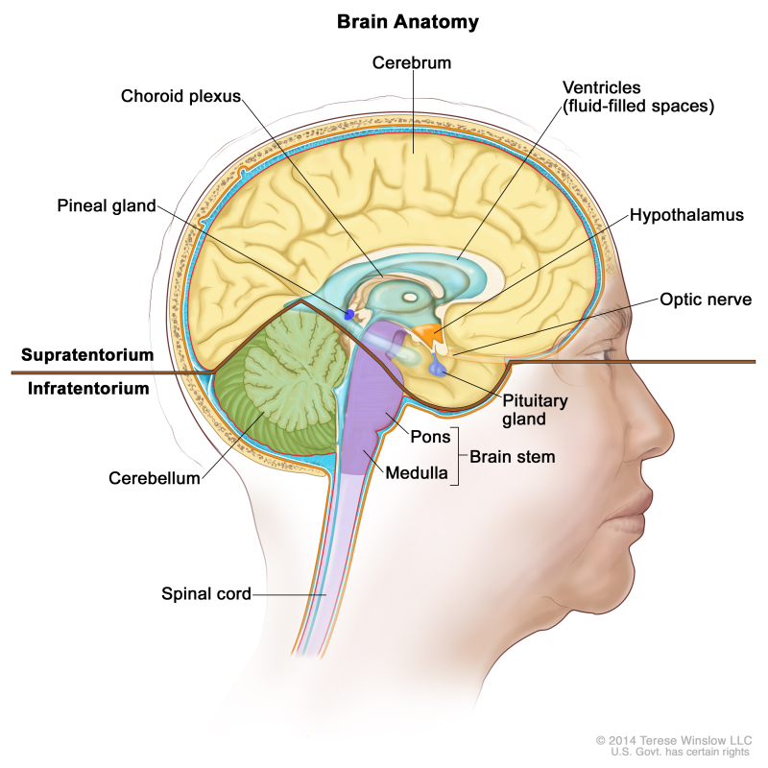
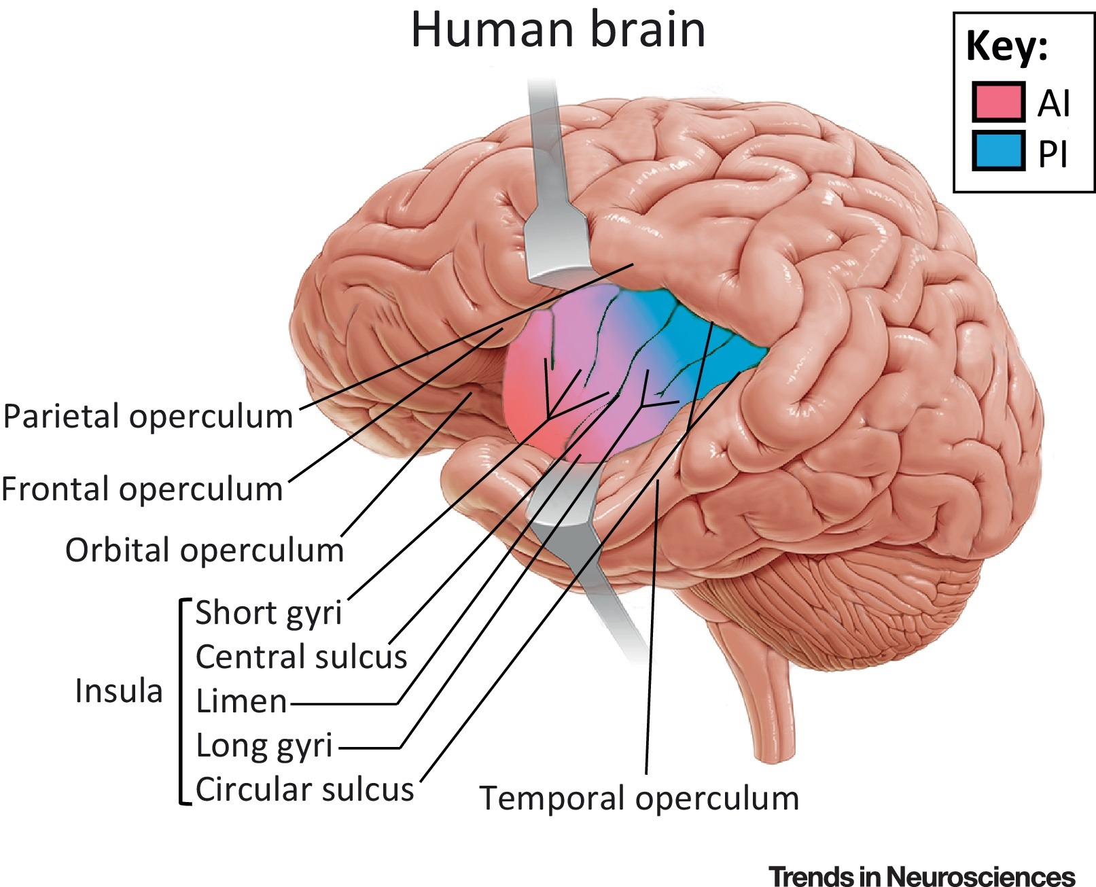
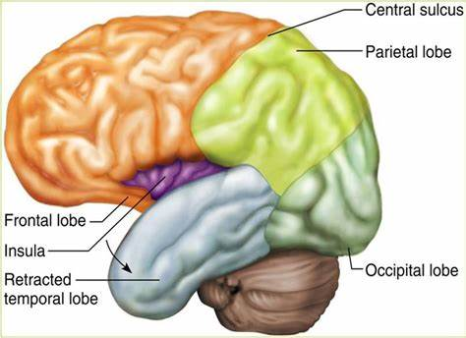
Case 2 Anatomy
What is the insula?
https://www.ncbi.nlm.nih.gov/pmc/articles/PMC6032992/
https://www.ncbi.nlm.nih.gov/books/NBK65982/bin/CDR0000765241.jpg
Notes:
The insula is a portion of the cerebral cortex.
The supratentorial region of the brain refers to the area located above the tentorium cerebelli. This region contains the cerebral cortex, making the insular part of the supratentorial region.
The insula subserves a wide variety of functions in humans ranging from sensory and affective processing to high-level cognition

Slide 47
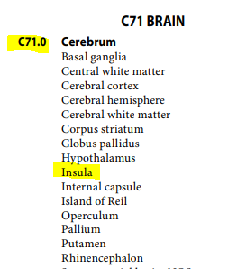
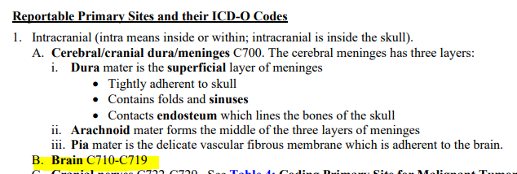
Case #2
Resources:
ICD-O-3
Solid Tumor Rules
Determine behavior
Per STR, cases are reportable as malignant when pathology states a WHO Grade 3 or 4
Check primary site reportability
Check histology reportability

Slide 48
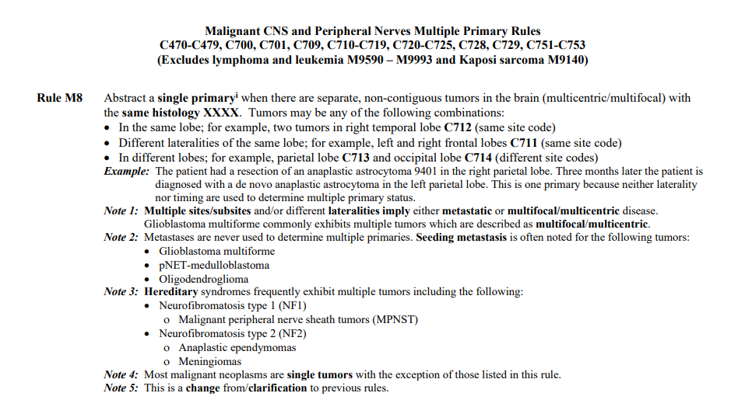
Case #2
Resources:
Solid Tumor Rules
Determine number of primaries, as there are 2 separate tumors

Slide 49
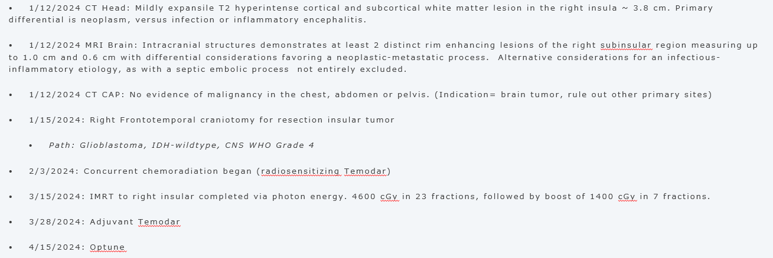
Case #2
Diagnosis Date | 01/12/2024
Site Code | C71.0
Histology Code | 9440/3
Sequence Number | 00
Tumor Size Summary | 038
Diagnostic Confirmation | 1
Laterality | 1
LVI | 9
Regional Nodes Positive | 99
Regional Nodes Examined | 99
Clinical Grade | 9
Pathological Grade | 4
Clinical Stage | 88
Pathological Stage | 88
Summary Stage | 1
Mets at Diagnosis | 0
Brain Molecular Markers | 05
Chromosome 1p: LOH | 9
Chromosome 19p: LOH | 9
MGMT | 9
Brain Primary Tumor Location | (blank)
Notes:
Summary stage: already determined to be supratentorial.

Slide 50
Case #2
Surgical Diagnostic/Staging Procedure | 00
Surgery Code 2023 | A210
Surgical Margins | 9
Scope of Reg LN Surgery | 9
Chemotherapy Start Date | 03/28/2024
Chemotherapy Code | 02
Hormone Start Date | (blank)
Hormone Code | 00
Immunotherapy Start Date | (blank)
Immunotherapy Code | 00
Other Treatment Start Date | 04/15/2024
Other Treatment Code | 1
Notes:
Breast cancer hx doesn’t affect benign sequencing.

Slide 51
Case #2
Radiation Start Date | 02/03/2024
Radiation End Date | 03/15/2024
Number of Phase | 02
Total Dose to Volume | 006000
Phase 1 Treatment Volume | 13
Phase 1 Radiation to Nodes | 00
Phase 1 Treatment Modality | 02
Phase 1 Planning Technique | 05
Phase 1 Number of Fractions | 023
Total Dose for Phase 1 | 004600
Phase 1 Dose per Fractions | 00200
Phase 2 Treatment Volume | 13
Phase 2 Radiation to Nodes | 00
Phase 2 Treatment Modality | 02
Phase 2 Planning Technique | 05
Phase 2 Number of Fractions | 007
Total Dose for Phase 2 | 001400
Phase 2 Dose per Fractions | 00200
Discontinued Early | 01
Notes:
Breast cancer hx doesn’t affect benign sequencing.

Slide 52
Case #2
Date of First Treatment | 01/15/2024
Systemic Surgery Sequence | 3
Date Systemic Therapy Started | 03/28/2024
Rx Summ – Treatment Status | 1
Recurrence Type | 70
Date Cancer Status | 01/15/2024
Cancer Status | 2
Notes:
Breast cancer hx doesn’t affect benign sequencing.

Slide 53
BONUs!

Slide 54
Is this reportable?
1. Redemonstrated central cord signal abnormality of the partially visualized cervical spine extending into the level of T1.
2. No T2 hyperintense cord signal abnormality or abnormal enhancement of the thoracic cord.
3. Widely patent thoracic spinal canal and neural foramina.
4. Marrow replacing lesion of the T10 vertebral body which is favored to represent an atypical intraosseous hemangioma given the enhancement pattern and suggestion of internal matrix on previous CT examination.

Slide 55
Is this reportable?
1. Redemonstrated central cord signal abnormality of the partially visualized cervical spine extending into the level of T1.
2. No T2 hyperintense cord signal abnormality or abnormal enhancement of the thoracic cord.
3. Widely patent thoracic spinal canal and neural foramina.
4. Marrow replacing lesion of the T10 vertebral body which is favored to represent an atypical intraosseous hemangioma given the enhancement pattern and suggestion of internal matrix on previous CT examination.

Slide 56
Is this reportable?
1. Redemonstrated central cord signal abnormality of the partially visualized cervical spine extending into the level of T1.
2. No T2 hyperintense cord signal abnormality or abnormal enhancement of the thoracic cord.
3. Widely patent thoracic spinal canal and neural foramina.
4. Marrow replacing lesion of the T10 vertebral body which is favored to represent an atypical intraosseous hemangioma given the enhancement pattern and suggestion of internal matrix on previous CT examination.

Slide 57
Is this reportable?
Suspected venous hemangioma present in the left cerebellar region.
Step 1: Behavior Code
/0 per ICD-O-3
Step 2:Histology
9122 per ICD-O-3 and STR
Step 3: Site Code
C49.0 vs C71.6

Slide 58
Is this reportable?
Suspected venous hemangioma present in the left cerebellar region.
Venous defined = relating to a vein or veins
Venous hemangioma = Hemangioma (tumor) arising in the veins
Step 1: Behavior Code
/0 per ICD-O-3 and AJCC
Step 2:Histology
9122 per ICD-O-3 and STR
Step 3: Site Code
C49.0 vs C71.6

Slide 59
Is this reportable?
Suspected venous hemangioma present in the left cerebellar region.
A tumor of the vein(s) in the brain.
Site = vein (C49)
C49.0 and 9122/0 a reportable combination
Step 1: Behavior Code
/0 per ICD-O-3
Step 2:Histology
9122 per ICD-O-3 and STR
Step 3: Site Code
C49.0 vs C71.6

Slide 60
Is this reportable?
Example 1: Clinical Diagnosis: Extradural spinal cord tumor compatible with schwannoma.
Example 2: Final Pathologic Diagnosis: Designated "C3-4 nerve sheath tumor" excision: Morphologic and immunohistochemical findings consistent with cellular schwannoma.
Example 3: Final Pathologic Diagnosis: T-8 vertebral tumor resection: Schwannoma with degenerative changes (calcification, cyst formation) - ganglion and nerve are identified.
Remember – must arise within the dura or parenchyma to be reportable as a non-malignant CNS tumor
https://seer.cancer.gov/seer-inquiry/inquiry-detail/20130148/

Slide 61
Is this reportable?
Example 1: Clinical Diagnosis: Extradural spinal cord tumor compatible with schwannoma.
Example 2: Final Pathologic Diagnosis: Designated "C3-4 nerve sheath tumor" excision: Morphologic and immunohistochemical findings consistent with cellular schwannoma.
Example 3: Final Pathologic Diagnosis: T-8 vertebral tumor resection: Schwannoma with degenerative changes (calcification, cyst formation) - ganglion and nerve are identified.
Remember – must arise within the dura or parenchyma to be reportable as a non-malignant CNS tumor. When not known, don’t report.
https://seer.cancer.gov/seer-inquiry/inquiry-detail/20130148/
Notes:
Per Ask-A-SEER Extradural schwannomas are not reportable (outside the dura). Neither vertebral nerve sheath nor a location of/on a specific vertebrae confirm the origin as being either extradural or intradural. Do not report a non-malignant tumor if it cannot be determined to be "intradural" or "of the nerve root."

Slide 62
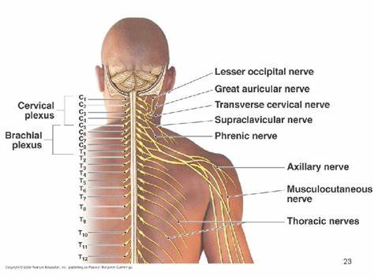
Is this reportable?
Left occipital nerve mass resection = benign schwannoma
Step 1: Behavior Code
/0 per pathology
Step 2:Histology
9560 per ICD-O-3 and STR
Step 3: Site Code
C47 vs C72
https://seer.cancer.gov/seer-inquiry/inquiry-detail/20041097/

Slide 63
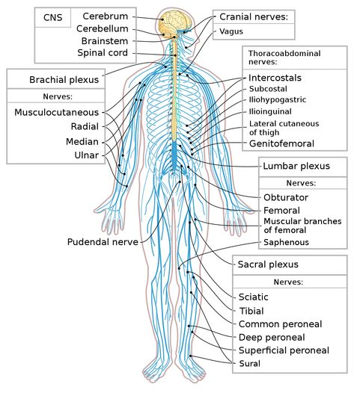
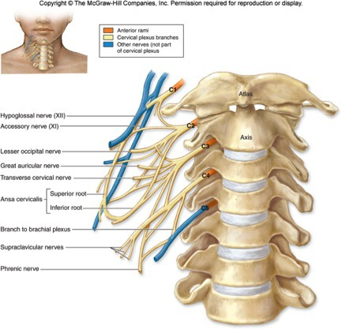
Is this reportable?
Per STR there are two major groups of reportable sites:
Intracranial
12 cranial nerves
When a cranial nerve exits the intracranial space, they become peripheral (non-reportable) nerves
Spinal sites
Within spinal cord and meninges only

Slide 64
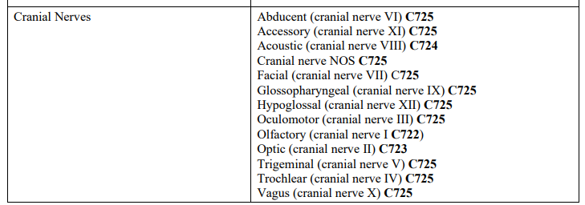
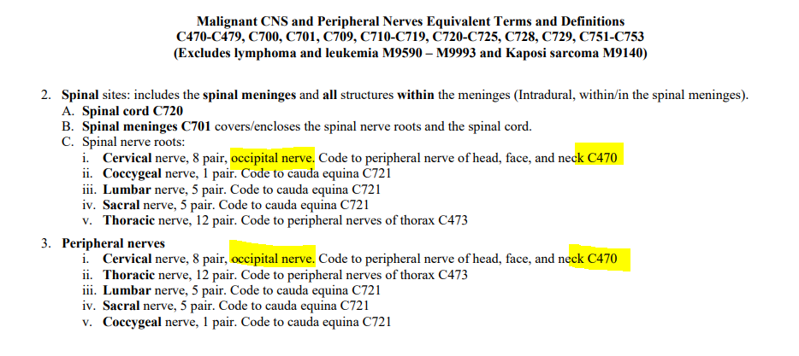
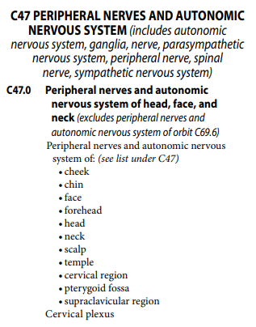
Is this reportable?
Left occipital nerve mass resection = benign schwannoma
Occipital nerve is not one of the 12 cranial nerves
It arises in the nerves of the cervical region
STR tell us the occipital nerve should be coded to C470
ICD-O-3 also shows cervical region nerves are C47.0

Slide 65
Is this reportable?
Left occipital nerve mass resection = benign schwannoma
C47.0 and 9560/0 a reportable combination
Step 1: Behavior Code
/0 per pathology
Step 2:Histology
9560 per ICD-O-3 and STR
Step 3: Site Code
C47 vs C72
https://seer.cancer.gov/seer-inquiry/inquiry-detail/20041097/

Slide 66
What is the histology code?
Brain stereotactic bx: high grade astrocytoma, at least anaplastic astrocytoma WHO grade 3, IDH-Wild Type (see comment)
Comment: The tumor cell morphology seen together with mitotic activity supports a high grade glioma, at least anaplastic astrocytoma, WHO grade III.

Slide 67
What is the histology code?
Brain stereotactic bx: high grade astrocytoma, at least anaplastic astrocytoma WHO grade 3, IDH-Wild Type (see comment)
Comment: The tumor cell morphology seen together with mitotic activity supports a high grade glioma, at least anaplastic astrocytoma, WHO grade III.
9401/3
Ask SEER CTR #29326

Slide 68
THANK YOU
Leslie Woodard, CHCM, ODS-C
ICRA Education Chair
Tumor Registry Manger, System Wide
Franciscan Health
Leslie.woodard@franciscanalliance.org

Slide 69
References
World Health Organization. (2013). Internation Classification of Disease for Oncology (3rd ed.). https://iris.who.int/bitstream/handle/10665/96612/9789241548496_eng.pdf.
Ruhl JL, Callaghan C, Schussler N (eds.). (2023). Summary Stage 2018: Codes and Coding Instructions. National Cancer Institute, Bethesda, MD.
Dickie L., Johnson, CH., Adams, S., Negoita, S. (December 2023). Solid Tumor Rules. National Cancer Institute, Rockville, MD 20850.
Ruhl J, Hofferkamp J, et al. (October 2023). Site-Specific Data Item (SSDI) Manual. NAACCR, Springfield, IL 62704-4194.
Ruhl J, Hofferkamp J, et al. (October 2023). Grade Manual. NAACCR, Springfield, IL 62704-4194.

