Slide 1

ICRA Q1 2026:
Hematopoietic Primary Site and Histology Coding
March 2026
Leslie woodard, ods-c
Icra education chair

Slide 2
ICYMI
Hematopoietic manual updated!

Slide 3
What Changed?
Hematopoietic Database
Hematopoietic manual
  New terms
  Immunophenotyping and genetics
  Abstractor notes
  Definitions
  Resources
No new or deleted rules or modules
Structured differently
New sections (introduction to heme neoplasms; coding mets at dx fields)
Updated instructions for assigning histology based on immunophenotyping and genetics
Many new detailed instructions and examples
Notes:
Many walk-through guides with snips, such as how to use the database, applying transformation rules, etc.

Slide 4

Important
The updates to the hematopoietic manual can be applied for all cases diagnosed 2010+. It is not recommended to make changes to already abstracted cases but apply to all new cases moving forward.

Slide 5
First Course of Treatment
When there is a single primary, use the documented first course of therapy (treatment plan). First course of therapy ends when the treatment plan is completed or remission is achieved.
  Keep in mind, the treatment plan evolves as the patient goes through treatment.
  Changes in treatment, due to either a patient responding well or not responding well is still first course of treatment.
    See the specific examples in the manual
  If active surveillance is the first course treatment, that is the only first course treatment.
    Starting treatment after a period of AS is subsequent therapy

Slide 6

Diagnostic Confirmation
There are a handful of histologies that can only be 3
  Noted in the database AND enforced by edits
Positive immunophenotyping doesn’t automatically = 3
  Registrars are NOT to update the diagnosis based on positive immunophenotyping and genetics results only. The updated diagnosis based on positive genetics or immunophenotyping MUST be provided by the pathologist or the managing physician
When in doubt, use code 1

Slide 7
Multiple Primary Rules
Clarifications made with examples added
Single histology = single primary
  No timing rule
Blood smear +/- flow cytometry is counted as a specimen
  Example: M11 says multiple primaries when there is a chronic and acute diagnosed during the initial workup with two biopsies
    Bone marrow biopsy on 3/4/26 = CMML
    Blood smear with flow cytometry on 3/19/26 = AML
      Although M11 says two biopsies, and the notes specifically list bone marrow biopsy, lymph node biopsy, or tissue biopsy only, Ask-A-SEER did confirm a blood smear counts as a 2nd specimen

Slide 8

Transformations
Section updated with lots of examples
Chronic = listed under transformations from
Acute = listed under transformations to

Slide 9
Mets at Dx
Primary site C421 = code 8 for all fields
Primary site C77 = code 8 only for distant lymph nodes

Slide 10

Histology Coding

Slide 11
Notes
For all heme cases, always start with a working histology and go to the database FIRST
Registrars are not to assign a more specific histology code based off immunophenotyping or genetics without a physician calling it a specific histology
Just like solid tumors, there are now terms that are no longer considered ambiguous for definitive histology coding
Notes:
The immunophenotyping/genetics must be used by the pathologist or physician to provide a more definitive histology. If the pathology report says AML and you find a cytogenetics report that shows RUNX1 and NPM1 are mutated but the histology reported by the physician and pathologist stays AML NOS. That’s what we code, even though RUNX1 and NPM1 mutations have specific histology codes.
‘ambiguous’ now definitive terms = compatible with, comparable with, consistent with, most likely, probably, typical of

Slide 12
Multiple Primary/Histology Examples

Slide 13
Follicular Lymphoma
2/7/2023 patient diagnosed with stage 3 Follicular Lymphoma Grade 1-2 (9691/3)
3/1/2026 patient presents to your facility, reporting a history of FL that has been in remission since 2024. Bone marrow biopsy reveals Grade 3 Follicular lymphoma (9698/3).
  Per rule M2 this is a single primary
  FL is always a single primary, even though there are different histology codes based on grade
  You would report this as 9698/3 with a diagnosis date of 2023 (highest grade is reported)
Notes:
The 2023 facility should update their histo from 9691/3 to 9698/3 if they’re aware of the new result.

Slide 14
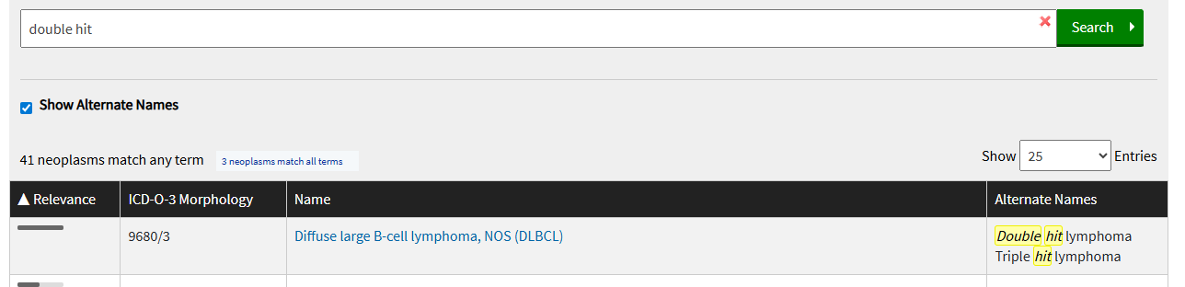
DLBCL
Patient has a history of colon stage 1E DLBCL from 1999
Returns to the facility with enlarged neck nodes, biopsy proven double hit lymphoma per medical oncologist
  Look up double hit in the hematopoietic database
  It is the same histology as DLBCL
  Single primary per rule M2

Slide 15
Chronic/Acute Rules
Common scenario:
  Imaging reveals a lesion in the rib, potentially metastatic
  Bx of rib = plasmacytoma
  PET and bone scan = multiple lytic lesions throughout the body consistent with multiple myeloma
    Single primary per rule M8
    Chronic (myeloma) and acute (plasmacytoma) diagnosed during the initial clinical workup with a single specimen
    Consistent with = definitive diagnosis terminology
Notes:
Rule M8: Chronic and acute diagnosed during the initial clinical workup with one specimen
Abstract as a single primary and code the acute neoplasm when both a chronic and an acute neoplasm are diagnosed during the initial clinical workup AND there is documentation of only one positive biopsy (bone marrow biopsy, lymph node biopsy, or tissue biopsy).
2. See Rule M11if there are two or more biopsies.

Slide 16
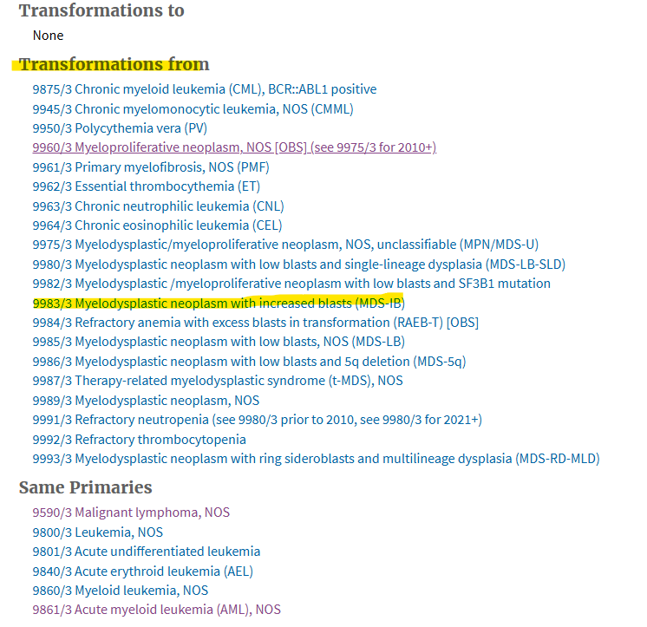
Chronic/Acute Rules
2021
Diagnosed and treated for AML with MDS related changes (9895/3)
2025
Bone marrow biopsy = MDS with excess blasts (9983/3)
Snip from database for AML w/MDS changes
  Originally diagnosed as chronic (9895/3), now with acute (9983/3)
  Rule M10, multiple primaries
Notes:
Rule M10: Chronic neoplasm followed by acute neoplasm
1. Abstract as multiple primaries when a neoplasm is originally diagnosed as a chronic neoplasm during the initial clinical workup AND there is a second diagnosis of an acute neoplasm after the initial clinical workup is completed.

Slide 17
Chronic/Acute Rules
10/2025 diagnosed with smoldering myeloma with no indication for treatment
1/2026 surveillance appointment for smoldering myeloma - stable
3/2026 patient presents with severe pain. Imaging shows a lesion in left hip; biopsy proven plasmacytoma

Slide 18
Chronic/Acute Rules
Acute Neoplasm
Myeloma (listed under transformations to)
Chronic Neoplasm
M12
No treatment
Plasmacytoma (listed under transformations from)
Single primary because there was no treatment of the acute neoplasm and the chronic was diagnosed after the initial clinical workup

Slide 19
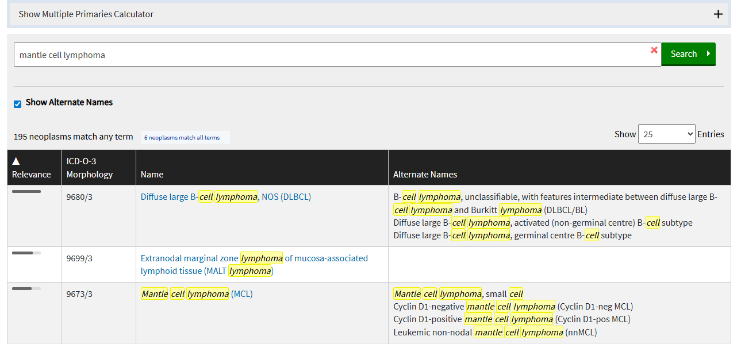
Multiple Primaries – Where do we stop?
2003: Lymphoplasmacytic lymphoma
2026: Mantle cell lymphoma
  Step 1: Look up working histology in database

Slide 20
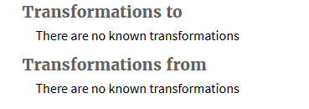
2003: Lymphoplasmacytic lymphoma 9671/3
2026: Mantle cell lymphoma 9673/3
M1: Minimal information
M2: Single histology
M3: AML/myeloid sarcoma or mast cell
M4: Two or more non-Hodgkin lymphoma diagnosed in the same specimen
M5: Hodgkin and non-Hodgkin
M6: Hodgkin and non-Hodgkin
M7: More specific histology diagnosed after NOS histology
M8-M13 are for transformations only

Slide 21
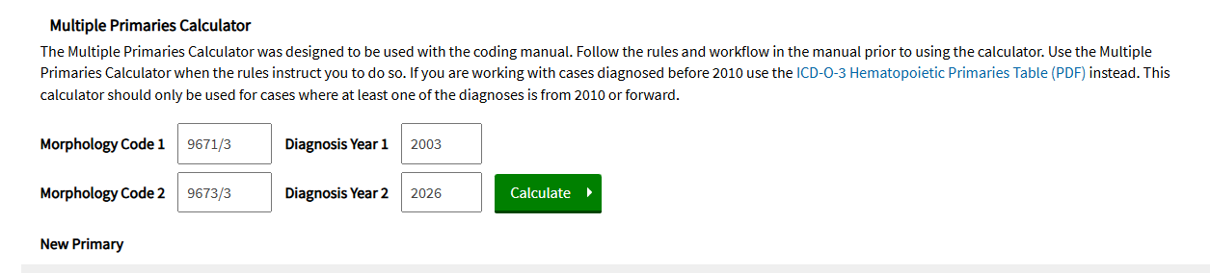
2003: Lymphoplasmacytic lymphoma 9671/3
2026: Mantle cell lymphoma 9673/3
M14: Post-transplant lymphoproliferative disorder
M15: Rules M1-M14 not applicable – use multiple primaries calculator

Slide 22
Determining # Of Primaries and Histology
2023 BM bx: Involvement by a myeloproliferative neoplasm, unclassifiable. Morphologic features are non-specific. The differential diagnosis includes essential thrombocythemia and primary myelofibrosis (pre-fibrotic stage).
2026 BM bx: Variable overall mildly hypercellular marrow (30% average cellularity) with megakaryocytic dysplasia and 2-3% blasts. Abnormal myeloid blast and monocyte populations identified by flow cytometry. Mild to moderate increase in reticulin fibrosis (grade 1-2 of 3).Peripheral blood with leukocytosis, normocytic anemia and thrombocytopenia and monocytosis (see Comment).
  DIAGNOSIS COMMENT
  Morphologic evaluation is limited by the lack of spicules in the aspirate smears. The findings are suspicious for involvement by a low-grade myeloproliferative neoplasm/chronic myelomonocytic leukemia. Correlation with the pending cytogenetic and molecular testing is recommended. This case will be sent to an outside facility for additional testing and review.
  ADDENDUM #1
  This case was sent to an outside facility for additional testing and review. The overall findings are compatible with a myeloproliferative chronic myelomonocytic leukemia-1 (MP-CMML-1).
  The results are as follows:
  Myeloid Gene Panel Result
  Positive for clinically significant variants:
  TET2 (p.Q321*, NM_001127208.2:c.961C>T, VAF 24%)
  BRAF (p.D594G, NM_004333.4:c.1781A>G, VAF 21%)

Slide 23
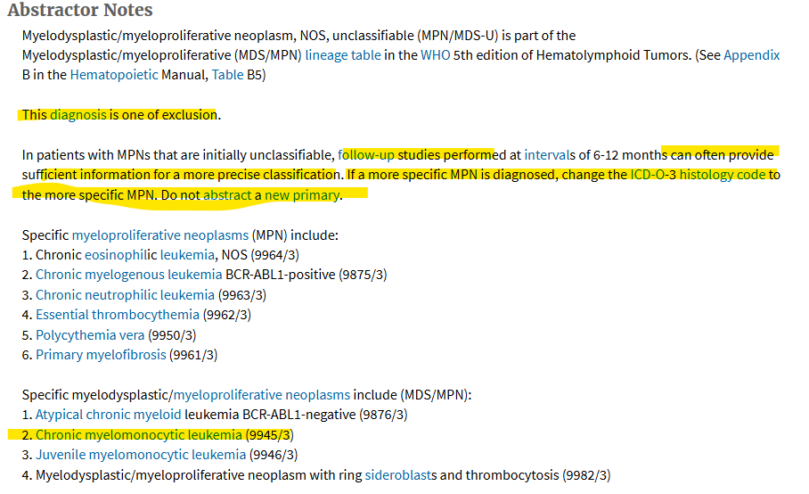

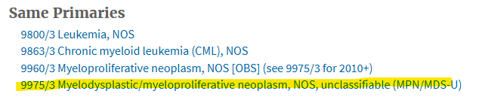
2023
MPN, NOS 9975/3
2026
CMML-1 9945/3

Slide 24
Determining # Of Primaries and Histology
2023: MPN, NOS 9975/3
2026: CMML-1 9945/3
M1: Minimal information, DCO
M2: Single histology
M3: AML/myeloid sarcoma or Mast cell
M4: Two or more NHL in the same specimen
M5: Hodgkin and non-Hodgkin in same specimen
M6: Hodgkin and non-Hodgkin in different specimens

Slide 25
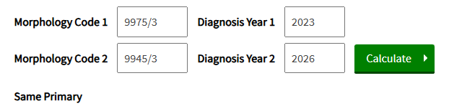
Determining # Of Primaries and Histology
2023: MPN, NOS 9975/3
2026: CMML-1 9945/3
M7: More specific histology diagnosed after an NOS histology
  Use the heme calculator to confirm that the NOS and more specific histology are the same primary
  No time restrictions

Slide 26
Determining # Of Primaries and Histology
Per rule M7, single primary
In 2023, this would have been abstracted as a MPN, NOS 9975/3
Come 2026, update the histology code to 9945/3
Per the abstractor notes in the hematopoietic database AND the notes under rule M7

Slide 27
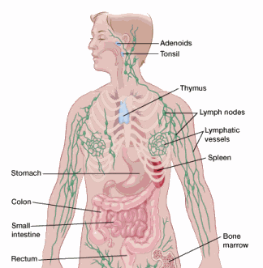
Primary Site Coding

Slide 28
Determining Primary Site
See pages 51-52 in the manual as a roadmap
Some histologies have a default primary site – noted in the database
  i.e leukemia
Site of the biopsy is not necessarily the primary site
Bone, brain, liver, lung, bone marrow are all common metastatic sites and not used to assign primary site when other organs are involved
  These are recorded in stage

Slide 29
Primary Site Roadmap
FIRST! Put aside the common metastatic sites and look for any other organ involvement
If there is a single organ involved (excluding spleen)
See if there are any regional nodes for that organ
If there are multiple non-metastatic organs involved
With lymph node involvement, code to C779
Go to rule PH24 or PH25
Distant nodes may be involved, but they are ignored when assigning primary site and accounted for in staging only.
Without lymph node involvement, you may end up at C809
If the organs involved are in the same system, use the NOS code (GI Tract, NOS, Female Genital System, NOS)

Slide 30
Primary Site Roadmap
Lymph nodes on both sides of the diaphragm
Could be C778
First rule out if there is an organ and its regional nodes involved
Any other involvement would be recorded in stage
Unable to determine if organ involvement is metastatic disease?
C778 when there are multiple lymph nodes/chains involved
C779 when there is nodal involvement, but unknown if multiple chains
C809 if there is no lymph node involvement

Slide 31
Primary Site Roadmap
Spleen involvement
Rare to have spleen as primary site, almost always recorded in stage
These histologies allow for spleen to be primary: 9689 (splenic marginal zone lymphoma), 9716 (hepatosplenic T-cell lymphoma), 9680 (DLBCL)
Bone marrow involvement
If it is the ONLY site involved, code to C421
If other organs and/or lymph nodes involved, it is recorded in stage only

Slide 32
Module 7
Single mass reported on imaging = code to that lymph node region
Such as neck mass (C770), pelvic mass (C775), etc.
A single lymph node chain or region involved = code to that lymph node region
Supraclavicular nodes, or neck nodes C770
Multiple lymph node chains in the same region = code to that lymph node region
Axillary and intramammary nodal chains involved, C773
Multiple lymph node regions = C778
Remember to ignore metastatic sites (bone, lung, liver, brain, bone marrow)
Neck, pelvic, and inguinal nodes with positive bone marrow, C778
Single organ and distant nodes OR multiple organs and nodes = C779
Again, ignoring the common metastatic sites
Breast with pelvic nodes, C779
Breast and axillary nodes, plus thyroid and neck nodes, C779

Slide 33
Module 7
Extension from nodes into an organ = code to lymph node region
Mediastinal nodal mass invading the lung, C771
Organ only = code to that organ
Make sure to rule out metastatic sites
Sigmoid colon with no other involvement, C187
Sigmoid colon, bone marrow and lung involvement, C187
Organ + its regional nodes = code to that organ
Ignore the common metastatic sites when their regional nodes aren’t involved
UOQ breast and axillary nodes, C504
LUL lung and hilar nodes plus liver, C341
Only bone marrow and/or peripheral blood = C421
CBC reveals NHL. PET shows no involvement anywhere, C421
Multiple organs without nodal involvement = C809 OR the site group NOS code
Ignoring the common metastatic sites
Colon, stomach, lung, and liver involved, C269
Colon and breast, C809
Bladder and kidney, C688
Notes:
The common metastatic sites fall under stage!
In Stage II, III, and IV disease, distant lymph nodes or other organs, such as spleen, may be involved. Disregard the distant lymph nodes and splenic involvement. Secondary involvement of distant lymph nodes, spleen, and/or bone marrow are recorded in stage.

Slide 34
Need additional help?
Follow the examples in the hematopoietic manual and the case examples in SEER Educate.

Slide 35

POLLS

Slide 36
True or False
The multiple primaries calculator is a good resource to check if you got the # of primaries correct

Slide 37
FALSE
Only use the multiple primaries calculator when instructed to do so. It can’t be used to check yourself, as it won’t always be accurate if applying the rules appropriately.

Slide 38
What is the correct histology code?
Left supraclavicular lymph node biopsy = non-Hodgkin lymphoma, suggestive of follicular lymphoma grade 2
Only notes available to you state patient is being treated for NHL
  Non-Hodgkin Lymphoma 9591/3
  Follicular Lymphoma Grade 2 9691/3

Slide 39
Non-Hodgkin Lymphoma 9591/3
Follicular lymphoma grade 2 followed ‘suggestive of’, which is not a definitive term. The documentation available to us did not support anything more than NHL.
If the physician documentation said patient is being treated for follicular lymphoma, then we could have assigned the more specific histology.

Slide 40
True or False
If bone marrow is involved, the primary site code is going to be C42.1

Slide 41
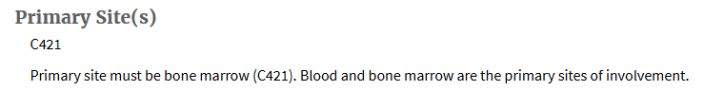
FALSE
Bone marrow is a common metastatic site and should be ignored when assigning primary site code when other organs are involved. It is not automatically the primary site unless documented in the hematopoietic database that way (leukemia, multiple myeloma, PV, etc.).

Slide 42
True or False
Patient is diagnosed with MDS and starts decitabine with plans for a stem cell transplant
He has minimal response after 3 months and physicians decided to add Ivosidenib to increase his chances of transplant
  This is all recorded as first course treatment

Slide 43
TRUE
First course of therapy ends when the treatment plan is completed or remission is achieved.

Slide 44
What is the primary site code?
Blood flow cytometry = involvement by CLL/SLL
PET = widespread nodes on both sides of the diaphragm
  C42.1
  C77.8
  C77.9

Slide 45
C42.1
With CLL/SLL, if blood is involved, primary site will ALWAYS be C42.1. Even with a negative bone marrow!
Module 3: Rule PH5

Slide 46
What is the primary site code?
Patient has involvement of the terminal ileum, ileocecal nodes, and the thyroid.
  C172
  C778
  C779
  C809

Slide 47
C77.9
We have two extranodal sites involved, with regional nodes for only one site and nobody can say where the lymphoma original arose from. Rule PH22

Slide 48
How many primaries?
1/2025 left orchiectomy = plasmacytoma of the left testicle
7/2025 elevation in serum light chains, abnormal ratio. Diagnosis is smoldering myeloma.
Rule | Description
M8 – Single primary | Chronic and acute diagnosed at the same time, single biopsy
M9 – Single primary | Chronic and acute diagnosed at the same time and no documentation of the biopsy(ies)
M10 – Multiple primaries | Chronic and acute diagnosed at different times
M11 – Multiple primaries | Chronic and acute diagnosed at the same time, two biopsies
M12 – Single primary | Acute neoplasm reverts to chronic and no treatment was given for the acute
M13 – Multiple primaries | Acute neoplasm reverts to chronic and treatment was given for the acute
Chronic
Plasmacytoma
Acute
Myeloma

Slide 49
Multiple primaries
Rule M10 – originally diagnosed as chronic; acute diagnosis following treatment (after the initial clinical workup was completed for the chronic)
Notes:
Just proves myeloma/plasmacytoma don’t have a set rules, it all depends on the timing of diagnosis and/or prior treatment.

Slide 50
Questions?
Leslie.Woodard@franciscanalliance.org

Slide 51

Thank you!
CE Certificate and Q&A to be emailed out to all who attended the live session.

Slide 52
Resources
Ruhl J, Callaghan C, Janes T, Adams S (November 2025). Hematopoietic and Lymphoid Neoplasm Coding Manual. National Cancer Institute, Bethesda, MD, 2025.
  Hematopoietic and Lymphoid Neoplasm Coding Manual 2026
The rules, guidelines, and the Hematopoietic Database follow the current edition of the World Health Organization (WHO).
World Health Organization (WHO) Classification of Tumours. Editorial Board. Haematolymphoid tumours. Lyon (France). International Agency for Research on Cancer: 2024. (WHO classification of tumours series, 5th ed.; vol 11) https:://publications.iarc.who.int/637
  SEER Hematopoietic and Lymphoid Neoplasm Database

Slide 53
